Slide 1
Altmetrics and Social Impact
Judit Bar-Ilan

Slide 2
Altmetrics
Term coined in 2010, short for “Alternative Metrics”
Not intended to replace but to supplement traditional metrics
Does not concentrate only on journal publications
Definitions
Altmetrics: “an approach to uncover previously invisible traces of scholarly impact by observing activity in online tools and systems” (Priem, 2014)
“Events on social and mainstream media platforms related to scholarly content or scholars, which can be easily harvested (i.e., through APIs), and are not the same as the more ‘traditional’ concept of citations.” (Haustein et al, 2016)

Slide 3
“previously invisible traces of scholarly impact “
Highly relevant for SSH
Bibliometric databases (WoS & Scopus) have poor coverage of SSH, especially of Humanities
Books and book chapters are mostly not covered
Very poor coverage of non-English language publications
Grey literature (reports, policy documents, publications by the government, NGOs, etc.) not covered

Slide 4
Evaluation
We live in the “Evaluation Society” Dahler-Larsen
Emphasis on the Journal Impact Factor
DORA Declaration, The Leiden Manifesto (Hicks et al.), The Metric Tide (Wildson et al.)
University rankings
AWRU, THE, QS, …
Recently introduced subject rankings
Even in the Evaluation Society
“Not everything that counts can be counted, and not everything that can be counted counts” (attributed to Albert Einstein)

Slide 5
What platforms can be tracked for Altmetrics?
Online reference managers
Mendeley, CiteULike, Zotero
Measure: readers – number of users who downloaded the publication to their Mendeley library
Twitter
By collecting Tweets with scholarly IDs: DOI, PubMed ID, arXiv ID, etc.
Usually not by title and/or author
Measure: Number tweets & retweets
Characteristics of Twitters like followers, following; tweets by hashtag – currently not tracked
Facebook
Open groups and pages mentioning scholarly output
Data collection strategy similar to Twitter
Measures: Number posts, likes, comments and shares

Slide 6
What platforms can be tracked (cont.)?
Measure Counts of publications mentioned in
News Media
Science sections of well known online news sites (e.g AP, American Heart Association, BBC News, CNN, Guardian, Newsweek)
See Altmetric’s list: https://www.altmetric.com/about-our-data/our-sources/news/
Wikipedia
References (usually only from the English Wikipedia) to scholarly publications
Blogs
Science blogs: individual blogs on science, blogs listed on aggregator sites, like researchblogging.org
Policy documents
Source list curated by the aggergator

Slide 7
What platforms can be tracked (cont.)?
Open peer review sites (e.g. F1000 Research, Pubpeer)
Reddit - social news aggregation, web content rating, and discussion website
Data repositories - DataCite
Software repositories (e.g GitHub) – usage
Youtube
Academic social media platforms
ResearchGate, Academia.edu
Measures: readers and citations, comments

Slide 8
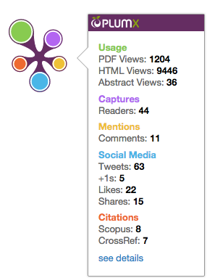
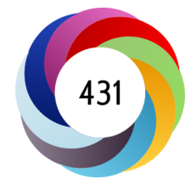
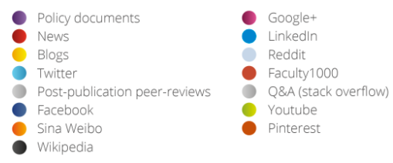
Altmetric aggregators and ResearchGate
Aggregators track most of the above-mentioned sources and create composite scores, by combining and weighing altmetric signals
Altmetric donut and attention score

Slide 9
Coverage by altmetric sources
Highest coverage: Mendeley
Usually 80-90% of publications of a journal appear in Mendeley with readership counts
~0.5 correlation with citation counts
Followed by Twitter
Around 15-25% coverage
Other altmetric data sources
Negligible coverage

Slide 10
An altmetric framework – Haustein et al., 2016
Terminology
research object: a scholarly object, for which an event can be recorded
event: a recorded activity or action which relates to the research object (e.g. a tweet, like, read, comment)
act: by researchers, publishers, the public and other stakeholders leading to an event
consumer: a party that collects and uses events to research objects
aggregator: a type of consumer who collects and provides events to research objects with a specific methodology;
end user or audience: a type of consumer who uses and applies events in a specific context and intention.

Slide 11
Levels of engagement
Access
Viewing metadata (document)
Downloading a CV (agent)
Appraise
comment, share, mention
Apply
Cite in subsequent article
Use software or dataset

Slide 12
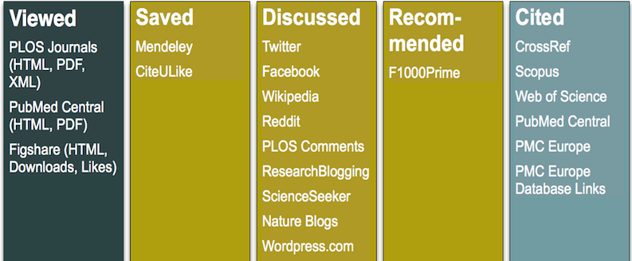
A different grouping – Lagotto (PLoS ALM)

Slide 13
Advantages
Fast
Indicates early interest in research results
Involves more than authors who cite publications
Students, the wider public
Measures social impact
Complements existing metrics
Can ease information overload “no one can read everything”, by pointing to items of interest

Slide 14
Disadvantages
There are many shortcomings of altmetrics
It is your job to come up with a list of problems, you may relate to a specific indicator or altmetrics in general.
Can you think of ways to overcome the shortcomings?

Slide 15
Disadvantages of altmetrics (1)
Many twitter accounts are bots, so you could easily manipulate and game the scores
It is based around technology and a particular relationship between scientist/ researcher and those technologies
There are national use patterns so China doesn’t allow Twitter and there’s a strong English language focus
No differentiation/ identification of audience, so it might be general publics but it might also be academics; at least citation scores are specific (peer citation)

Slide 16
Disadvantages of altmetrics (2)
Does it cover all the stakeholders and could it be an impact measure?
The grey market for diffusion of knowledge are missed – with pirate versions of articles not being counted
The problem of dancing to someone else’s tune: these are not measures that come from the ‘community’
Coerces academics to participate in commercial sites (RG/ Academia.edu potentially against their will (‘conscientious objectors’)

Slide 17
Disadvantages of altmetrics (3)
There is a problem that they count the new things much more than they count the old things
A risk of increasing gaps
between popular fields of science and others,
promoting English language/ orthodox research
also the risks of creating hypes/ bubbles and
exacerbating the ‘Matthew Principle’
What do research evaluators do with these numbers? We don’t know and the potential for false precision is slightly scary
You can also Tweet your disadvantages to me via the #SSHImpact18 tag…

Slide 18
Disadvantages of altmetrics (4)
It is maybe encouraging a move away from things that we as academics have long found useful for our research
There are almost no quality controls on the production of the data, they show visibility
The altmetrics do not capture the uses of the data by users, so it relies on tagging to objects, not circulating ideas
It’s experiment and there is a tendency to treat it as it if it all established and proven, telling us more that perhaps it does

Slide 19
Disadvantages of altmetrics (5)
Stimulates the exhibitionism of people and also the graphomania and logorhea – good to share ideas & exchange opinions but overlooks databases like ERIH+
“Altmetrics is just another way to get the white guys to shout loudly” (from Twitter discussion…)
Humanities scholars publish by themselves whilst STEM publish in big teams so there is an attribution problem
It’s not clear what is useful about what altmetrics measure from an evaluation perspective
11 in favour, 11 against

