Slide 1
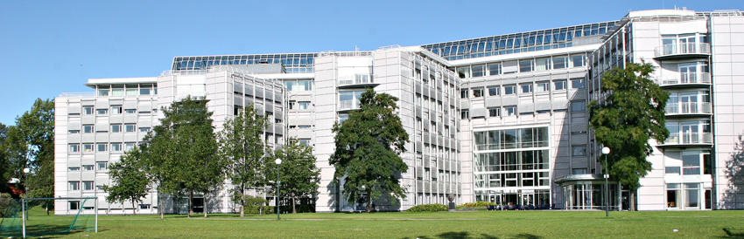
Policy context and evaluation practices
ENRESSH training school 15 February 2018
Dr Jon Holm RCN / Dr Silje Tellmann NIFU

Slide 2
Learning outcomes (TS handbook)
Having completed the training school, participants are expected to be able to:
Explain the principles of creating societal impact from research
Distinguish different pathways for creating research appropriate to different contexts
Apply these impact pathways to create recommendations for their own research and other research with which they are familiar
Analyse case studies of impact creation to highlight barriers and drivers underpinning and reducing the effectiveness of impact
Propose country-specific policy interventions to improve the volume and quality of impact creation from SSH research activities
Produce a non-academic summary of a research project indicating potential audiences for that research activity.

Slide 3
Presentations
Policy context
Societal impact in research evaluation at RCN
Impact cases - Group work (Silje)

Slide 4
Policy context

Slide 6
Long-term plan for research and higher education 2015-2024
To strengthen competitiveness and innovation capacity
To solve major challenges to society
To develop high-quality research groups

Slide 7
Long-term plan: Six priority areas
the oceans
climate change, the environment and environment-friendly energy
public sector renewal and higher quality, more efficient welfare, health and care services
enabling technologies
an innovative, adaptable private sector
world-class research groups

Slide 8
The Research Council’s main strategy for 2015–2020 takes its starting point in two overarching challenges
Society must expand its innovation capacity, in both the private and the public sectors,
Sustainability should be enhanced in all areas.

Slide 9
Why invest in world-class research groups? Politically correct answer: Societal benefit

Slide 10
Why invest in world-class research groups? According to RCN budget proposal
World-class research groups:
Contribute to the international research front
Increase the quality of the research system
Are attractive partners for cooperation
Facilitate technology adoption
Contribute to increased productivity and innovation through spill over effects (documented by OECD)

Slide 12
Societal impact in research evaluations at RCN

Slide 13
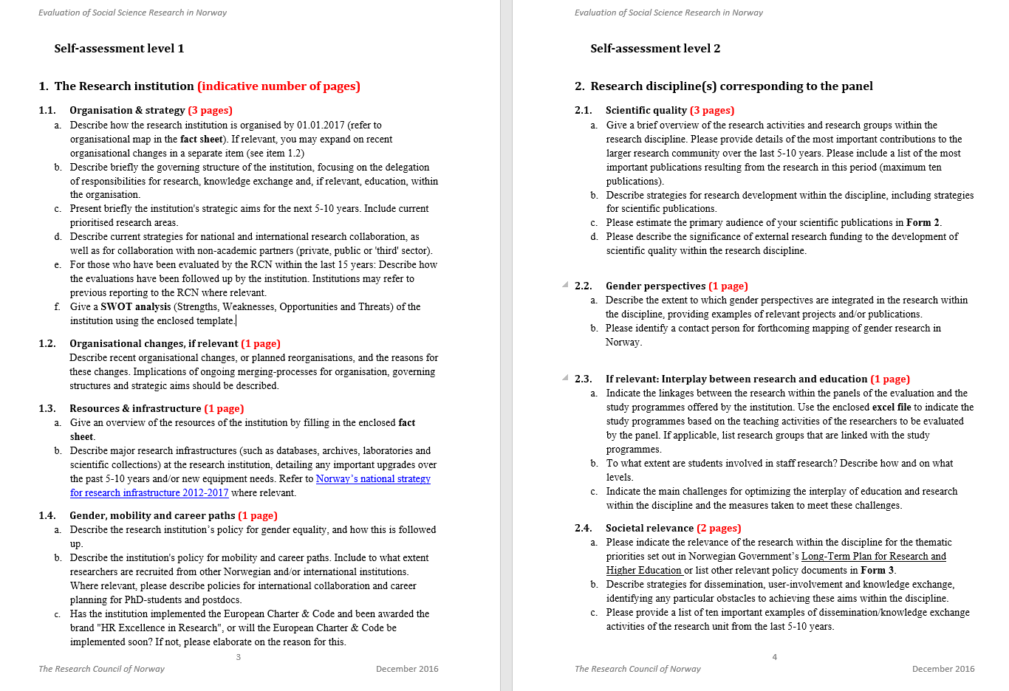
b. Delegation of responsability for Knowledge exchange
d. Collaboration with non-academic partners
a. Relevance for policy
b. Strategies for disseminations, user-involement and knowledge exchange
c. Most important dissemination activities
d. Impact case

Slide 15
Notes:
Impact wrong word? Implies a linear relationship?

Slide 16
Not perfect - may be critized
for only covering a small part of the societal relevance of an institution
for implying a linear relationship between research and impact
for not assessing productive interactions between researcher and users
for not covering the important impacts taking place within academia
for embracing "exceptional" impact instead of normal impact

Slide 17
Still…
They illustrate a great diversity of social impact resulting from research
We get insight in the pathways and channels through which impacts occur
We learn about the reach and significance of research activities for different users and different sectors – nationally and internationally
Potentially useful for Ministries, funding bodies, research communities and institutions

Slide 18
Impact cases – group work

Slide 19
Impact definition
any effect on, change or benefit to the economy, society, culture, public policy or services, health, the environment and quality of life, beyond academia.
Impact includes, but is not limited to, an effect on, change or benefit to:
the activity, attitude, awareness, behavior, capacity, opportunity, performance, policy, practice, process or understanding
of an audience, beneficiary, community, constituency, organisation or individuals
in any geographic location whether locally, regionally, nationally or internationally.
Notes:
The institutions taking part in the evaluations of humanities and social sciences in Norway were invited to document impact of their research beyond academia, according to the 2014 Research Excellence Framework (REF) definition of impact.
Impact was in the REF defined as…

Slide 20
Submitted impact cases I
HUMEVAL: 168 cases divided between 8 panels
SAMEVAL: 245 cases divided between 6 panels
Aesthetic Studies | 14
Nordic Languages and Linguistics | 29
Nordic and Comparative Literature | 7
Modern and Classical Languages, Literatures and Area Studies | 31
Archaeology, History and Cultural Studies | 32
Philosophy and Studies in Science and Technology | 27
Religion and Theology | 13
Media Studies | 15
Geography | 23
Economics | 38
Political science | 52
Sociology | 58
Social anthropology | 22
Economic-administrative research | 52
Notes:
To the evaluations of humanities and social sciences (also called HUMEVAL and SAMEVAL) we received 413 impact cases all together.
168 cases were submitted to HUMEVAL divided between 8 panels and 245 cases were submitted to SAMEVAL divided between 6 panels

Slide 21
Submitted impact cases II
HUMEVAL: 168 cases divided between 8 panels
SAMEVAL: 245 cases divided between 6 panels
Aesthetic Studies | 14
Nordic Languages and Linguistics | 29
Nordic and Comparative Literature | 7
Modern and Classical Languages, Literatures and Area Studies | 31
Archaeology, History and Cultural Studies | 32
Philosophy and Studies in Science and Technology | 27
Religion and Theology | 13
Media Studies | 15
Geography | 23
Economics | 38
Political science | 52
Sociology | 58
Social anthropology | 22
Economic-administrative research | 52
Notes:
Of the 413 cases submitted we have selected 6 different examples that will be used during the group work session today.
The 6 cases represent 6 different disciplines or panels and 5 different institutions.
Three of the cases are taken from HUMEVAL and three from SAMEVAL.
I will give you a short introduction to all the six cases before pointing out some of the differences between them.

Slide 22
Case 1: Disseminating knowledge about language on Norwegian national radio
HUMEVAL Panel 2 Nordic Languages and Linguistics
Norwegian University of Science and Technology – Faculty of humanities
Claim: Prof. Kristin Melum Eide’s presentation of her research on the national radio show “Språkteigen” has made people aware that some of the decisions made for the written norms in the Norwegian language are mostly accidental.

Slide 23
Case 2: Hardanger and Hardangervidda: National park and interdisciplinary research laboratory
HUMEVAL Panel 5 Archeology, History and Cultural studies
University Museum of Bergen
Claim: The museum’s interdisciplinary research on Hardanger has had impact on identity and management in Hardanger and beyond
Notes:
Hardanger a district in the western part of Norway and Hardangervidda a mountain plateau in Norway

Slide 24
Case 3: Security and the media
HUMEVAL panel 8 Media Studies
University of Oslo - Faculty of Humanities
Claim: Prof. Christina Archetti's research has played a significant role in the growing awareness on the role of media developing (and limiting) terrorism and extremism.

Slide 25
Case 4: SolarX
SAMEVAL Panel 1 Geography
University of Oslo – Faculty of Social Sciences
Claim: The research projects Solar Transitions and Solar xChange have led to impact on the energy sector in Kenya through inspiring new activities incorporating the use of Solar PV technology and led to experimentation and learning on decentralized solar power supply for different groups

Slide 26
Case 5: Human Trafficking
SAMEVAL Panel 4 Sociology
Fafo Research Foundation
Claim: Fafo’s research on human trafficking has had an impact on how police and other institutions work to identify victims of trafficking.

Slide 27
Case 6: Evaluation of speed cameras
SAMEVAL Panel 4 Sociology and Panel 6 Economic-adm. research
Institute of Transport Economics
Claim: Research leader Elena Høye’s study on section speed cameras had a crucial impact on the public debate as well as the political decision of continued installation of section control which can save substantial numbers of lives.
Notes:
A camera mounted beside a road used to monitor compliance with speed limits

Slide 28
Variation between the 6 cases
the research underpinning the impact has either been
carried out by an individual researcher or a group
part of a long research tradition, a research project, one scholar’s research interest or commissioned research
the path from research to reported impact has gone through different channels: Research dissemination, policy advising and/or professional training
the documented impact may either be an intended outcome of the research or an unintended result of interaction between researchers and users
Notes:
The 6 cases I presented vary along many dimensions..
First of all…
the six impact cases touch upon several of the aspects mentioned in the impact definition presented earlier
but also in this regard there are variation between the cases… witch leads us to the group work session…

Slide 29
Group work – questions for discussion
Which aspects of the impact definition are reflected in the two cases?
How well is the path from research to reported impact described in the two cases?
What are the merits and limitations of the impact case method?
Notes:
You may divide into three separate groups, each group discussing two of the cases I just presented
the questions we would like you to discuss are the following…
You have approximately 30 minutes for the group discussion.
Afterwards we wish that all groups give a short presentation of their work before we end this session with a plenary discussion

Slide 30
Group work - scores
How would you score the impact cases?
A: Excellent Demonstrated large impacts in terms of reach and significance.
B: Good Demonstrated considerable impacts in terms of reach and significance.
C: Fair Demonstrated modest impacts in terms of reach and significance.

Slide 31
Reach: The extent and/or diversity of the organisations, communities and/or individuals who have benefited from the impact.
Significance: The degree to which the impact enriched, influenced, informed or changed the policies, practices, understanding or awareness of organisations, communities or individuals.

Slide 32
Group assignment
 | 1st assessor | 2nd assessor
Case 1: Disseminating knowledge about language on Norwegian national radio | Group 1 | Group 2
Case 2: Hardanger and Hardangervidda: National park and interdisciplinary research laboratory | Group 2 | Group 3
Case 3: Security and the media | Group 3 | Group 4
Case 4: SolarX | Group 4 | Group 5
Case 5: Human Trafficking | Group 5 | Group 6
Case 6: Evaluation of speed cameras | Group 6 | Group 1

