Slide 1
The evaluation of societal impact of research in the 21st century
Jack Spaapen
ENRESSH training school in Zagreb
12-16 February 2018

Slide 2
Three parts
Changing context for academic researchers
Global and European societal demand
New demands from research funders
Responses from the academic world
Challenges for academic researchers
Methods to evaluate ‘research in context’
National systems for impact evaluation
UK, Netherlands, Canada, Australia
Assignment

Slide 3
The world split in equal sections of 1 billion inhabitants (2000)

Slide 4
The world in 2050: 9,8 billion people

Slide 5
Policy goals at the global level

Slide 6
EXAMPLE: AUTOMATED VEHICLES
Scientists and policymakers say reducing emission figures will be key to addressing man-made climate change
Perhaps no area is more uncertain than the environmental impact of automated vehicles. 217% increase or 90% decrease in fuel demand as a result of self-driving cars in the most extreme projections
The wide range of potential outcomes is the result of a long list of variables about how a future with automated cars will take shape
A lot of the uncertainty comes from not knowing how the value of people’s time is going to change → SSH research is vital here

Slide 7
Big Challenges for academicS who want to have impact
Seek collaboration outside academia
business and industry
government at all levels
NGOs, consumer organisations, general public
Engage in MIT research:
Input from many different disciplines, both from the technical sciences and social science and humanities; other expertise (legal, ethics, political, economical, etc.)
→ Ideal: A common research and innovation agenda (Dutch NSA)

Slide 8
Small and medium range challenges
Impact on curriculum development in high schools [f.e. modern languages]
Impact on local and regional policy [f.e. asylum seekers centers]
Fight against fake news [countries’ IQ scores]
Impact stories [examples to be found in impact summaries document, the REF impact database, LERU paper on productive interactions]
→ Ideal: An inclusive network of stakeholders

Slide 9
European r&I Policy: Excellence, openness and impact
EU HORIZON 2020: excellence, openness and impact
Excellent Science: ERC, Future and Emerging Technologies, MC, Infrastructures
Industrial Leadership: Enabling and Industrial Technologies, Access to Risk Finance, Innovation in SME’s
Grand Societal Challenges: Health, Food, Energy, Climate, Transport, Secure and Inclusive Societies
RESPONSIBLE RESEARCH AND INNOVATION (RRI): public engagement, gender equality, open access, science education, social justice, sustainability, inclusiveness
“a transparent, interactive process by which societal actors and innovators become mutually responsive to each other with a view on the (ethical) acceptability, sustainability and societal desirability of the Innovation process and its marketable products.” (von Schomberg 2011)

Slide 10
FUNDERS DEMANDING SOCIETAL IMPACT: NL
2012: TOP SECTOR POLICY/NWO: Stimulating collaboration in the golden triangle between science, industry, policy/society: Energy, high tech, water, agriculture and food, creative industry, …
2014: SCIENCE VISION: International Excellence, Maximum Societal Impact, Cradle for talent
2015 NATIONAL SCIENCE AGENDA: combining forces, strategic choices http://www.wetenschapsagenda.nl/home-2/?lang=en
Current government: research in universities more connected to societal demand (PPP, start ups); NWO (research council): sponsor fundamental research that is directed to top sectors and national science agenda

Slide 11
End of part one

Slide 12
Societal demand /challenges
EU: Grand Societal Challenges
Health, demographic change and wellbeing;
Food security, sustainable agriculture and forestry, and the Bioeconomy;
Secure, clean and efficient energy;
Smart, green and integrated transport;
Climate action, environment, resource efficiency and raw materials;
Europe in a changing world - inclusive, innovative and reflective societies;
Secure societies - protecting freedom and security of Europe and its citizens.
→ UN: Sustainable Development Goals
No poverty
Zero hunger
Good health and well being
Quality education, life long learning
Gender equality
Clean water and sanitation
Affordable and clean energy
Decent work and economic growth
Industry, innovation, infrastructure
Reduced inequalities within and between countries
Sustainable cities and communities
Responsible consumption and production
Climate action
Life below water
Life on land
Peace, justice and strong institutions
Partnerships for the goals

Slide 13
COMMON FEATURES OF R&I POLICY
High level political goals (‘responsible research for a better world’), all aggregation levels, national, supra-national organisations (EU, ASEAN, UN)
Increasing role of industry and the economy: new knowledge + new markets
Stimulate new connections between academic research, industry (big and small), civil society, public sector, and also the general public
Distributed agenda setting and governance, consensus orientated, RRI

Slide 14
Science in Society
Question, issue, problem
society
research
policy
industry
Question, issue, problem
society
research
policy
industry

Slide 15
Academic Research at Crossroads
researchers are partners in a larger innovation process
both technical and social
squeezed between competition and collaboration
excellence in (international) competition, fields / institutions
relevance for (democratic, sustainable) society, local, national

Slide 16
ARE WE PREPARED TO EVALUATE IN THIS NEW CONTEXT
Regular bibliometrics, scientometrics = not enough
Societal impact metrics, third stream metrics = promising but contextual
New bibliometrics: altmetrics = not far enough
Open Science and Block chain
Blockchain for research. Perspectives on a new paradigm for scholarly communication. Digital Science Report. Joris van Rossum. 2017

Slide 17
RIFT BETWEEN THEORY AND PRACTICE
The current state of the art in evaluation practice for measuring societal impacts does not match the concepts that are most common in the research literature to describe the connections between knowledge, policy and society.
The dominant concept in evaluation practice is still linear, framed by logic models and the terminology of inputs, activities, outputs, and outcomes, sometimes with a loop back to planning. The policy process itself is a black box.
In contrast, the dominant concept in the research literature is the network or system, which is made up of many small conversations, interactions, and adjustments among a diverse set of actors; and complex concepts of the ebbs and flows of the policy process itself are incorporated. [Cozzens and Snoek, 2010]

Slide 18
Responses from the academic world
1990s: Rethinking Science: Nowotny, Scott, Gibbons → mode 2, transdisciplinary R&I
2000s: ERiC and SIAMPI → productive interactions
2013: Science in transition: http://scienceintransition.nl/en/
2015: EVALHUM & ENRESSH
2017: LERU: paper about productive interactions
2017: Living labs → Univ Helsinki: Think corner
Metrics community:
DORA and Leiden declarations, Metric Tide report
Scientometrics is making a turn to societal impact
Altmetrics
Crypto fever: block chain as a new communication and sharing vehicle?

Slide 19
No easy answers…
Depend on:
The field: some fields are more oriented towards societal impact than others (health, agriculture, law, architects)
The institution: some institutions have a clear policy and reward system
The country: some countries are more developed than others (cf REF, SEP)
The individual department/ researcher (attitude)
Source: technopolis study
Interaction with stakeholders is something that can be learned (see recent articles)

Slide 20
Siampi: Productive interactions
The concept of productive interactions (PI) was developed in the FP7 SIAMPI project.
PI between researchers and societal stakeholders are indispensable to reach meaningful impact = societal innovation. There are three main types of productive interactions:
via people, formal and informal
via media, digital, social
via material exchanges (financial support, sharing of facilities)
PI unlike impact is not a linear concept but the result of a collaborative interaction between a variety of stakeholders that strive for societal innovation
.
Networks in which impact is achieved can be more or less stable, depending on the interest of stakeholders.

Slide 21
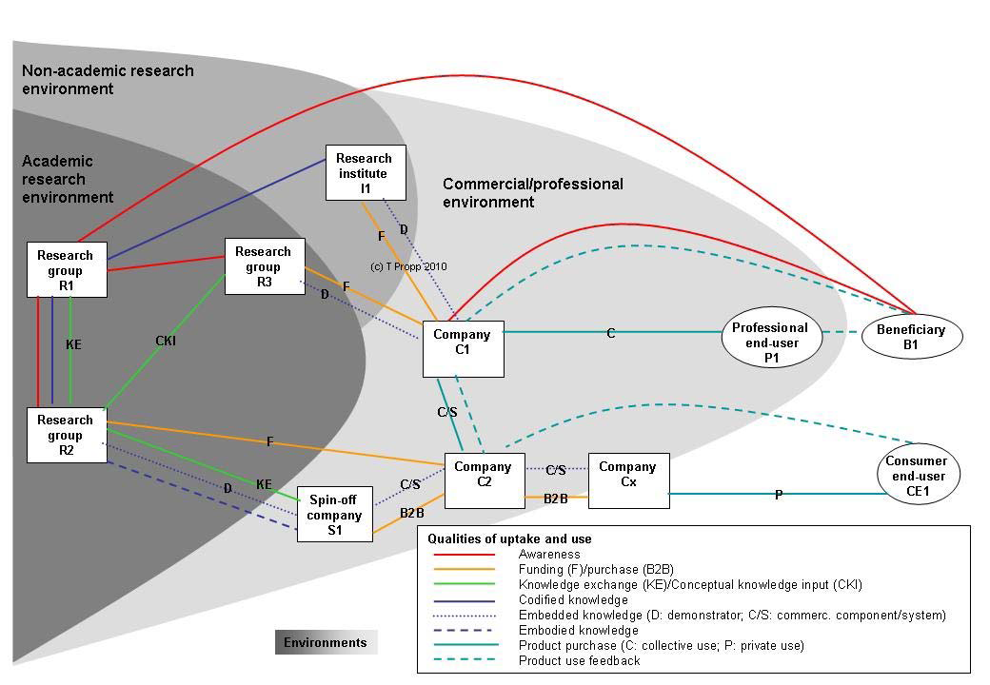
NANO RESEARCH IN CONTEXT [@ TILO PROPP]

Slide 22
Leru on societal impact of universities
Knowledge production is not a linear process starting with basic research and ending up with applications, but instead progresses in increasingly open and collaborative ways
Innovation in society is not only the result of scientific and/or technological progress, but to a large extent the outcome of interaction between scientific and other social domains and its stakeholders.
In this process, research and innovation are recognised to take place in a network in which different partners with diverse expertise and knowledge collaborate on the basis of a joint agenda.
Competition or comparison should no longer be the main (or only) drivers in the production of knowledge, but collaboration : productive interaction between stakeholders and the formulation of common goals and joint achievement of results.

Slide 23
End of part TWO

Slide 24
What kind of society / economy?
European Commission: Science, Technology and Innovation primary goals : Growth and Jobs
The global new green deal van Mariana Mazzucato?
a new social contract between science, governments and industry for fundamental green innovations
Kate Raworth – the dougnut economy, not growth but societal values as the key driver for the economy (sustainability, inclusiveness, gender equality…)
Enric Duran Giralt, The Catalan Robin Hood,
a new economic world order: more social, ethical, responsible, compare Manuel Castells

Slide 25
What kind of universities
VSNU and Rathenau [Patricia Faasse, Barend van der Meulen] developed 4 scenarios/profiles for universities, leading to comprehensive evaluation
cross cutting uncertainties:
Who “owns” the universities?
Competition or collaboration
National solidarity: public value of R&E
Regional power: economic opportunities in the region, knowledge = private commodity
European variation: European funding, PPS
International selection: hyper competitive global environment, rankings
2

Slide 26
National solidarity
26

Slide 27
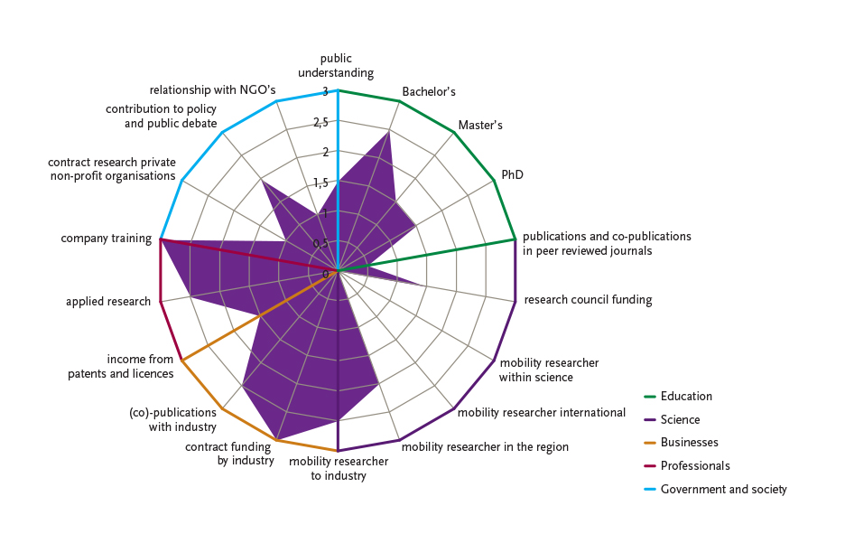
Regional power

Slide 28
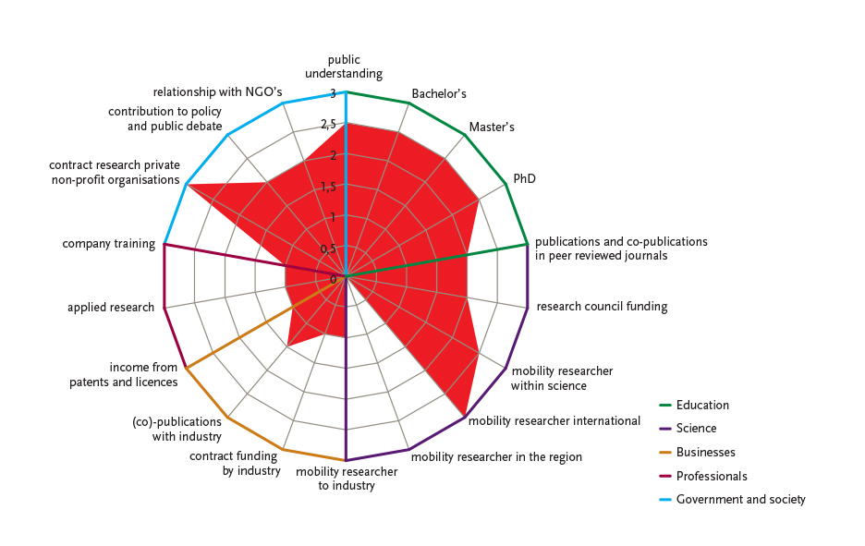
European variation

Slide 29
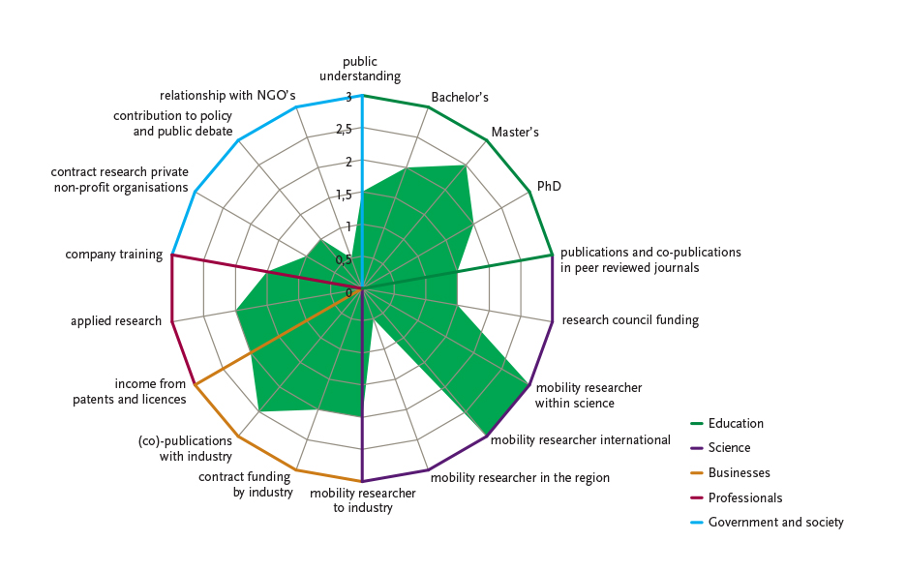
International selection

Slide 30
ARE COUNTRIES PREPARED TO EVALUATE IN THIS CONTEXT
Only 2 countries have a national system including societal impact evaluation
Research Excellence Framework: REF UK
Standard Evaluation Protocol: SEP NL
Some countries experiment: Italy, Estonia, Austria… [perfomance based funding in EU - Technopolis report]

Slide 31
Standard Evaluation Protocol SEP 2015-2021
PEERS, OTHER EXPERTS
and STAKEHOLDERS
EQUAL ATTENTION
IN ASSESSMENT
INDICATORS
BOTTOM UP
Extended ‘peer’ review
Scientific quality
Output
Use
Societal quality
Recognition

Slide 32
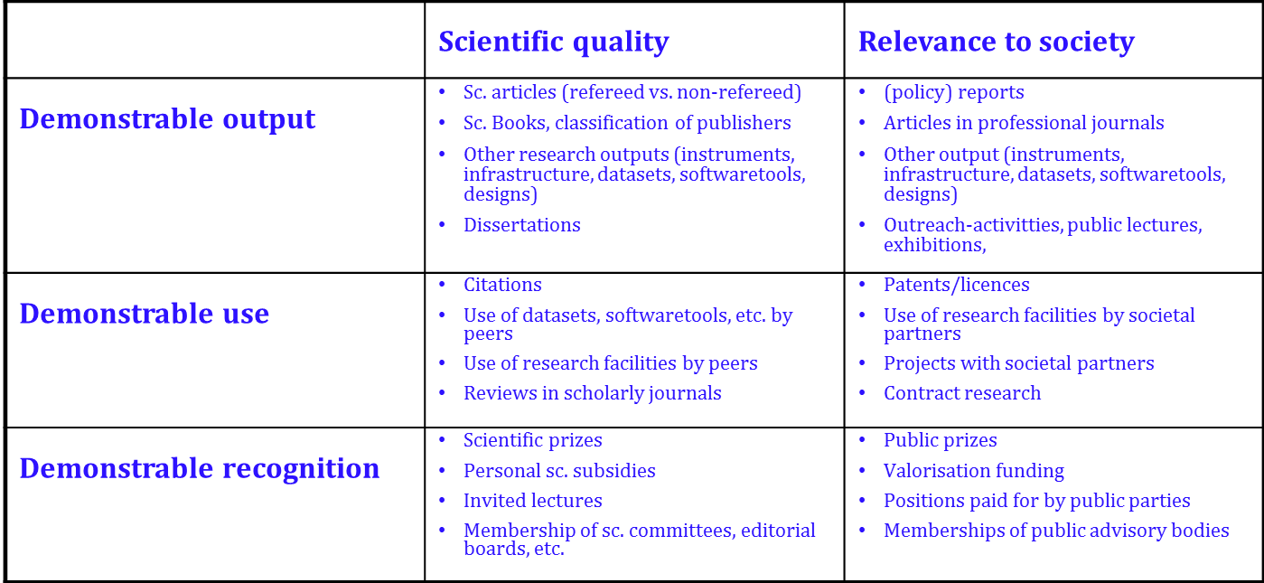
SEP Indicator Scheme Disciplinary variation possible

Slide 33
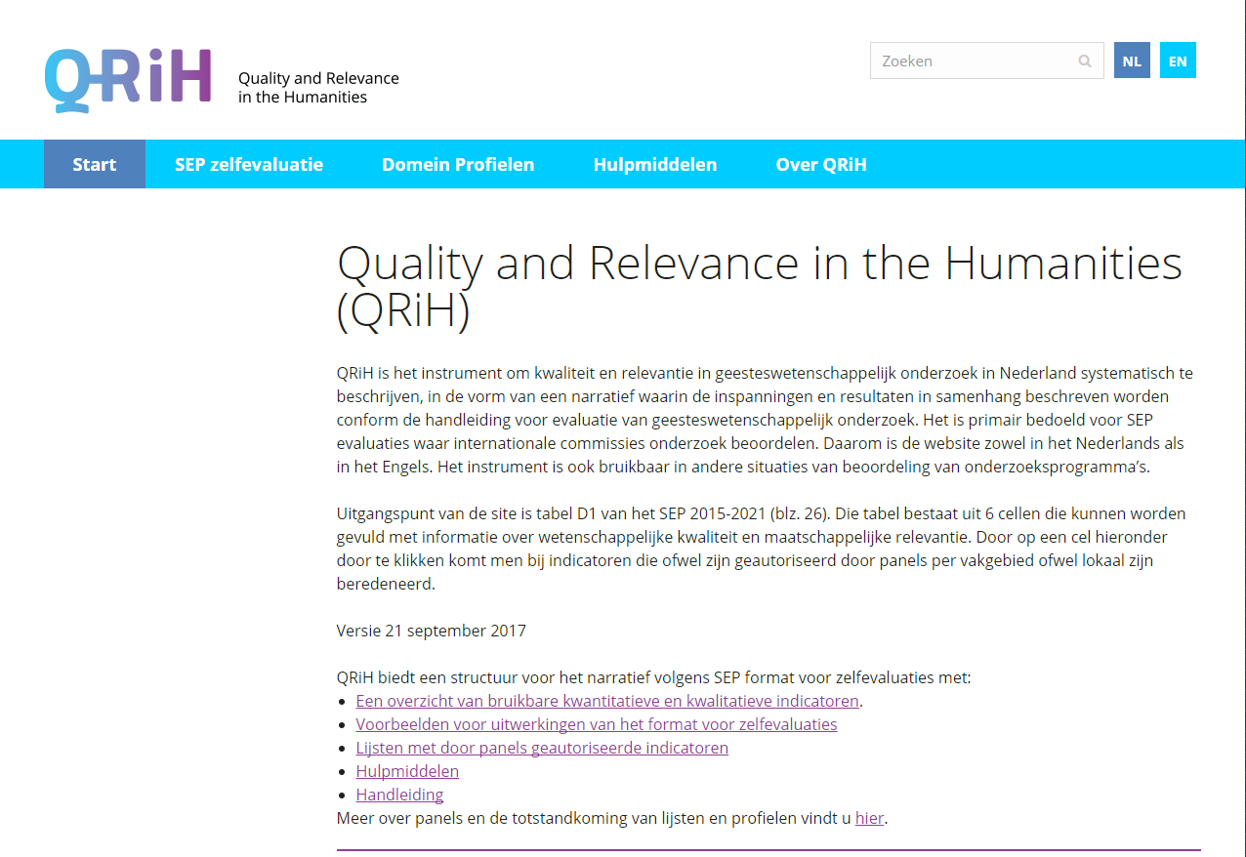
Societal impact assessment in humanities
https://www.qrih.nl/en

Slide 34
 | Research Quality | Relevance to society
Demonstrable products | Research products for peers Articles in scientific journals proceedings edited volumes Books Edited volumes including special issues of s. journals Dissertations Pro memorie: Datasets | Research products for societal groups Articles in professional journals edited volumes Books Reports Instruments Educational material Websites In-service professional development Pro memorie: Documentaires
Demonstrable use of products | Use of research products by peers (Projects in) cooperation with academic partners (joint products are a requirement) Use of publications in narrative reviews and meta-analyses Citations of publications Pro memorie: Use of datasets | Use of research products by societal groups (Projects in) cooperation with societal Partners (contract research) Reviews of publications Use of publications (for example in education and training) Use of instruments Pro memorie: Political and policy spin off
Demonstrable marks of recognition | Marks of recognition from peers Science awards/scholarly prizes Research grants awarded to individuals Funding of projects (2e geldstroom) Invited lectures (including Guest lectures for students at other universities) Membership of scientific bodies Membership of editorial boards of scientific journals or bookseries Fellowships and Visiting professorships Peer Review Supervision of external (doctoral) research Membership of external doctoral examination committees Pro memorie: Honorary Doctorates | Marks of recognition by societal groups Public prizes Funding by societal parties (3e geldstroom) Membership of societal bodies Membership of editorial boards of journals or series for professionals or the general audience Interviews Invited lectures

Slide 35
ref impact case studies
Format
Submitting unit
Summary of impact
Underpinning research
References to research
Details of impact (on policy, on engagement, on industry…)
Sources to corroborate impact

Slide 36
Results impact case studies
Almost 7000 impact case studies
60 different societal areas
Impact also outside UK
A lot of MIT research
Having multiple impact
Different types of HEI have different kinds of impact
Some more regional, some more national or international

Slide 37
Canadian Federation for the social sciences and humanities 2017

Slide 38
Australian pilot to develop engagement and impact measurement
Allowing for the submission of interdisciplinary and Indigenous research UoAs for impact.
Assessing engagement using a suite of quantitative indicators and supporting narratives.
Assessing impact through narrative studies with one impact study submitted per UoA.
Using expert review panels—comprising academics and end-users—to determine the ratings.
→ Public consultation
→ End user review (1900 end users)

Slide 39
End of part Three

Slide 40
How to evaluate research impact in this context?
40
Big chance to innovate the evaluation process and methodology
Contextual: allow for different profiles, no one size fits all
Mission of institutes can differ: variation in profiles and measurements
Input from different disciplines and expertise required: how to balance that
Measuring impact: qualitative over quantitative?
Peer review, extended peer review, mixed review
Focus on mutual learing instead of on accountability

Slide 41
ASSIGNMENT
Identify variegated impacts in the impact summaries
Classify the different kinds of impact and how they are created
Are there impact pathways and productive interactions to distinguish?
If so, what are the different stages? For example can we map the impact, linking the research, the user, the productive interaction, the stakeholder and the outcome; and perhaps different organisational levels at which impact is being produced
Are some impacts more useful than others
How can we best evaluate these impacts? Qualitative and quantitative measurements

