Slide 1
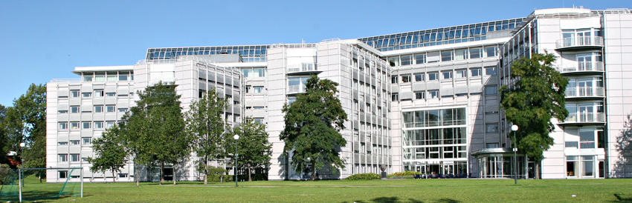
Evaluation for open science
- towards a new evaluation protocol
  ENRESSH training school 15 February 2018
Dr Jon Holm RCN

Slide 2
What is the purpouse of RCN’s national research evaluations?
Evaluation for accountability
Evaluation for development / learning
Evaluation for knowledge
Donovan, C. & Hanney, S. (2011) “ The ‘Payback Framework’ explained” Research Evaluation, 20(3), September 2011

Slide 3
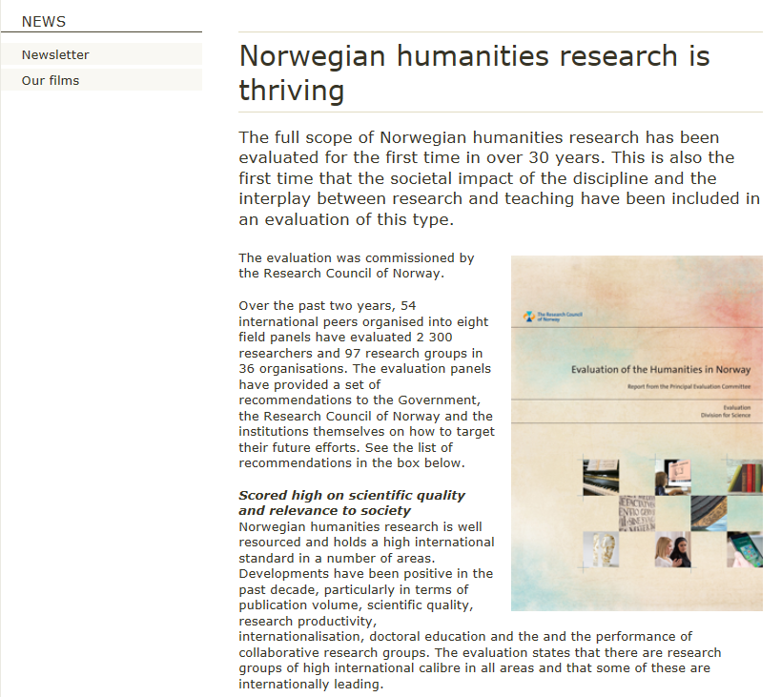

Slide 4
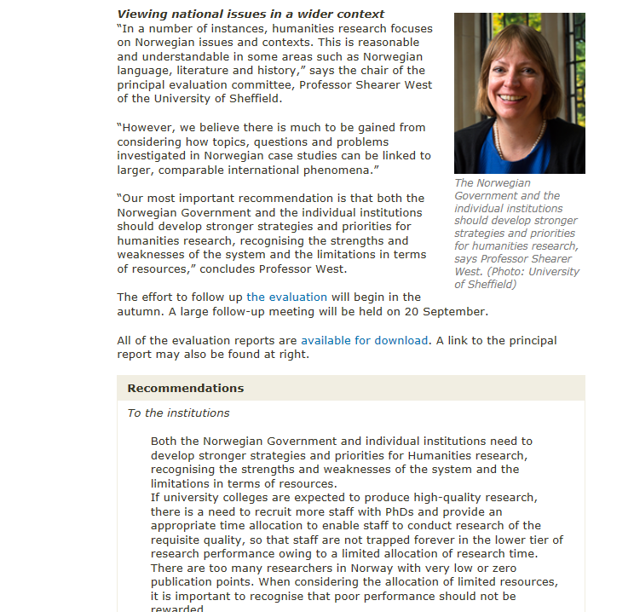

Slide 5
Practice of impact evaluation vs. research literature on impact
Cozzens and Snoek (2010)
The evaluation practice is primarily directed towards identifying social impact using linear concepts or models, whereas most of the literature discusses the process of how impact is achieved using network and interaction concepts.
To narrow that gap, one has to concentrate on what happens in the process of knowledge production, and on the role different stakeholders play in this process.
The introduction of knowledge about the process into assessment procedures will also help us to understand how (potential) social impact is being achieved.

Slide 6
From impact case back-tracing (linear model)…
…to monitoring of productive interactions
Alignment of supply and demand (Push & Pull)
Knowledge Exchange
Co-production of knowledge
Notes:
Michael Gibbons, Camille Limoges, Helga Nowotny, Simon Schwartzman, Peter Scott and Martin Trow The New Production of Knowledge: The dynamics of science and research in contemporary societies Sage. 1994 => Mode 2: Knowledge is created in broader, transdisciplinary social and economic context. Mode 1 is meant to summarise in a single phrase the cognitive and social norms which must be followed in the production, legitimation and diffusion of knowledge of this kind = Science
Mode 1 problems are set and solved in a context governed by the, largely academic, interests of a specific community
Mode 2 knowledge is carried out in a context of application that is characterized by: heterogeneity, transciece, reflexion and social accountability

Slide 7
Productive interactions
SIAMPI project
The object of evaluation shifts from a research entity towards the process of interaction
The number of stakeholders grows
Reviewers are facing a greater challenge
  Stakeholders become peers
  No reliable quantitative measures => altmetrics ?
  Need to consider institutional and disciplinary context
  => case studies and other thick data

Slide 8
Open Science

Slide 9
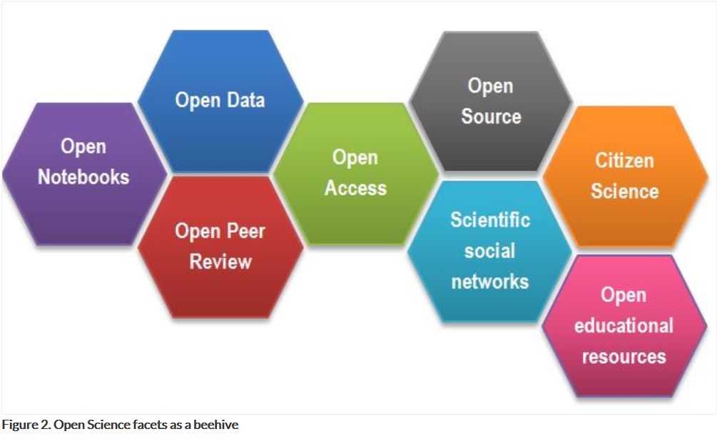

Slide 10
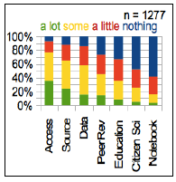
Awareness of Open Science (OS) among researchers
Three out of four
have some knowledge of OS
Open access and Open data
are the most known
Citizen science and Open notebook
are the least known
Experienced researchers (R3/R4) know more than young researchers
Source:
Providing researchers with the skills and competencies they need to practise Open Science – Report of the Working Group on Education and Skills under Open Science (juli 2017)
Notes:
SGHRM gjennomførte Undersøkelse som ble sendt ut til europeiske forskere via organisasjonen European Young Researchers – og via andre kanaler.
1277 forskere besvarte skjemaet. Ikke representantivt, mene svaret er omtrent på nivå med andre tilsvarende europeiske undersøkelser.
I hvilken grad kjenner forskerne til de ulike aspektene ved åpen forskning – og av europeiske initiativer på området?
Open notebook science is the practice of making the entire primary record of a research project publicly available online as it is recorded. This involves placing the personal, or laboratory, notebook of the researcher online along with all raw and processed data, and any associated material, as this material is generated. The approach may be summed up by the slogan 'no insider information'. It is the logical extreme of transparent approaches to research and explicitly includes the making available of failed, less significant, and otherwise unpublished experiments; so called 'dark data'.^{[1]} The practice of open notebook science, although not the norm in the academic community, has gained significant recent attention in the research^{[2][3]} and general^{[1][4]} media as part of a general trend towards more open approaches in research practice and publishing. Open notebook science can therefore be described as part of a wider open science movement that includes the advocacy and adoption of open access publication, open data, crowdsourcing data, and citizen science. It is inspired in part by the success of open-source software^{[5]} and draws on many of its ideas.

Slide 11
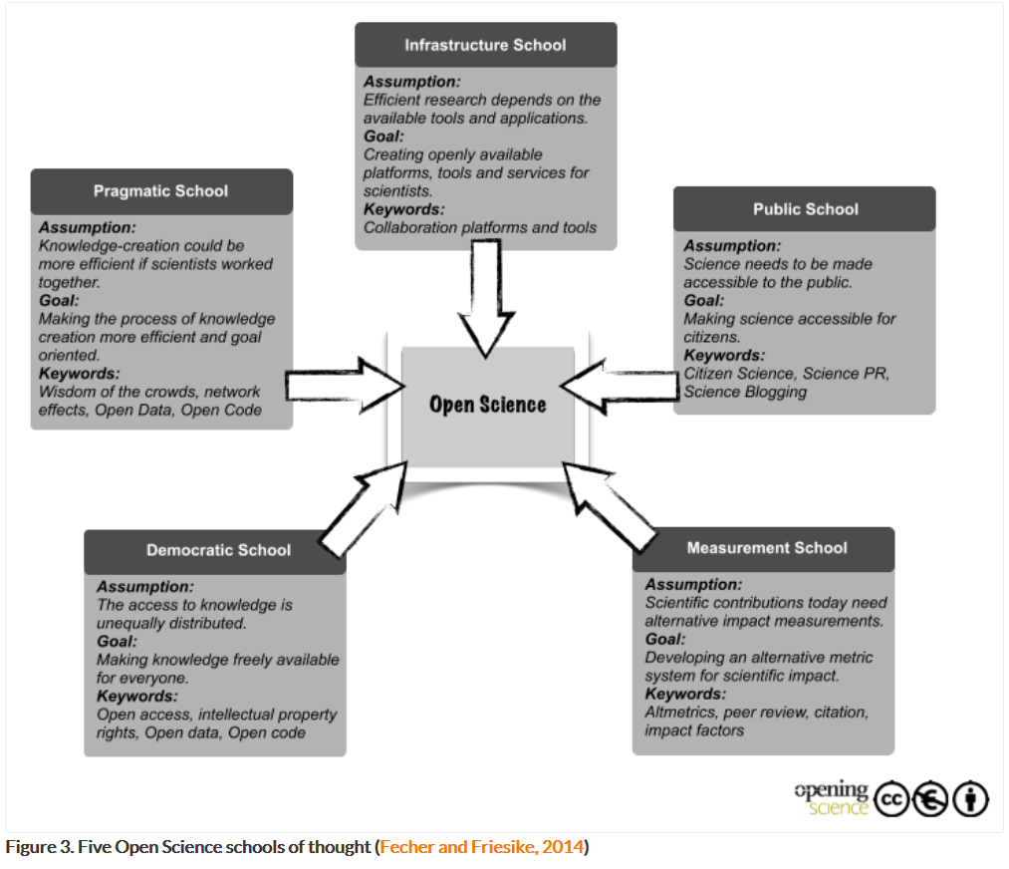

Slide 12
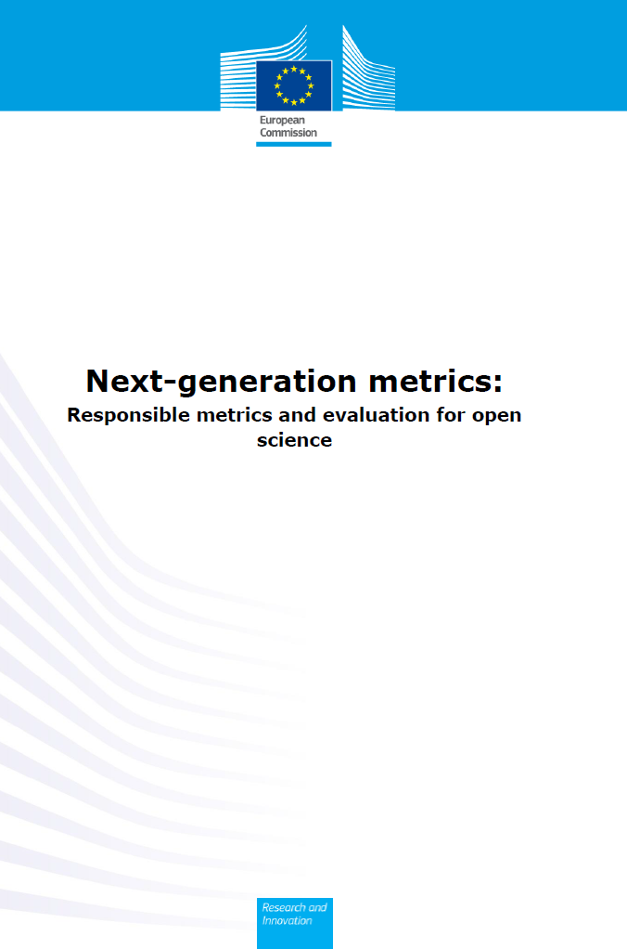
Expert Group on Altmetrics
James Wilsdon
Professor of Research Policy
University of Sheffield (UK)
Judit Bar-Ilan
Professor of Information Science
Bar-Ilan University (IL)
Robert Frodeman
Professor of Philosophy
University of North Texas (US)
Elisabeth Lex
Assistant Professor
Graz University of Technology (AT)
Isabella Peters
Professor of Web Science
Leibniz Information Centre for Economics and Kiel University (DE)
Paul Wouters
Professor of Scientometrics, Director
Centre for Science and Technology Studies at Leiden University (NL)
Notes:
James Wilsdon, chair
Professor of Research Policy and Director of Impact and Engagement in the Faculty of Social Sciences at the University of Sheffield. Since 2013, he has been Chair of the UK’s Campaign for Social Science, and he recently chaired an independent review of the role of metrics in the management of the UK’s research system, which published its final report The Metric Tide in July 2015.
Previously, he worked as Professor of Science and Democracy at SPRU, University of Sussex (2011-2015), Director of Science Policy at the Royal Society (2008-2011), Head of Science and Innovation at Demos (2001-2008), Senior Research Fellow at Lancaster University's Institute for Advanced Studies (2006-2008) and Senior Policy Adviser at Forum for the Future (1997-2001).
James is one of the editors of the Guardian's 'Political Science' blog, on science, research and innovation policy, and an Associate Editor of the open access journal Palgrave Communications. In 2015, he was elected a Fellow of the Academy of Social Sciences, the UK's national academy of academics, learned societies and practitioners in the social sciences.
Paul Wouters
Professor in Scientometrics professor of scientometrics and director of the Centre for Science and Technology Studies at Leiden University. He has published on the history of the Science Citation Index, on and in scientometrics, and on the way the criteria of scientific quality and relevance have been changed by the use of performance indicators. Since 1999, he was appointed as leader of two research programs on the role of information technology in research by the Royal Netherlands Academy of Arts and Sciences, published in Virtual Knowledge. Experimenting in the Humanities and Social Sciences (MIT Press 2013). He was Principal Investigator of several European research consortia, among others ACUMEN on research careers and evaluation of individual researchers. Paul is chair of the Dutch STS Graduate School Science, Technology, and Modern Culture (WTMC).
Robert Frodeman
Professor in philosophy at the University of North Texas Was the Principal Investigator of the NSF funded project (2008-2012) Comparative Assessment of Models for Integrating Societal Impacts Concerns into the Peer Review of Grant Proposals.
He is globally networked on the issue of 'broader impacts of science', and has organised numerous international workshop underpinning work on altmetrics.
He received his Ph.D in Philosophy in 1988 from Pennsylvania State University, and a Masters in the Earth Sciences (Colorado) in 1996.
Judit Bar-Ilan
Professor at the Department of Information Science at Bar-Ilan University She holds the Chair of the Library Committee and headed the Department of Information Science from 2008-2012. She is the academic head of the Israeli Consortium for Digital Information Services and she earned her Ph. D in computer science from The Hebrew University of Jerusalem in 1990.
Elisabeth Lex
Assistant Professor at Graz University of Technology Elisabeth Lex is assistant professor at Graz University of Technology and she heads the Social Computing research area at Know-Center GmbH. Her research interests include Social Computing, Web Science, Science 2.0, Open Science, Social Media Analytics, Social Networks, Data Mining, Machine Learning, and Information Retrieval. As an area manager at Know-Center, Elisabeth is responsible for managing multiple large national and international scientific and industry driven projects. Among other courses at Graz University of Technology, Elisabeth teaches Web Science as well as Science 2.0 at Graz University of Technology.
Isabella Peters
Professor Web Science at ZBW Leibniz Information Center for Economics and Kiel University Isabella Peters has been Professor of Web Science at ZBW Leibniz Information Centre for Economics and Chair of the Web Science research group at Kiel University since 2013. She received her PhD in Information Science at the Heinrich Heine University in Düsseldorf. Her research focusses on user-generated content and its potential in knowledge representation and information retrieval as well as on scholarly communication on the social web, e.g. altmetrics.
Professor Peters is active in the Association for Information Science and Technology (in particular European Chapter and SIGMetrics) as well as in the Leibniz Research Alliance Science 2.0.

Slide 13
Open science indicators
=> Altmetrics
Metrics can play two roles in support of open science:
  Monitoring the development of the scientific system towards openness at all levels
  Measuring performance in order to reward improved ways of working at group and individual level
These goals require the development of new indicators, as well as prompting the use of existing metrics in a more responsible fashion.
Notes:
The San Francisco Declaration on Research Assessment (DORA), which called in 2012 for research to be assessed on its own merits and for ending the use of journal impact factors in funding, hiring and promotion decisions. By January 2017, DORA has over 800 organisational and 12,500 individual signatories;
The Leiden Manifesto, which was published in 2015 by a group of leading scientometricians, and which sets out ten principles for the use of quantitative indicators in research evaluation (Hicks et al., 2015);
Science in Transition, a movement established in 2013 by researchers in the Netherlands, with the aim of tackling systemic problems in research and university culture, which “has become a self-referential system where quality is measured mostly in bibliometric parameters and where societal relevance is undervalued” (Dijstelbloem et al., 2014);
The Metric Tide (2015): the report of an independent review of the role of metrics in research assessment and management in the UK system, which set out a framework and targeted recommendations for responsible metrics (Wilsdon et al., 2015).

Slide 14
Level of assessment
Article level indicators are provided by most major publishers (downloads, Mendeley readers, tweets, news mentions etc.)
Author-level (Impactstory)
Research unit and institution level (PLUMx)
Datacite, Zenodo, GitHub and Figshare (and possibly other repositories) provide DOIs for uploaded data, which enables to cite data sources and to track usage, an excellent altmetric for open science.

Slide 15
Potential strenghts of altmetrics
Broadness - altmetrics can measure not only scholarly influence, but impacts on other audiences as well;
Diversity – they have the ability to measure different types of research objects (e.g. data, software tools and applications);
Multi-faceted - the same object can be measured by multiple signals (e.g. comments, tweets, likes, views, downloads);
Speed - altmetric signals appear faster than conventional metrics.
Notes:
Although altmetrics are usually viewed as pure quantitative indicators, they offer the option to also analyse qualitative information about users and beneficiaries of scholarly products (e.g., via content analysis of user profiles or comments)

Slide 16
Reservations and limitations
Goodhart’s Law: When a measure becomes a target, it ceases to be a good measure
Lack of free access to the underlying data
Underlying basis of altmetrics is not yet well understood (e.g., sharing and liking behaviour, motivations for sharing, and types of users of social media platforms)
New form of competition not based on scientific quality
Additional burden that can limit researchers in unleashing their creativity.

Slide 17
Metrics and peer review
=> complementary tools
The concept of a peer has traditionally meant an expert within the same field of science
Question of moral hazard: the danger that experts would serve their own interests rather than those of the larger community
Metrics is inherently more democratic: anyone can judge one number as being greater than another
But: An act of judgment lies at the roots of any process of measurement (DORA, Leiden Manifesto)
As a result, measurement and narrative, metrics and peer review should be treated as complementary tools of evaluation

Slide 18
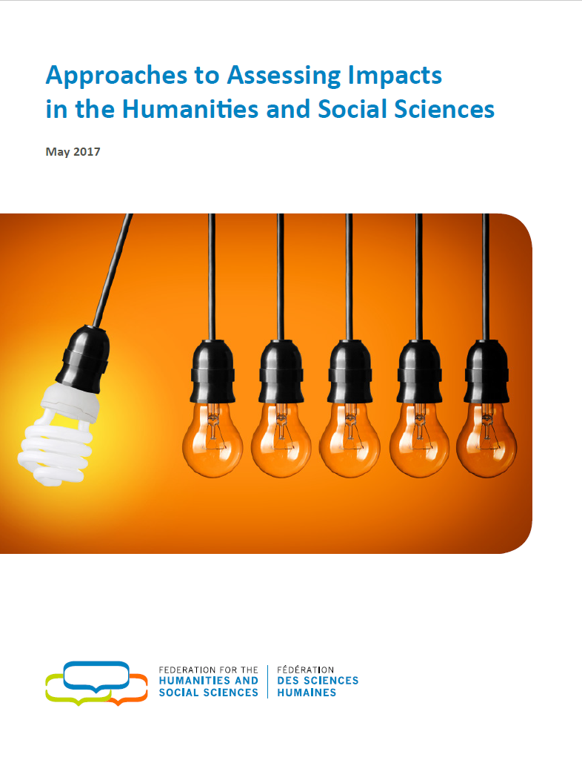
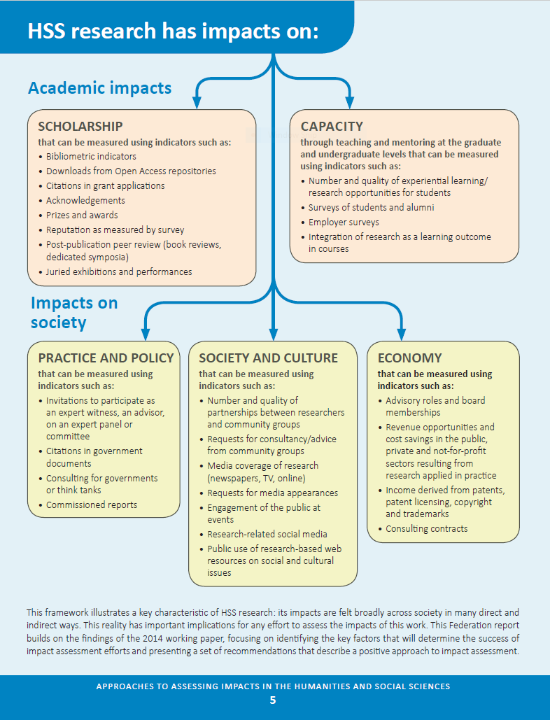

Slide 19
Quantitative vs qualitative indicators
RAND 2013: A standardized, numerical measure can help ensure transparency, consistency, comparability across disciplines, the creation of a longitudinal record, and impartiality at the evaluation stage.
  Availability of robust data!?
Qualitative approaches, on the other hand — such as case studies, testimonials and peer reviews — can accommodate many of these challenges [but raises new ones]:
  human judgement raises subjectivity and transparency challenges.
  difficult to make large-scale comparisons among researchers, projects and institutions, both across disciplines and over time.

Slide 20
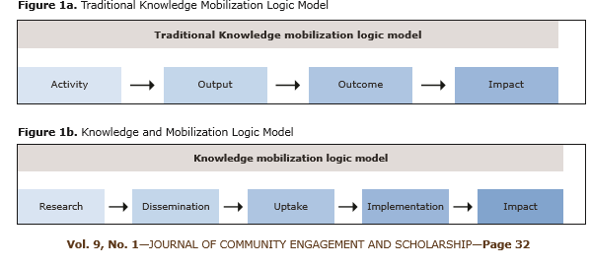
Pathway to Impact
Phipps, D. J., Cummings, J., Pepler, D., Craig, W., Cardinal, S. (2016)
The co-produced pathway to impact describes knowledge mobilization processes. Community Engagement and Scholarship, 9(1): 31-40 http://bit.ly/2fCqTcw

Slide 21
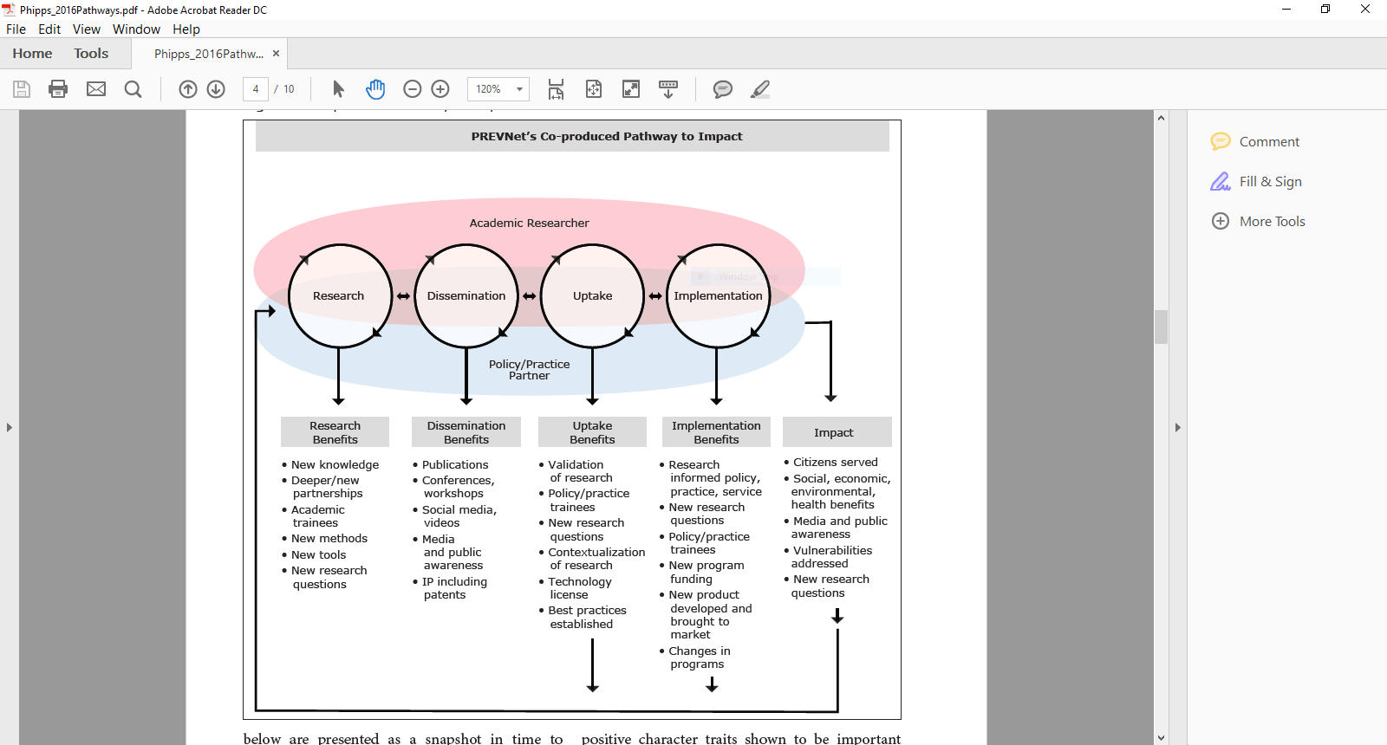

Slide 22
Task:
Evaluation of progress towards impact
Design a research-to-impact pathway for a specific project, programme or academic unit
Identifiy indicators of impact to be used at each stage
  Indicators could be quantitative or qualitative
  Describe data needed to establish indicators
How could existing data be used (Altmetrics)?
Mesurement and interpretation
  An indicator is basicly a mesurement with an interpretation
  How could the accuracy a measurement be assured?
  How should interpretations be established?
Who should be involved in evaluating impact?
Make a single slide setting out an indicator framework (and mail to p.benneworth@utwente.nl )

Slide 23
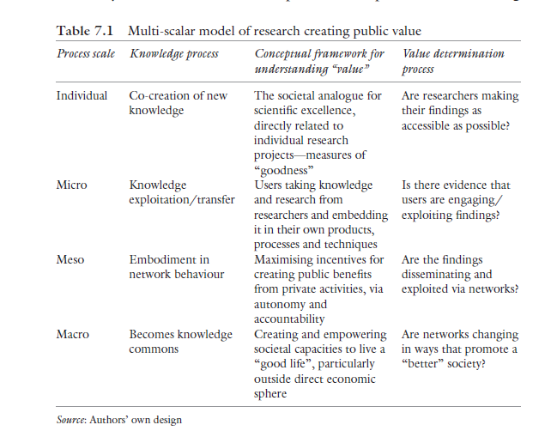
Benneworth et al. The Impact and Future of Arts and Humanities Research. Palgrave 2016

Slide 24
Impact planning and assessment
Example 1 : Project level
Goals
Activities
Expected impacts
Indicators of impact
Assessment of impact

Slide 25
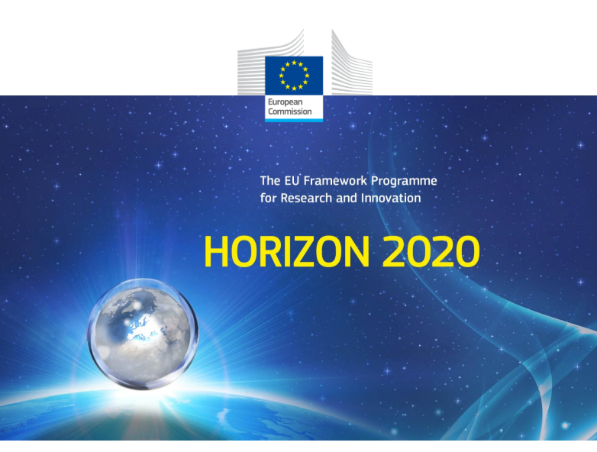
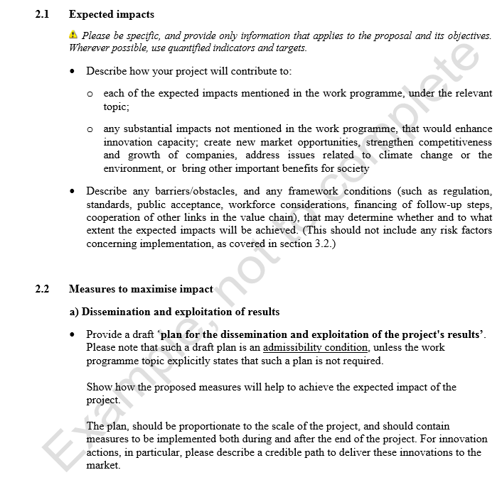

Slide 26
Impact planning and assessment
Example 2 : Programme level
Goals
Activities
Expected impacts
Indicators of impact
Assessment of impact

Slide 27
Programme for Sámi Research at RCN
Primary objective
The Sámi Research programme will help Norway to fulfil its responsibility for generating new research based knowledge that will enable the Sámi people to strengthen and further develop their own language, and their own culture and community life
Secondary objectives
Generate new knowledge about the Sámi language, culture, community life and history;
Increase use of comparative and transnational perspectives in research on the Sámi community and its institutions;
Cultivate new knowledge about Sámi identity and self-articulation in time and space;
Acquire new knowledge about relations within Sápmi and between Sápmi and other population groups, public authorities and international actors;
Acquire new knowledge about the impacts of cultural protection measures and measures to improve living conditions and industrial activities.

Slide 29
Impact planning and assessment
Example 3 : Academic unit
Goals
Activities
Expected impacts
Indicators of impact
Assessment of impact

Slide 30
