Slide 1
The practices of research impact
of SSH research impact and evaluation
Leonie van Drooge, ENRESSH training school, Zagreb, 14th of February, 2018

Slide 2
The practices of research impact
SSH research impact
Organisation, governance and thus evaluation
Starting with your research – what impacts, from what, for whom? (“impact pathways”)
Impacts expected in your context (policy analysis)
Starting form the impacts needed (theory of change) - how to organise? - how to evaluate?
Reflection

Slide 3
1. Impacts from research
“Typology of impacts from research”:
Types of stakeholders
The relation between research and practice
The type of knowledge involved
Assignment: how do you organise impact?
Based on: Leonie van Drooge and Stefan de Jong. Valorisation: researchers do more that they realize - e-publication with examples and guidelines for knowledge transfer. The Hague: Rathenau Institute, 2015.

Slide 4
Reetta Muhonen: SSH pathways to societal impact

Slide 5
Types of stakeholders
Professional users (Continuous Access To Cultural Heritage programme + many in HE studies and STS)
Students and teachers (The Peaceful School )
Interest groups (Science shops)
Field experts (Why teenagers can be so irritating, and how parents can learn to cope with them)
Interested laypersons (Kieskompas - Electoral Compass )
Other academics (Software issues at CERN)
“The general public” (State Commission for review of the Dutch constitution )

Slide 6
The relation between research and practice
Research aimed at improving an existing situation (The Veggiefruities) http://www.bitescience.com/Products/BitescienceCustomSolutions/ProjectVeggiefruities.aspx
Using research results in a different context (The end of the world + Magnetic cooling)
Collaboration with field workers for the purposes of development and testing (Understandable language )
Intervening in an existing situation (action research) (Biofuel policy)

Slide 7
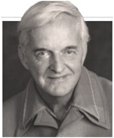
Donald Stokes: Pasteur’s Quadrant (1997)
Addition of Peterson Quadrant by Leonie van Drooge

Slide 8
The type of knowledge involved
Knowledge developed in a collaborative project (Sustainable Accessibility of the Randstad)
New research results suitable for a patent (Study of Parkinson’s disease)
A great many results (Birth of a kingdom)
Combination of knowledge from various disciplines (GLIMPS - GLucose IMaging in ParkinsonismS )
Techniques or data as an aid to research (Dutch Song Bank)
General knowledge of a particular discipline (The National IQ test)
Expertise of a single researcher (Pronunciation of English)

Slide 9
Assignment: impact from your research
Identify how you / your organization organizes impact
Stakeholder
Relation between research and practice
Type of knowledge involved
Other aspects
There are more impact pathways!

Slide 10
2. Impact in your context
Definition of impact depends on contexts
Discipline
Organisation (and aggregation level within organisation)
Funder
National (supranational / subnational) policies
Impact intended vs. impact perceived
The issue with evaluation of impact
Assignment: impact perceived and intended

Slide 11
What is impact?
Law and architecture – biomedical sciences in the Netherlands
Dutch Rathenau Institute – CWTS Technical university – Land Grant university - Oxbridge
US NSF – Dutch NWO EU H2020 – Dutch NWO
UK REF - Dutch SEP Dutch ministry of science, evaluation protocol, research council

Slide 12
Assignment: impact perceived and intended
Choose one context
What impact do you think is intended
Check the policy
Discuss with the group

Slide 14
3. Impact organized in a non-academic initiative
Multistakeholder / transdisciplinary initiatives
Examples (ctd from yesterday)
Ways to organise
Consequences for academic practice
Consequences for evaluation
Assignment: preparation for science slam

Slide 15
Multistakeholder / transdisciplinary initiatives
Citizen science projects
Dutch National Research Agenda
Development projects
Regional program

Slide 16
Theory of change
A theory of change is a shared narrative or joint understanding of a change or impact (journey)
It’s a joint vision and a joint causal logic that explains how activities are understood to produce a series of results that contributes to achieving final impacts

Slide 18
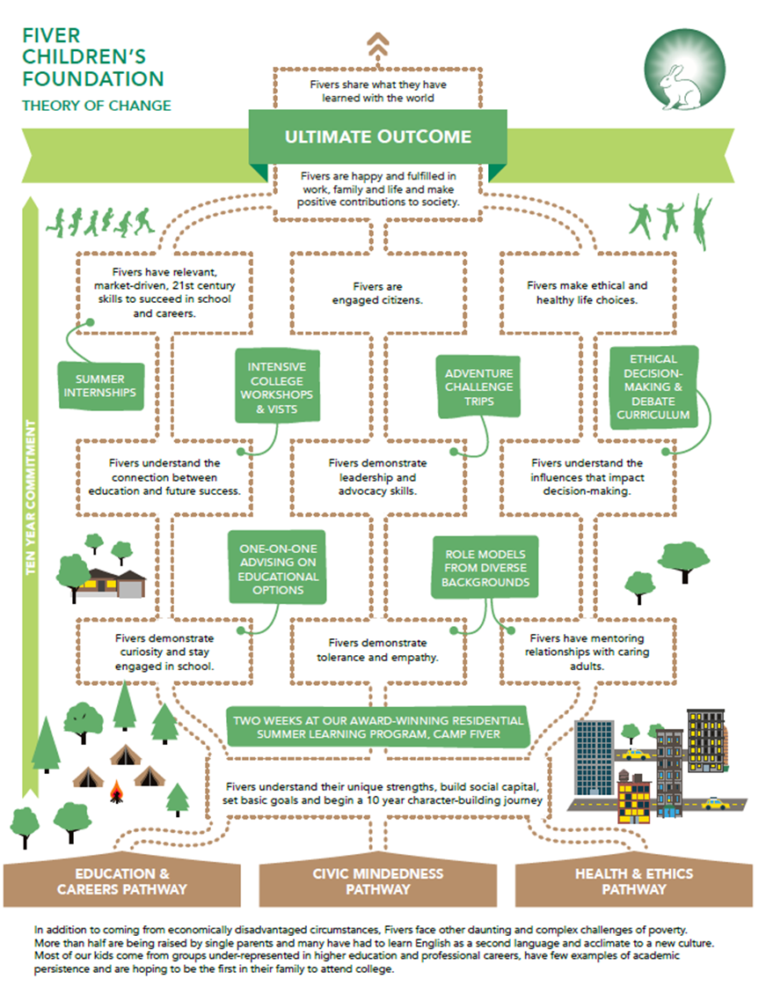

Slide 19
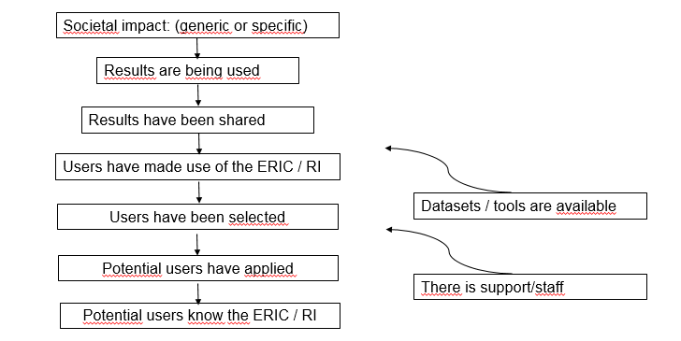

Slide 20
Theory of change
Start at the end, end at the beginning "What is our shared vision?"
Identify long-term goals / impact / change
Map backwards
Do not start with solutions and activities, start with preconditions: "What is needed before that is achieved?"
Connect preconditions and requirements - explain why
Identify basic assumptions
Identify interventions that the initiative will perform to reach the desired change
Formulate indicators to monitor progress or development
Develop a narrative explaining the logic

Slide 21
Slow down – in order to speed up
New institutions, mandates, governance arrangements, capacities, processes, participation, relations, ....
New practices, policies, networks
Strategies that promote the use of project results
Involve stakeholders / shareholder, increase awareness

Slide 22
Theory of change and a shared and joint governance
Evaluation framework is developed jointly, at the start and maintained / revised during the lifetime
Shared responsibility, including of the funder
Process indicators, indications, intermediary endpoints, proxies
A range of aspects is addressed: technical and scientific, agendas, expectations, resources, powers, capabilities
From evaluation for accountability, to monitoring in order to understand and be able to intervene

Slide 23
Theory of change and evaluation
Understand what serves as evidence, as an indication of progress toward the goal or promise or of understanding
Select a number of indications, quantitative as well as qualitative for monitoring purposes
Collect other evidence as well: decisions, cases, policies, practices
Indicators of progress – can be used to monitor, as well as to evaluate

Slide 24
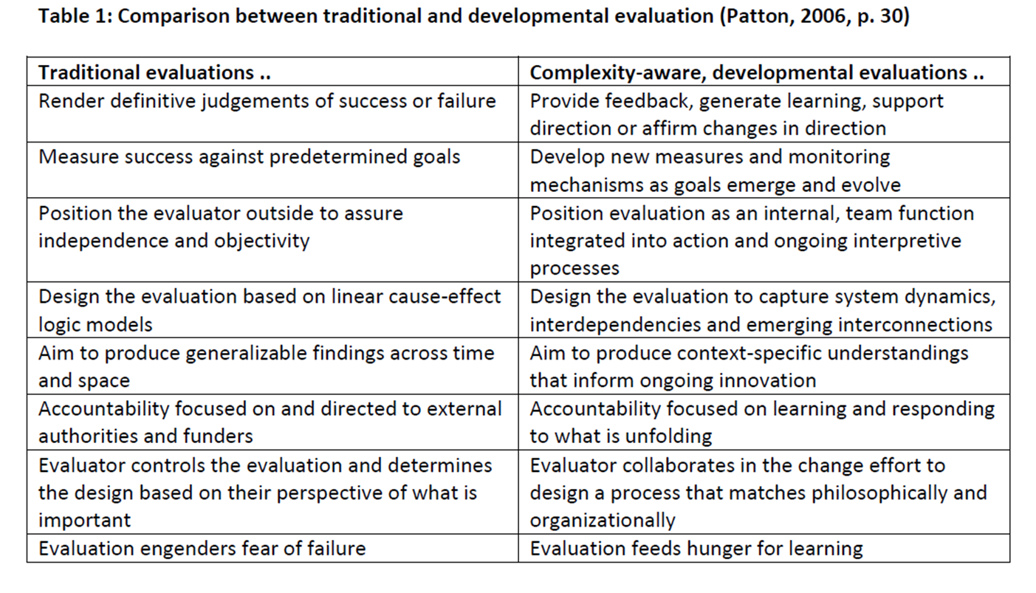

Slide 25
Assignment: develop a theory of change – for tonight's science slam
Identify the needs in the given situation in relation to the science slammer’s research and preferred ways to impact
What stakeholders are relevant?
Roleplay: each of the group members (but not the slammer) represents a specific stakeholder
Jointly develop a theory of change (so including the slammer)
What is the impact or change your group aims for
What are necessary preconditions
Identify what relevant and urgent interventions the science slammer can contribute
Develop a causal narrative (not a chronicle) – centrered around the contribution of the science slammer

Slide 26
Final assignment: reflection
You have used impact pathways and theory of change
What are the pros and cons?
When to use what?
What are consequences if you would use a theory of change approach in your academic context?
What are consequences for monitoring and evaluation?
Did you indentify in your group impact policies that are more or that are less in favour of theory of change approaches?

Slide 27
Leonie van Drooge
Rathenau Institute
l.vandrooge@rathenau.nl
@LeonievanDrooge
www.rathenau.nl/en

