Slide 1
ENRESSH Training School
Societal Impact of SSH
Training School, Zagreb, 5-9 February 2018
Paul Benneworth, Center for Higher Education Policy Studies, University of Twente, the Netherlands.
@heravalue
p.Benneworth@utwente.nl

Slide 2
Overview
Practicalities (Antun Plenkovic, Hosting Organisation)
Introduction to ENRESSH
A COST Action (2016-20)
Introduction to Working Group 2
The societal value of SSH
Introduction to the Training School
Four days (Theory, Practice, Policy, Career Impact)
Introduction to Day 1
Understanding the theories of SSH Research Impact

Slide 3
ENRESSH: key facts
A COST Action: coordination of research
Uses the “networking instruments” offered by COST: working group meetings, short term scientific missions, conferences, training schools...
Started on the 8th of April 2016 > end of the Action in April 2020
35 European countries having signed the Memorandum of Understanding
2 Near Neighbour Countries: Moldova and Albania
2 International Partner Countries: Mexico, South Africa

Slide 4
ENRESSH objectives
To enable the SSH to demonstrate their place in academia and society, by bringing together different strands of work dedicated to SSH research evaluation in different parts of Europe, in order to gain momentum, to exchange best practices, and to avoid unnecessary duplication
To improve the understanding of how SSH fields generate knowledge, through upscaling research conducted in local and national contexts.
To observe what kind of scientific and societal interactions characterize SSH disciplines in general, and some in particular
To understand and explain patterns of dissemination in the SSH, through confrontation of information stored in national databases and field interviews.
To bring together all types of researchers whose tools and methods can help tackling the complex problems of SSH evaluation.
To bridge the gap between scholars in SSH research evaluation, research managers and policy makers
To put together a pool of specialists upon which external stakeholders may call to solve questions linked to the evaluation of SSH research.
To prepare a roadmap for a European database of outputs of SSH research.
To create a movement promoting the research in the SSH as a cornerstone of European framework programmes and research strategy.

Slide 5
ENRESSH organisation
Working groups
WG1. Conceptual frameworks for SSH research evaluation.
WG2. Societal impact and relevance of the SSH research.
WG3. Databases and uses of data for understanding, monitoring and evaluating SSH research.
WG4. Dissemination.
+ transversal special interest group for early stage researchers.

Slide 6
Tasks of WG1
Collect, review, conduct studies on knowledge production and dissemination (incl. quality perceptions)
Analyse quality representations and assumptions in peer review
Observe national regulations, recommendations, procedures for research evaluation and their effects on knowledge production
Overview quality criteria based on scholars’ notions of quality
SG1: Legal frameworks
SG2: Evaluation procedures
SG3: Peer review practices
SG4: Scholars’ notions of quality and impact
SG5: Scholars’ attitudes and behaviour regarding evaluation
SG6: Bibliography
SG7 (transversal): evaluation and gender

Slide 7
WG3
Tasks
1: To compare publication patterns across countries and disciplines
2: Analyse characteristics of dissemination channels
3: Develop rules and procedures for databases
4: Design a roadmap for a European SSH research information system
5: Develop alternative metrics
A pilot study for an integrated data-infrastructure for the SSH
SSH metrics survey
Predatory publishing : what after Beall’s list ?
Attempt at estimating the total European volume of SSH output

Slide 8
Tasks and Deliverables for WG4
www.enressh.eu
See our dowloads page (open access publications, reports, etc.)
See our STSM page
Facebook -https://www.facebook.com/ENRESSH/
Twitter @ENRESSH
Newsletter
Every three or four month, you can subscribe via our website
Tasks
provide internal and external communication means for the Action
organise Action’s conferences

Slide 9
SIG for Early Career Investigators
The focus of the SIG: on ECI in Europe, their experiences, career paths, challenges and opportunities within the context of research evaluation in SSH field.
Expected outcomes:
(1) Organisation of a training school in 2019
(2) to prepare 'a manual' with helpful ideas for the future ECI in SSH, to draw the attention of evaluators and stakeholders to ECI position and problematic issues related to research evaluation in SSH.

Slide 10
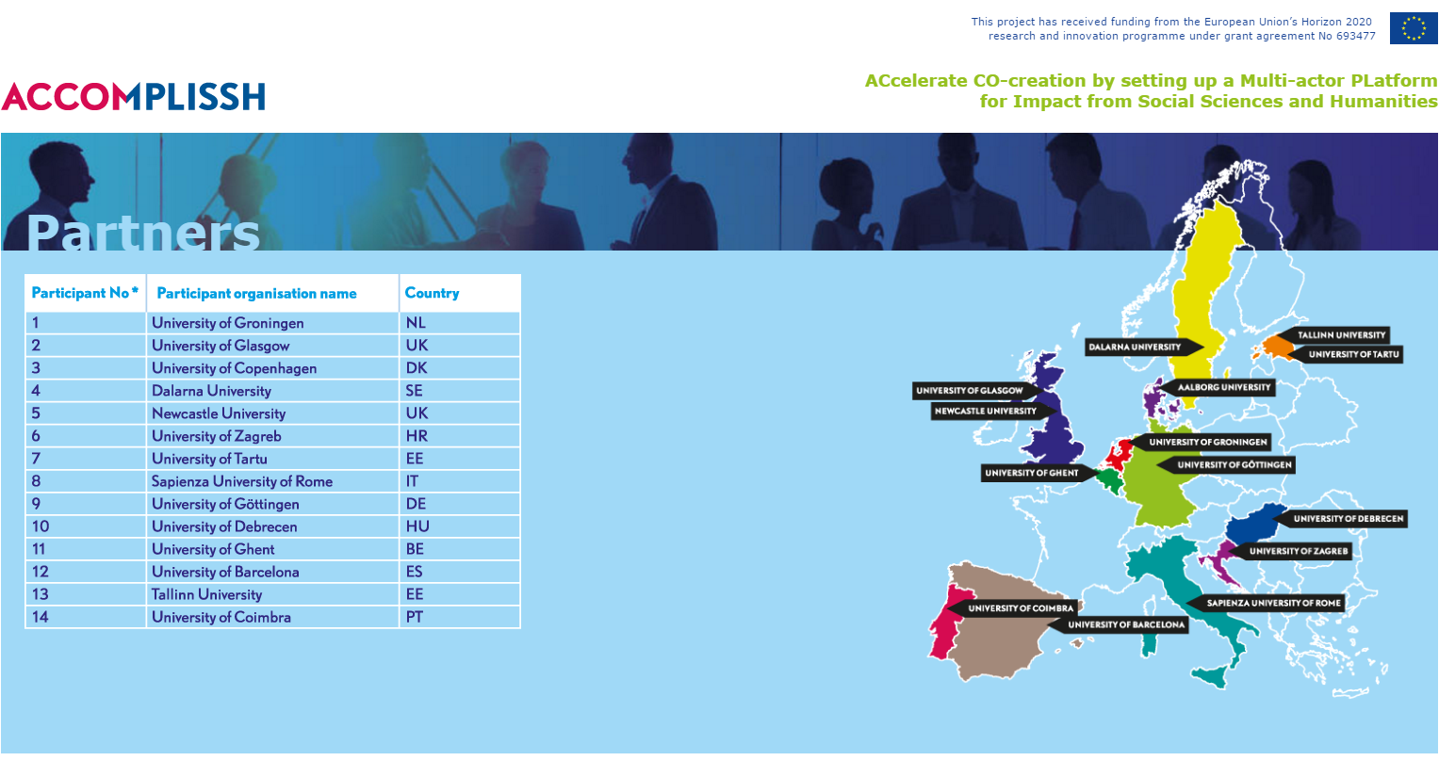
WG 2: the strange urgency of evaluating SSH Research Impact.

Slide 11
Introduction to WG2
The objective of this working group is to analyse the non-academic partnerships and environments of SSH research, in their diversity
Task 1. Generate a typology of societal forms of engagement in the SSH, and observe commonalities and specificities in national and disciplinary practices of engagement.
Task 2. Observe the structural requirements and conditions favouring the flowing of SSH knowledge towards society at large.
Task 3. Observe national policies to stimulate cooperation between the research sector and the socio-economic or NGO partners.
Task 4. Propose easier procedures for collecting data about engagement with society, or socio-economic stakeholders. Reflect about possibilities of their inclusion in national information systems.
Task 5. Propose measures to better value the SSH.

Slide 12
YEAR 1 YEAR 2 YEAR 3 YEAR 4
WG report on good/ interesting practice
WG report on engagement dynamics
WG report on policies for SSH engagement
WG members report on indicator practice
Overview of how SSH engages with society
Overview of conditions for success by context
Policies and measures to stimulate SSH benefiting society
Options for better measuring and monitoring SSH societal engagement
Co-ordinator drafts synthetic typology of ‘modes of SSH engagement’
Co-ordinator drafts structural requirements for SSH valorisation
Co-ordinator synthesises national SSHV practice overview
Co-ordinator proposes measures to better value SSH
TASK 1
TASK 2
TASK 3
TASKS 4, 5
DELIVERABLES

Slide 13
YEARLY WORK CYCLE
M1-4 M5-8 M9-12
WG receive and work on fiche into phase 2
fiches
WG finalise fiches/ comments on reflection
comments
WGs agree further output actions (e.g. papers)
DELIVERABLES
Meeting 1 (M2): agree topic for gathering/ fiche
Meeting 2 (M6): receive/ digest completed fiches
Meeting 3 (10): receive/ conditionally agree year report
Co-ordinator prepares meeting position paper
Co-ordinator circulates fiches/ initial reflection
Co-ordinator circulates 1st draft of year output
REPORT 1
STSM 1: gaining more detail on interesting cases
STSM 2: working on value-added synthesis

Slide 14
Main working practices
WG Meetings (2-3 times per year) – chance for group to shape ongoing activities
Active discussion in these sessions – brainstorming/ convergence/ decision
Data gathering by WG participants (prerequisite to attending WG meetings)
Short-term scientific missions (4 to date) – travel by researcher to host to undertake key piece of work in the programme

Slide 15
Future plans
Year 3 – focus on policy analysis – comprehensive mapping of policy approaches across Europe
Year 4 – developing policy tools, instruments and recommendations for improving the impacts of SSH Research
2018 – together with ESI SIG – the impacts of
Potential STSMs
The dark side of engagement/ negative impact
The effects of engagement on academic careers

Slide 16
Achievements to date
Policy Roundtable (Feb 2017, Prague) – types of European impact evaluation systems
Special session at the RESSH 2017 Antwerp Conference on Societal impact and SSH Research
Special Issue of Research Evaluation (forthcoming) on “Societal impact and SSH Research”
Training school (Zagreb, Feb 2018) “Understanding and stimulating SSH impact and engagement with society”
Short term scientific missions
#1 Reetta Muhonen (Q1 2017), a typology for SSH societal impact
#2 Stefan de Jong (Q3 2017), key distinctions in SSH impact
#3 Agne Girkontaitis, (Q3 2017) a literature review of SSH Impact tensions
#4 Eirikur Smari Sigurdarson (Q1 2018) towards a moral philosophy of impact
To be presented in the course of the Training School

Slide 17
Introduction to the Training School
Understanding and stimulating SSH impact and engagement with society
Having completed the training school, participants are expected to be able to:
Explain the principles of creating societal impact from research
Distinguish different pathways for creating research appropriate to different contexts
Apply these impact pathways to create recommendations for their own research and other research with which they are familiar
Analyse case studies of impact creation to highlight barriers and drivers underpinning and reducing the effectiveness of impact
Propose country-specific policy interventions to improve the volume and quality of impact creation from SSH research activities
Produce a non-academic summary of a research project indicating potential audiences for that research activity.

Slide 18
Logic of the Training School
Four Themed Days
Day 1: The principles of evaluating SSH Research Impact
Day 2: The practices of evaluating SSH Research Impact
Day 3: Stimulating impact & engaging with policy makers
Day 4: Impact and career development
Organisation of Days 1-3
Morning 1: Findings from the ENRESSH network to date
Morning 2: Keynote lecture & group exercise (1)
Afternoon 1: Keynote lecture & group exercise (2)
Afternoon 2: Report back from the groups and End-of-day discussion

Slide 19
Practicalities
Designed as a high-level think tank primed & steered by Expert Trainers rather than long series of keynote lectures
‘Chatham House Rules’ for discussions – what is said is public but non-attributable
Exercises’ purpose is to stimulate informed collective discussions & move to consensus/ identify tensions
Group Rapporteur: presents back from own group (M2-A1) in Afternoon 2
Day Rapporteur gives final round-up of discussions in Afternoon 2 session.
Social Media
Please be active in posting material on Social Media, particularly Twitter.
@enressh (me)
@COST_programme (our funders)
#SSHImpact18 (our hashtag)
Please also make use of our Facebook Page (Tony will be uploading photos from the day).
Please let us know if your image cannot appear!

Slide 20
Introduction to day 1
Introducing WG2 (1): developing a typology for SSH Research impact, Reetta Muhonen.
Working session (1) – conceptualising the impact of SSH Research (Paul & Jack)
Working session (2) – the principles for evaluating SSH’s research impact
Report back to plenary and concluding discussion.
0900-0930 | Registration, welcome and coffee
0930-1030 | Introduction to ENRESSH & the Training School Paul Benneworth, ENRESSH WG2 Coordinator Reetta Muhonen, ENRESSH WG2 Vice Coordinator | Conference hall
1030-1100 | Coffee Break | Council`s room
1100-1230 | Conceptualising the societal impact of SSH Research Paul Benneworth, ENRESSH WG2 Coordinator Jack Spaapen, Vice Chair, ENRESSH | Conference hall
1230-1330 | Lunch Break | Council`s room
1330-1500 | Understanding the principles of the evaluation of the societal impact of SSH Research Paul Benneworth, ENRESSH WG2 Coordinator Jack Spaapen, Vice Chair, ENRESSH | Conference Hall / Room 23 / Council`s room
1500-1530 | Coffee Break | Council`s room
1530-1700 | Groups report Task Results back to plenary session Chair: Paul Benneworth | Conference hall
1730 | Guided Tour of City. Under lead of Antun Plenkovic, ENRESSH Facebook lead
2000 | Evening meal in city | Brewery Medvedgrad

