Slide 1
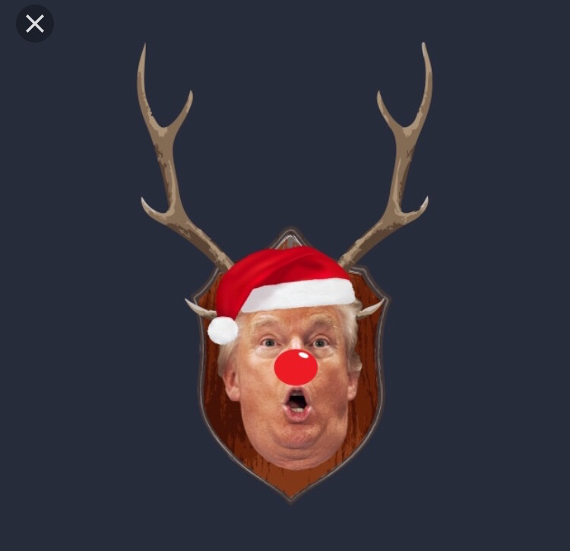
Group 2
Make reindeers great again!!

Slide 3
Goal: preserve cultural and environmental inheritance
Collecting reindeer archeological – establish an exhibition of archived material about reindeers and human interaction
Engaging schools, and enriching tourists’ experiences – the reindeer bus, the rein-day (x-mas time), #reindeerimpact, activities in the park, folklore
Altmetrics (tweeter), surveys (visitors, schools, regional/national) on attitudes and behaviours)
Training practitioners (museum workers, teachers) – how many trainees, changes in attitudes
Crowdsourcing – empowering the community for preserving inheritance in years to come

