Slide 2
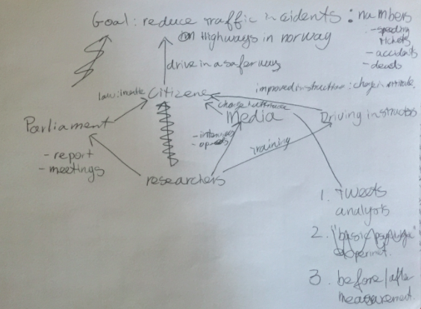
Grassroots Indicators
Generative Mecha

