Slide 1
European databases for research output
Diversity of publication patterns and its implications for evaluation
ENRESSH Dissemination Event
Université Sorbonne Nouvelle, Paris, February 18th 2020
Tim C.E. Engels & Emanuel Kulczycki

Slide 2
SSH publication patterns are divers
In terms of publication channels used
In terms of publication types

Slide 3
Book chapters in humanities and social sciences
Engels et al (2018), https://doi.org/10.1108/AJIM-05-2018-0127

Slide 4
SSH publication patterns are divers
In terms of publication channels used
In terms of publication types
In terms of languages used

Slide 5
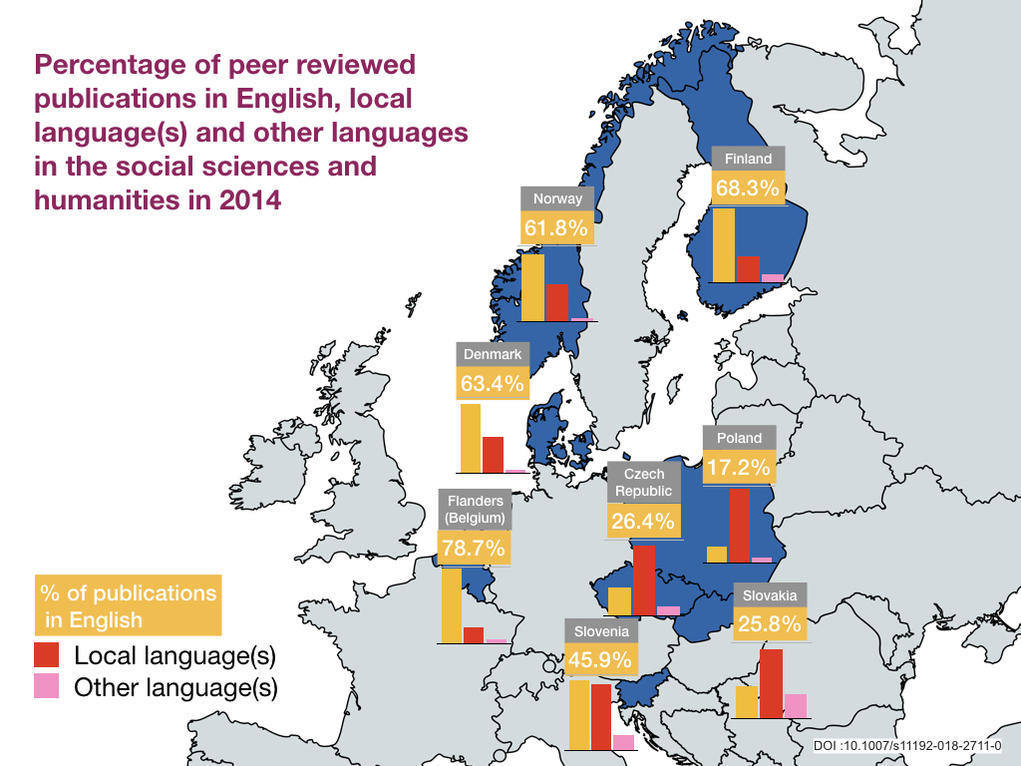
Kulczycki et al 2018, https://doi.org/10.1007/s11192-018-2711-0

Slide 6
SSH publication patterns are divers
In terms of publication channels used
In terms of publication types
In terms of languages used
In terms of (main) target audience

Slide 7
Therefore, evaluation of research
Needs to provide ample room for variation and diversity
Benefits from national bibliographic databases that comprehensively cover scholarly publications
Will benefit even more from ESPI, a European Scholarly Publication Infrastructure that allows to find, share, monitor and benchmark open metadata of scholarly publications

Slide 8
In sum
Appreciate SSH communication practices
Invest in infrastructures to support diversity of scholarly communication practices

