Slide 1
“Professional factors affecting career and engagement success for Early Career Researchers”
Julia Olmos Peñuela & Paul Benneworth
Paper presented to ENRESSH Working Group 2 meeting, Podgorica, Montenegro, 7-8 March 2019.

Slide 2


Acknowledgements
The European Network on Research Evaluation of the Social Sciences and Humanities (CA15137)
COST (European Cooperation in Science and Technology)
ZSI for hosting the brainstorming day in November 2018
Julia, Marta, Rita, Reetta, Corina, Brad, Stefan, Marc, Natasa,
COST (European Cooperation in Science and Technology) is a pan-European intergovernmental framework.
Its mission is to enable break-through scientific and technological developments leading to new concepts
and products and thereby contribute to strengthening Europe’s research and innovation capacities.

Slide 3
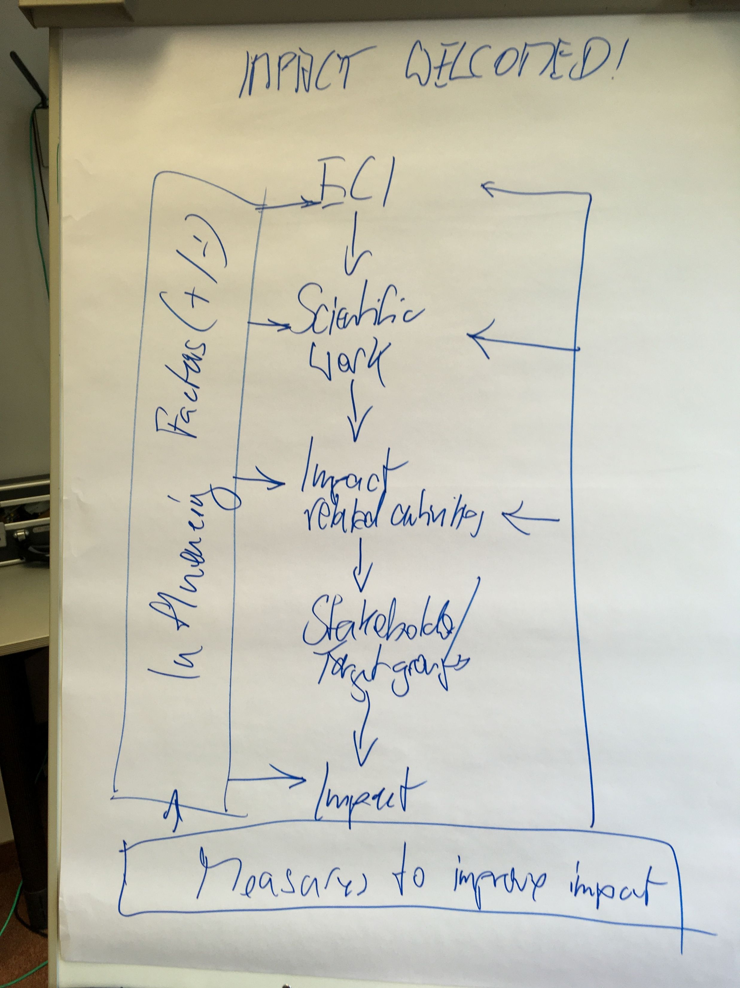
Overview
Introduction: retrospectively adding quantitative analysis to qualitative study
Research question: which factors influence engagement success by ECRs?
Qualitative Comparative Analysis to ID success “combinations”
Reflection on implications for CARES project
Image c/o Christoph Koller

Slide 4

Science policy & the art of steering academics
Academic knowledge creates scientific and societal advances
Applying research for societal benefit → societal impact
Increasing policy demands and pressure to improve impacts
Which factors associated with greater “impact”?
How can research policy stimulate impact creation?

Slide 5
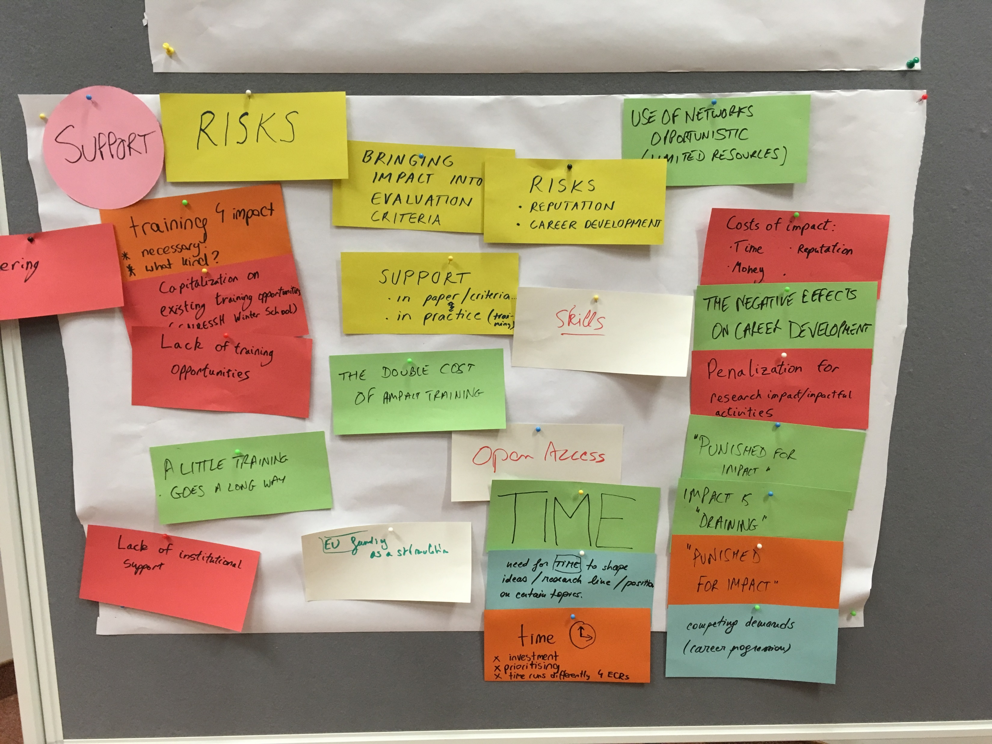
Why the (CARES) focus on ECRs?
Contemporary situation of conjunction of increased:
  Intensity of evaluation across research systems
  Stakes (academic precarity)
  Expectations (‘all must be excellent’)
  Breadth of evaluation (excellence, engagement)
  Workload (junior mental health crisis)
→ Very complex environment to anticipate/ unexpected effects

Slide 6
What influences academics’ decision to attempt creating impact?
Research (knowledge creation) is a highly uncertain activity
Researchers draw heavily on available resources/ past experiences (Knorr-Cetina, 1981)
Key influences
  Personal-intrinsic – age, gender, nationality
  Personal-academic - academic identity & experience
  Professional-academic – local environment, extended network, epistemic community
Olmos Peñuela et al (2015)

Slide 7
The road to hell is paved with good intentions
Decision to engage not sufficient:
  Can good engagement intentions be translated into successful outcomes?
Engagement activities influenced by moderating factors
  +/ve factors: funding, peers, infrastructure, mentors, rewards
  -/ve factors: barriers, rejection, negative feedback, unsupportive partners…?
Barriers encountered en route
Decision to engage
Efforts to create impact
Successful impact?
Supportive infrastructures

Slide 8
A first cut model of the factors influencing ECRs creating societal impact
Personal-intrinsic
Demographic
Barriers encountered en route
Identity
Personal-academic
Experience
Choice to engage
Efforts to create impact
Successful impact?
Are HPC/ LPC different? Muhonen & De Jong, 2019
Local env
Professional-academic
Wider network
Supportive infrastructures
Epistemic community

Slide 9
Preliminary sensemaking activities
Instrument developed for data-gathering
  Brainstorm (07.18)
  N=1 feedback (08.18)
  N=18 group coding session (11.18)
  N=102 final analysis (02.19)
Distributed via ENRESSH WG2 network + contacts
  Non-representative
  Seeking interesting examples
  Identifying factors that influence (career) decision making
Hierarchies, disciplinary norms and power in academia: impact as emancipation or tension?
Incentives for impact creation: formal and informal steering by evaluation systems
The consequences of impact evaluation for ESIs’ motivations or identities
The diversity of impact evaluation and academic careers: accounting for local context

Slide 10
The pilot instrument
QUANTITATIVE QUESTIONS
QUALITATIVE QUESTIONS
1a Importance of Research (Likert)
3a Importance to own research (Likert)
3c Motivation to impact (Likert)
4a Training (Likert)
4b impact required for Ph.D. (1=yes)
5a involved in creating (1=yes)
5c Success to date(Likert)
6a University emphasis (1=yes)
6b University support (1 = yes)
7a additional workload (1=yes)
8a problems with impact (1=yes)
8c tensions with aims (1=yes)
8e tensions for career (1=yes)
9a issues stopping impact (1=yes)
1.b Why do you believe that creating wider impact in society is important for (publicly-funded/ academic) research in general?
2.a. What kinds of impacts, if any, do you believe research can usefully create in society?
2.b. Can you give any emblematical examples of what you would regard as ‘worthwhile’ research impact?
3.b. Why do you believe that creating impact in society is important for the research that you are doing?
3.d. Why are you motivated to do research that can create societal impact?
5.b. Please describe involvement in creating societal impact out of your research-duties
6.c. In your career to date, what kinds of other support and encouragement have you been given to do research that creates societal impact?
7.b. Please describe whether creating societal impact requires additional work from your regular workload
8.b. In your career to date, please describe any problems have you experienced problems in trying to do research that creates societal impacts
8.d. Please describe any tensions that doing research creating societal impacts produces against with your other aims for research (e.g. doing excellent research, creating knowledge useful for teaching)?
8.f Please describe any tensions hat doing research that creates societal impacts originates for your career development?
9.a. Can you please describe any particular issues or features that stop you from doing research that is useful for society?
10. Please name up to three key improvements/ interventions that could be made to make it materially easier to do research that created societal impact:
11. Are there any issues or information which you would otherwise think are relevant but have not been able to ask?

Slide 11
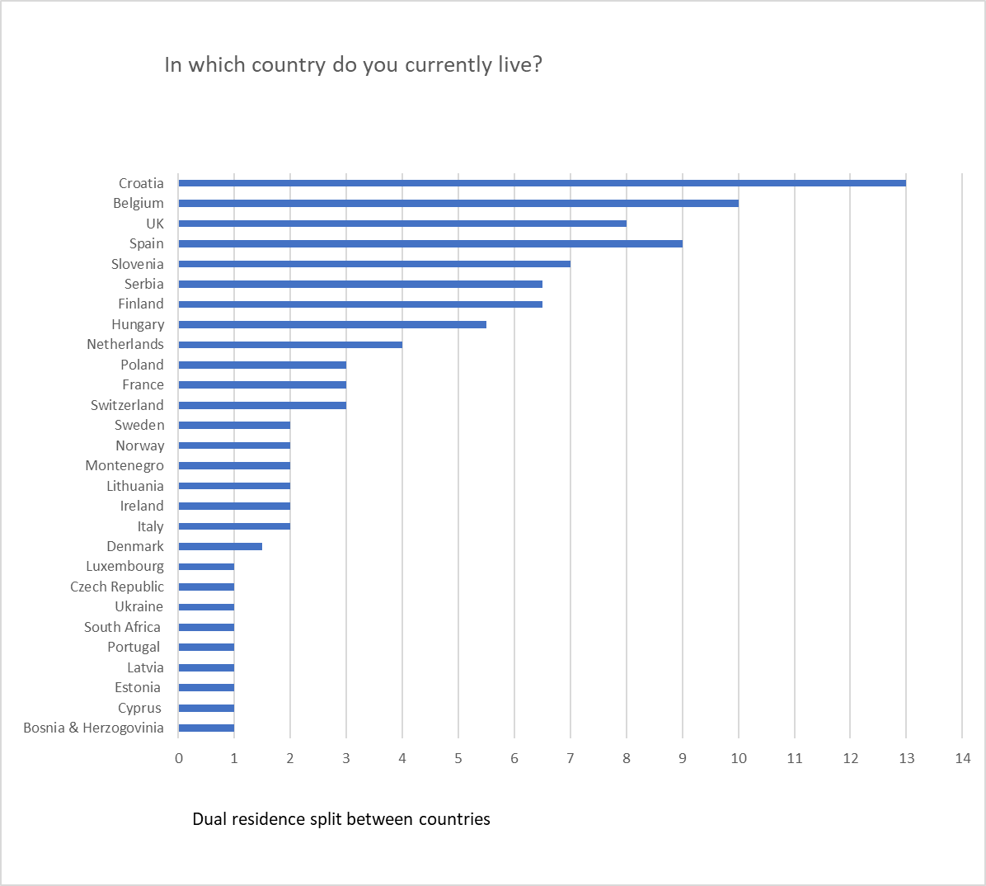
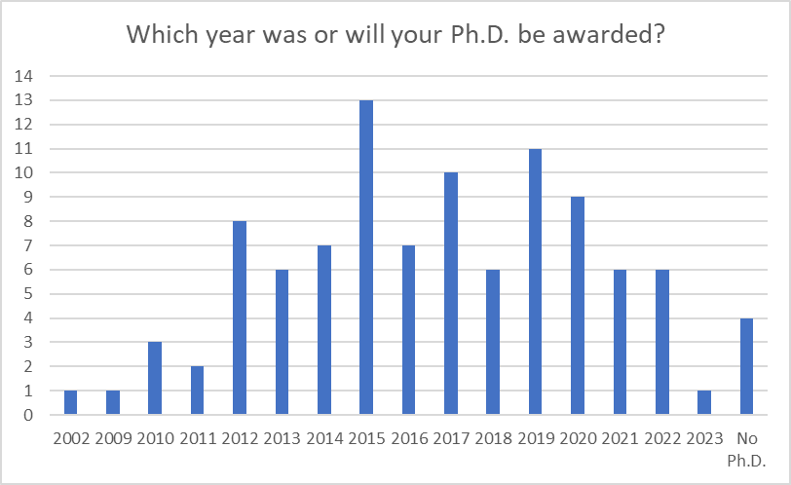
Overview of the respondents

Slide 12
Methodology
We use Qualitative Comparative Analysis (QCA), an analytic technic that builds on set theory and allows for an in depth analysis of how causal conditions contribute to an outcome.
QCA assumes that the influence of particular attributes on a specific outcome depends on how attributes combine, rather than on the level individual attributes.
QCA considers equifinality and can be used in samples where a low number of observations.
In our study, we aim to explain:
  Which combination of professional conditions lead to the presence or absence of the considered output;
  Whether the combination of this professional conditions differ between ECR belonging to High and Low Performance countries
We use 93 valid questionnaire ( without no missing data) and divide it in 2 samples High (N=46) and Low (N=47)

Slide 13
Variables operationalisation
Field Dynamic: measured as a construct built from the following 2 items (α=0.74)
1a Importance of Research
3a Importance to own research
University environment: measured as a construct built from the following 2 items (α=0.61)
6a University emphasis
6b University support
PhD requirements: measured through the item 4b impact required for Ph.D.
Problems related to engaging: measured as a construct built from the following 5 items (α=0.64)
7a additional workload
8a problems with impact
8c tensions with aims
8e tensions for career
9a issues stopping impact
Success (OUTPUT): measured as the extent to which the ERC feel that he/she has been successful in creating societal impact:
5c Success to date
Field dynamic
(1a+3a)
University Environment
(6a+3b)
Ph.D. Requirement
(4b)
Problems
(7a, 8a, 8c, 8e, 9a)
HPC or LPC
(from residence)
Success to date
(5c)

Slide 14
QCA Analysis considerations
We use fuzzy-set QCA (fsQCA) because we have at least one non-binary variable in our analysis
fsQCA ignores missing data (cause of having N=93).
Non binary variables have to be calibrated between 0-1:
  Continuous variables: percentiles 10 (0), 50 (0.5) and 90 (1) (Woodside, 2013)
  Ordered variables (4a impact required) calibrated as 0= no impact required,, 0.5= neutral & 1 = impact required.
We conduct necessary and sufficient analyses
  Necessary: there is a single variable that is always present for that condition – it is necessary for the desirable end state (it ‘causes’ the end state)
  Sufficient: there are one or more combinations of variables that are associated with the presence of the desirable end state (they together ‘cause’ the end state)
The intermediate solution of the sufficient analysis is presented in this study
Notes:
I think this is very sofisticated so I would remove this or leave it as appendix in case they ask for.
I guess you are aware that you are only presenting the sufficient conditions and not the necessary ones….

Slide 15
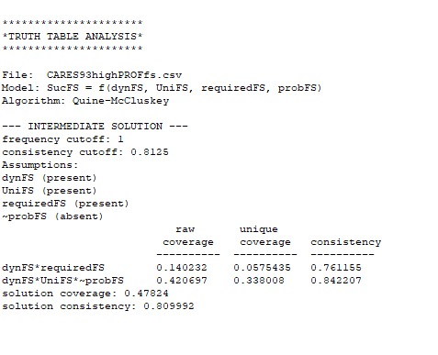
Good performance in HPCs
No necessary variable
Two unique sufficient configurations that can lead to good performance
  dynamic & required
  dynamic, Uni support, no problems
Combination of Internal belief (+ve) plus
  Compulsion: requirement to do impact in Ph.D.
  Achievability: there is support/ guidance plus no problems

Slide 16
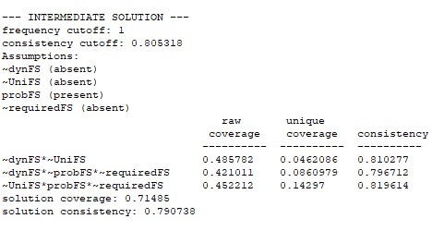
Bad performance in HPCs
No necessary variable
Three unique sufficient configurations explaining no success
  not dynamic, not university
  not dynamic, no problems, not required
  not university, problems, not required
A lack of belief in importance, or absence of urgent pressures
  If do not believe relevant AND not needed for Ph.D. or important for Uni.
  No real pressures plus problems to creating impact

Slide 17
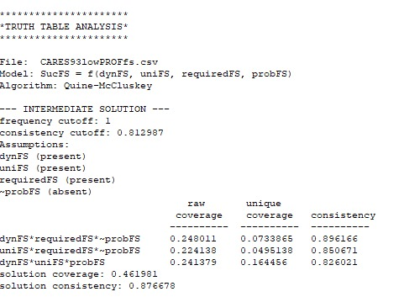
Good performance in LPC
No necessary variable
Three unique sufficient configurations associated with success
  Dynamic, required, no problems
  University, required, no problems
  Dynamic, university, problems
When there are problems, need aligning intrinsic motivations + university support
If no problems, then past experience+ either belief or support

Slide 18
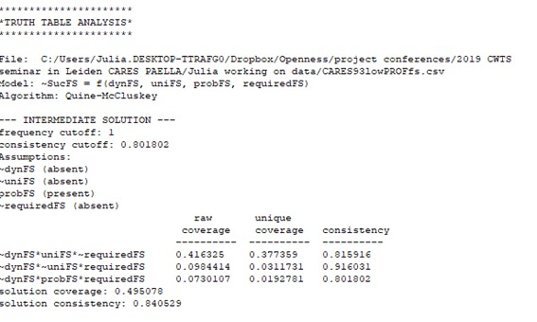
Bad performance in LPC
No necessary variable
Three unique sufficient configurations explaining no success
  Not dynamic, University, not required
  Not dynamic, not university, required
  Not Dynamic, Problems, required
Lack of intrinsic motivation + lack of push/ pull
  “Not dynamic” not necessary
  Not required, no support, or problems reduce activity

Slide 19
Clear differences between HPC/ LPC
High Performing Countries
Impact creation | Combination of intrinsic motivation (+ve) plus Compulsion: requirement to do impact in Ph.D. Achievability: there is support/ guidance plus no problems
No impact creation | A lack of intrinsic motivation, or absence of urgent pressures If do not believe relevant AND not needed for Ph.D. or important for Uni. No real pressures plus problems to creating impact
Low Performing Countries
Impact creation | When there are problems, need aligning intrinsic motivations + university support If no problems, then past experience+ either belief or support
No impact creation | Lack of intrinsic motivation + lack of push/ pull “Not dynamic” (lack of intrinsic motivation) not necessary Not required/ no support/ or problems reduce impact success

Slide 20
Conclusions, discussion, implications
Possible to identify factors influencing ECR impact success
  Factors differ between HPC and LPC → pull factors play a role
Intrinsic motivation as + most common in both country types
  Lack of intrinsic motivation seems most problematic in LPCs – easy for other factors to discourage
    Incidental discouragement – LPCs
Needs bringing back to qualitative data (1a/ 3a) e.g. Balaban et al stable impactful identities…
How to influence how important researchers find impact in general/ to their own research?
  Ph.D. training
  Peer behaviour within field
  Impact → funding/ publications
  Examples of impactful leaders
Role of evaluation in signalling ‘goodness’ of impact
  Driving university priorities in HPC
  Signalling necessity of impact
  Letting funding/ publications follow impact

Slide 21
Appendix
High Performance Countires (N=46)

Slide 22
Appendix
Low Performance Countires (N=47)

