Slide 1
national bibliographic databases for research evaluation the knowns and the unknowns
Linda Sīle, doctoral researcher
Centre for R&D Monitoring (ECOOM), University of Antwerp, Belgium
ENRESSH: Paris, 18/02/2020

Slide 2
2016 ENRESSH meeting in Poznan
Presentations of 6 European databases:
RIV in the Czech Republic
VABB-SHW in Flanders, Belgium
CRISTIN in Norway
VIRTA in Finland
BFI in Denmark
Lituanistika in Lithuania

Slide 3
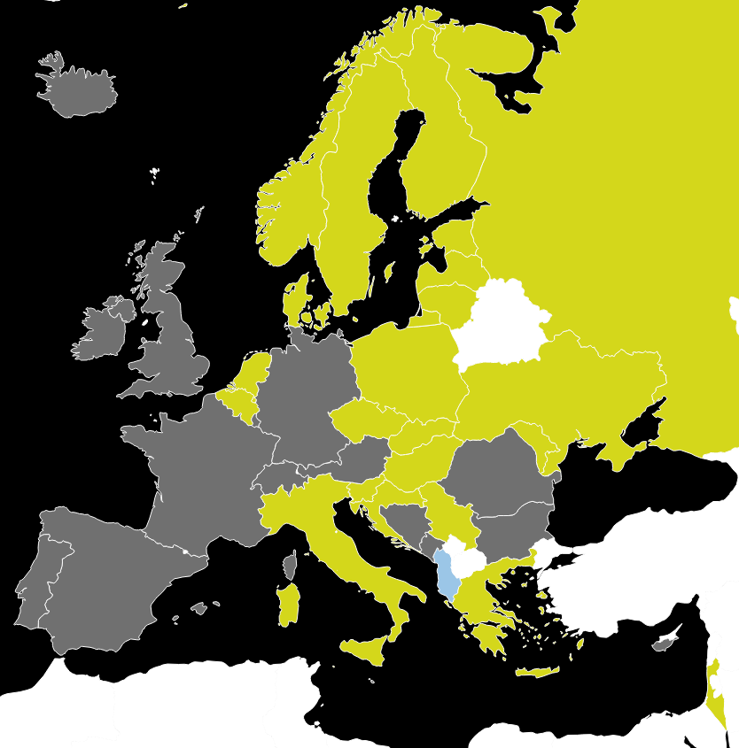
Green – national database exists
Blue – national database under implemented
Grey – no national database
White – no information
Data from the survey (2017*)
*Partially updated on 2020

Slide 4
Definition
Bibliographic database for research output is
a structured set of bibliographic metadata (e.g. title, type, year, and author) of artifacts authored by researchers

Slide 5
Database for research evaluation
Valid database records refer to existing research output
Comprehensive database represents the total volume of the (social sciences and humanities) research output of a country
Reliable data collection and registration method provides accurate and traceable information
Endorsed by government the implementation and maintenance of a database is embedded in a legal framework at the national level

Slide 6
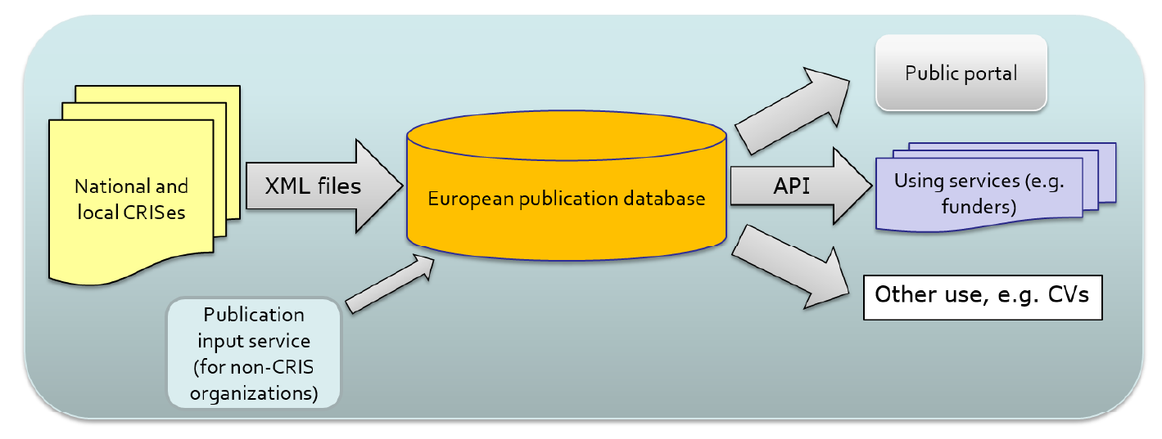
VIRTA-ENRESSH pilot
The main challenge is that institutional and national data sources use different data models as well as different data collection and validation procedures.
(Puuska et al. 2018)

Slide 7
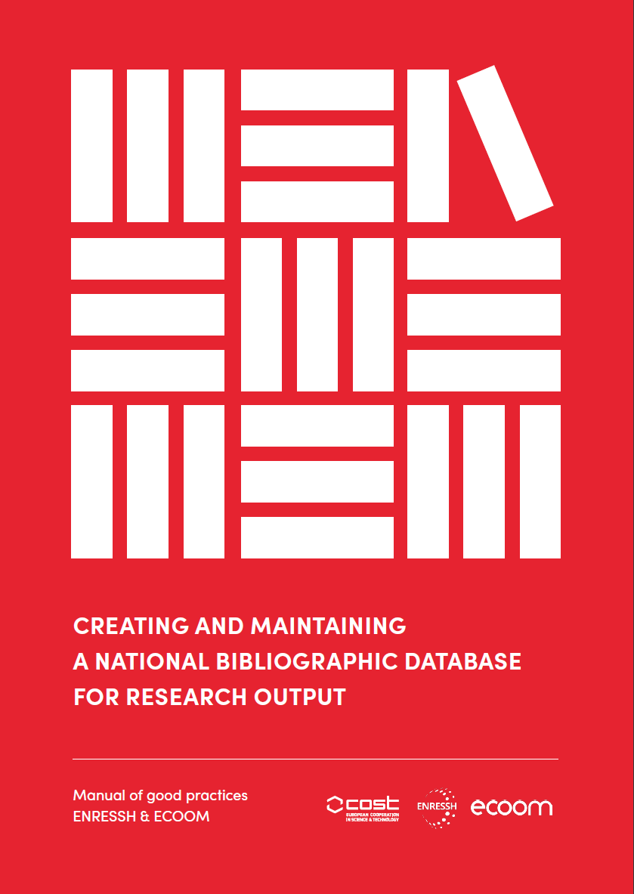
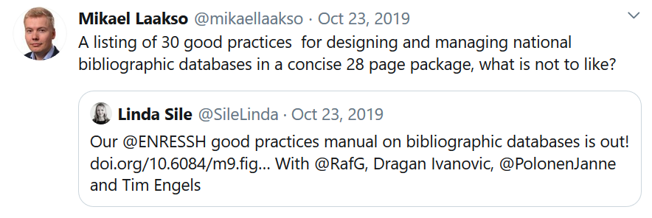

Slide 8
Databases as mirrors
of research
Notes:
https://encrypted-tbn0.gstatic.com/images?q=tbn%3AANd9GcSYy_LPPtgq1Ie--PkeaR-BpNnSkgYbD4Ck1qX2dlIn53ntS7YG

Slide 9
Thank you!
Linda.Sile@uantwerpen.be

Slide 10
Presentation based on
Puuska, H.-M., Guns, R., Pölönen, J., Sivertsen, G., Mañana-Rodríguez, J., & Engels, T. (2018). Proof of concept of a European database for social sciences and humanities publications: Description of the VIRTA-ENRESSH pilot (p. 23). CSC & ENRESSH. https://doi.org/10.6084/M9.FIGSHARE.5993506
Sīle, L., Guns, R., Ivanović, D., Pölönen, J., & Engels, T. C. E. (2019). Creating and maintaining a national bibliographic da­tabase for research output: Manual of good practices. ENRESSH & ECOOM. https://doi.org/10.6084/m9.figshare.9989204
Sīle, L., Pölönen, J., Sivertsen, G., Guns, R., Engels, T. C. E., Arefiev, P., … Teitelbaum, R. (2018). Comprehensiveness of national bibliographic databases for social sciences and humanities: findings from a European survey. Research Evaluation. https://doi.org/10.1093/reseval/rvy016
Sīle, L., Guns, R., Sivertsen, G., & Engels, T. C. E. (2017). European Databases and Repositories for Social Sciences and Humanities Research Output (p. 25). Antwerp: ECOOM & ENRESSH. Retrieved from https://doi.org/10.6084/m9.figshare.5172322.v2

