Slide 1
Ambiguity, labelling, and questionable practices in peer review
Raf Guns, Marek Hołowiecki – Paris – 18.02.2020

Slide 2
Ambiguity in peer review
Co-publications reported differently
Bottom-up (authors) vs. top-down (panels)
Top-down classification Finland vs. Flanders
Pölönen, J., Engels, T., & Guns, R. (2019). Ambiguity in identification of peer-reviewed publications in the Finnish and Flemish performance-based research funding systems. Science and Public Policy. https://doi.org/10.1093/scipol/scz041
Notes:
In 2014, researchers from two Finnish universities published an article in the journal Flux.
One university reported it as PR, while the other reported it as not PR.
After some deliberation, the universities agreed to register the publication as PR.
However, in the Finnish Publication Forum list, which is put together by panels of experts, the same journals is not recognized as PR.
Finally, panels in different countries may disagree, because the journal is classified as PR by the panel in Flanders, Belgium.
At 3 levels: ambiguity regarding PR status of this journal/publication.

Slide 3
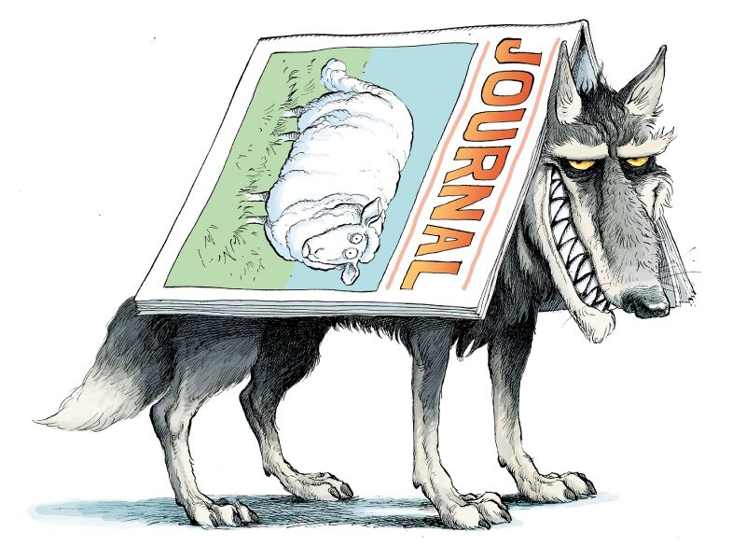
?
8 to 9.5% of channels
Psychology: 7%, Arts: 20%
Higher for book publications, local languages
Pölönen, J., Engels, T., & Guns, R. (2019). Ambiguity in identification of peer-reviewed publications in the Finnish and Flemish performance-based research funding systems. Science and Public Policy. https://doi.org/10.1093/scipol/scz041
Notes:
When discussing peer review, we tend to think of extremes:
On the one hand, we have prestigious publication channels (publishers/journals) that carry out strong peer review and are typically perceived as high-quality.
On the other hand, we have ‘predatory’ journals and publishers that carry out no or weak PR, and sometimes border on fraudulent.
The story of Flux shows that there are also channels in the grey zone between these extremes.
Using the three levels (co-publications, top-down vs bottom-up, Finland vs Flanders), we tried to assess what this grey zone looks like.
Overall, we find that about 10% (8 to 9,5%) of channels are in the grey zone.
This percentage is typically a little higher for the Humanities than the Social sciences (Psychology ~7%, Arts ~20%).
Ambiguity seems to arise esp. when a channel is also used to communicate with professional and general audience: more common for book publications, local-language publications (both around 20%).
Identifying PR channels is harder than often assumed, among other things because some channels use PR for some but not all publications. One tool that can help with this are peer review labels.

Slide 4
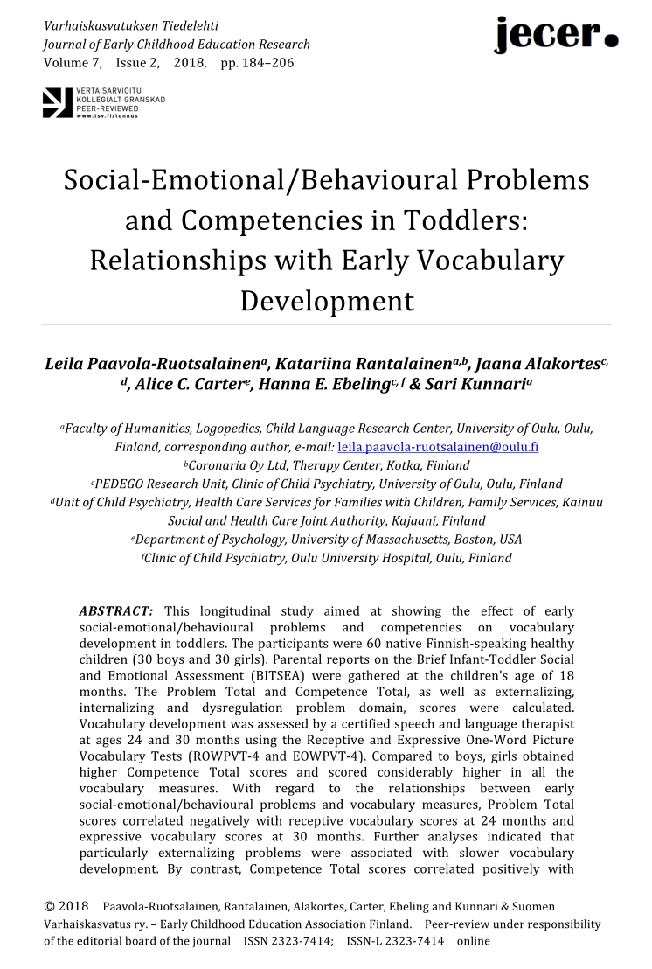
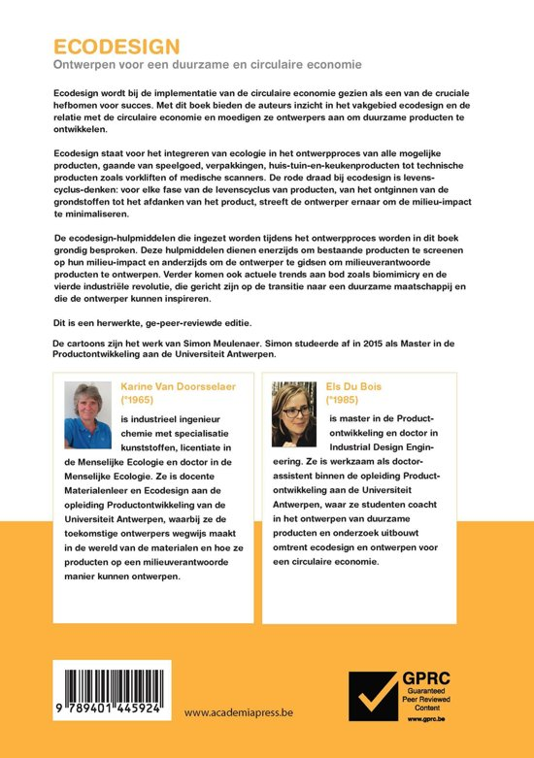
Peer review labels
Kulczycki, E., et al. (2019). How to identify peer-reviewed publications: Open-identity labels in scholarly book publishing. PLOS ONE, 14(3), e0214423. https://doi.org/10.1371/journal.pone.0214423
Notes:
A country like Finland and a region like Flanders, Belgium have witnessed the introduction of labels for PR publications.
Label implies:
PR was carried out
PR process was controlled by publisher
Publisher has archived all documents/reviews/…
→ formal process, related to funding and evaluation processes

Slide 5
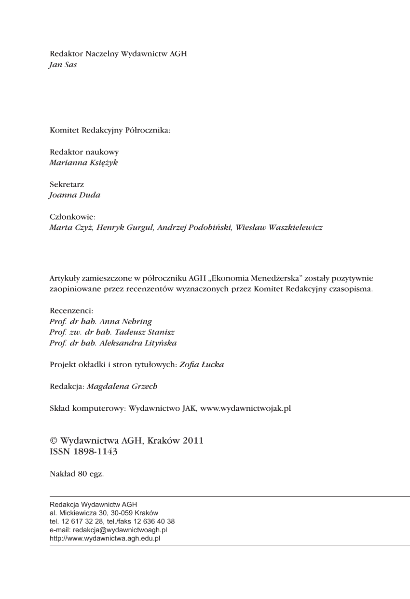
Open-identity label
Common in Central and Eastern European countries
Social practice rather than formal instrument
…but fulfils similar function
Labels can be used as one indicator of many in book evaluation
Kulczycki, E., et al. (2019). How to identify peer-reviewed publications: Open-identity labels in scholarly book publishing. PLOS ONE, 14(3), e0214423. https://doi.org/10.1371/journal.pone.0214423
Notes:
In Central and Eastern European countries, it is common to mention the names of reviewers in the colofon of a book. We refer to this as an open-identity label. It predates the Open Science movement, but can be considered a form of open-identity peer review.
While this is more of a social practice than a formal instrument, our research has shown that it in fact fulfils a similar function as the formal labels from Finland and Flanders: publishers, authors and reviewers are in agreement that the book is indeed peer-reviewed.
We conclude that labels, whether formal or informal, can be used as an indicator (among many others) in the evaluation of books.

Slide 6
?
Notes:
In our research we also address journals from right part of the arrow.

Slide 7
Questionable practices
„…scientific paper, (…) with such grave errors that a competent peer reviewer should easily identify it as flawed and unpublishable” (Bohannon,2013)
Predatory journals recruit fake editor (Sorokowski, P., Kulczycki, E., Sorokowska, A., & Pisanski, K. (2017)) “Anna O. Szust (Oszust is the Polish word for 'a fraud’)”
Bohannon, J. (2013). Who’s Afraid of Peer Review? Science, 342(6154), 60–65. https://doi.org/10.1126/science.342.6154.60
Sorokowski, P., Kulczycki, E., Sorokowska, A., & Pisanski, K. (2017). Predatory journals recruit fake editor. Nature, 543(7646), 481–483. https://doi.org/10.1038/543481a
Notes:
In a sting experiment conducted in 2013 more than 50% of targeted open-access journals accepted a flawed article.
4 years later different authors (our chair Emanuel Kulczycki among them) went even further and created a fake editor who was accepted as a editorial team member or even an editor-in-chief to a third of selected journals from so-called Beall’s list of predatory journals.
Please meet Anna Olga Szust. Oszust means in Polish fraud.
Nonetheless, those journals still operate and publish new volumes.

Slide 8
Questionable journals: a comparison of Finnish, Flemish and Polish data
To review and compare how questionable open access (POA) journals are identified and managed in the context of performance-based research funding.
To find out how the yearly number of publications in questionable SSH journals and legitimate OA journals has evolved, and to compare SSH journal lists from the aspects of predatory and legitimate OA in Finland, Flanders and Poland.
Notes:
Therefore, a further research is needed to better understand this part of scientific knowledge production.
In a first study that is still in a work in progress state w want to review how questionable open access journals are identified.

Slide 9
Country | Publications | Questionable publications | Questionable publications % | Journals | Questionable journals | Questionable journals %
Finland | 26,650 | 313 | 1.2 | 6,893 | 119 | 1.7
Flanders | 31,769 | 76 | 0.2 | 8,608 | 60 | 0.7
Poland | 120,111 | 512 | 0.4 | 8,577 | 137 | 1.6
Notes:
Initial results show that the scale is not large. However the publications from questionable journals can be found in national databases used for evaluation purposes.

Slide 10
Citations of articles from the blacklisted journals
To find out in what contexts are blacklisted journals cited in articles indexed in Web of Science.
To check self-citation rates.
To identify the pairs of corresponding authors countries.
Notes:
Another study that is also a work in progress is about the citations of articles published in blacklisted journal and legitimisation of knowledge published in them by citing in journals indexed in Web of Science.
From 74 blacklisted SSH journals, almost 5000 articles were cited by more than 10.000 articles.

Slide 11
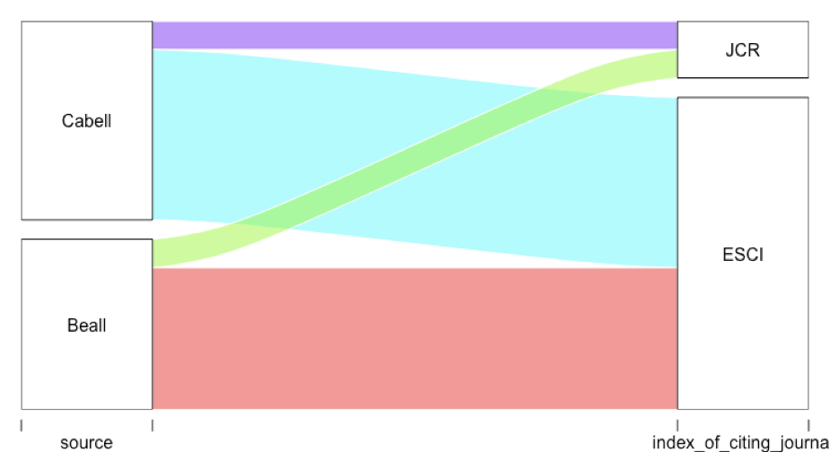
Notes:
Initial results show articles published in blacklisted journals are cited in journals indexed in Web of Science – which is considered as a database of high quality journals. It is used in many performance based research funding systems.
Thus, one can assume that the knowledge from blacklisted journals is legitimized by citing in prestigious journals.
We are talking not only about citation contamination, but also about legitimization of knowledge published in journals that were published.

Slide 12
Thank you Raf Guns Marek Hołowiecki

