Slide 1
Diversity of evaluation systems
The case of the career promotion
Michael Ochsner and Ginevra Peruginelli

Slide 2
The context
Source: Comparative study, showing the differences and similarities of national research evaluation systems and procedures in 19 countries
Evaluation is innate in research
Countries have different evaluation procedures in place
Different types of research evaluation procedures (e.g. national career promotion, excellence initiatives, performance-based funding…) and level of main evaluation procedure (national, regional or institutional)
Different combinations
Different functions
Link to political situation in country
Few countries have SSH specific adaptations

Slide 3
Researchers and evaluation
Researchers:
Are constantly evaluated during their lifetime
Know that their work is subject to evaluation from the very beginning of their life as researchers
Act also as evaluators of their peers

Slide 4
Career promotion procedure : Why is important
Research evaluation practices influence the strategic behaviour of researchers
Most of the procedure of evaluation induces researchers in developing career strategies favouring quantity over quality
Scholars should keep in mind the differences in career systems, career steps and progression:
In case they want to change their country
When collaborating with scholars from other countries

Slide 5
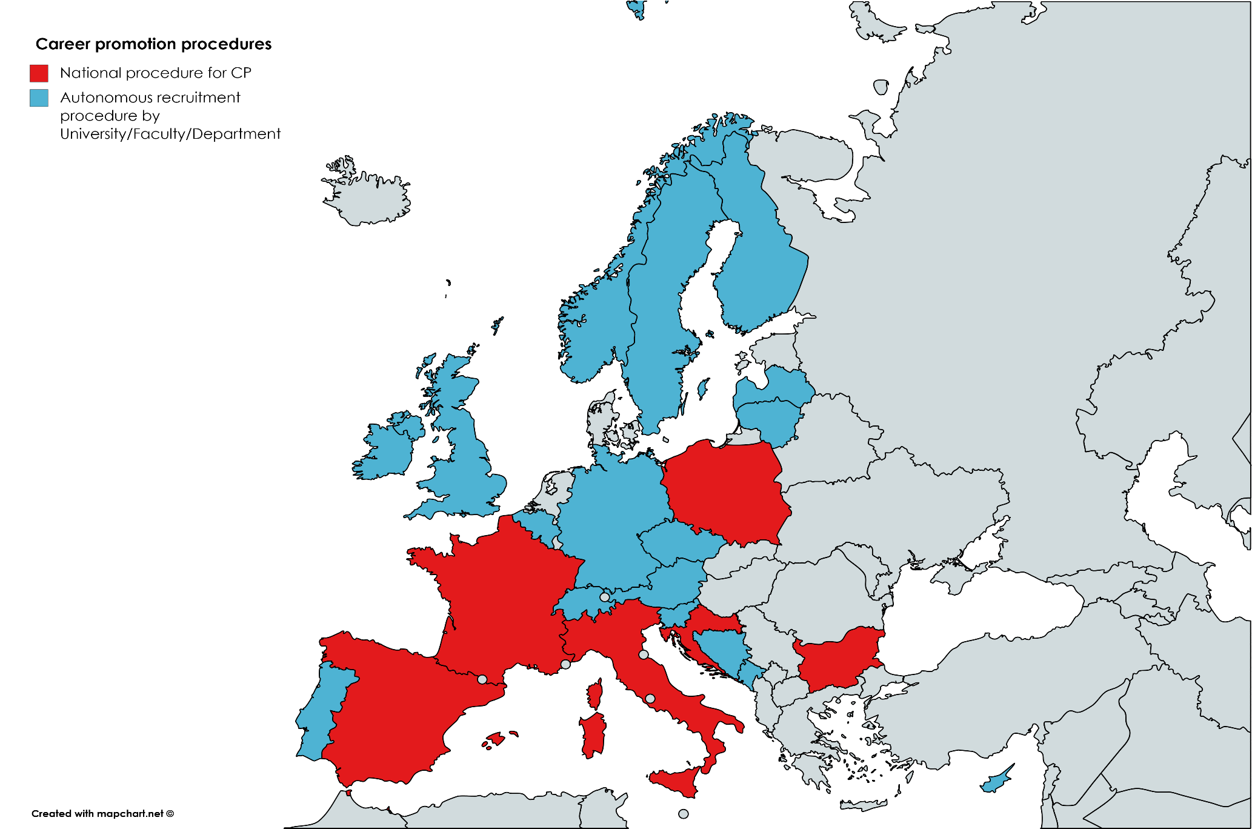
The National Evaluation Procedure for Career Promotion

Slide 6
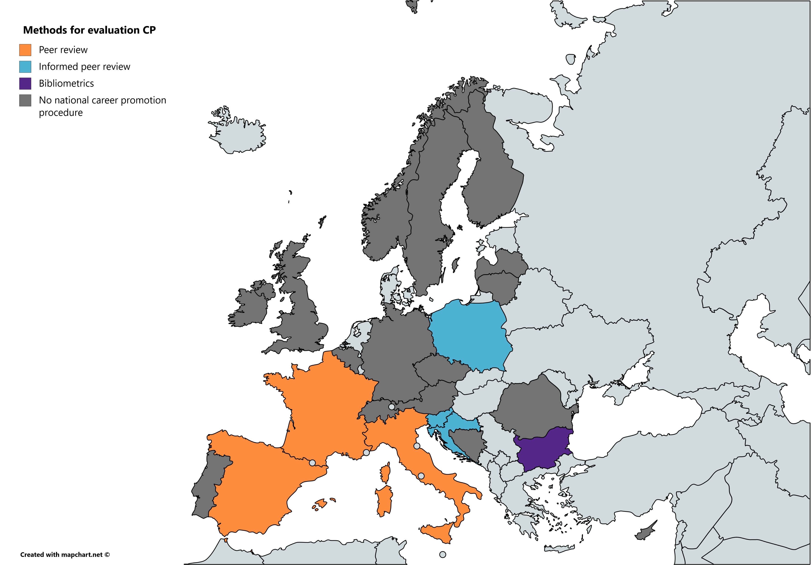
Methods for Evaluating Career Promotion

Slide 7
Recommendations for Researchers
Extraordinary diversity of evaluation procedures
Be aware that there are different approaches to evaluation and to see research quality
Make sure to follow a strategy that is compatible with many systems as you might change country
Respect the needs of your colleagues to fulfil requirements of their system (and they will work best with you if they get the acknowledgement in their system)
Critically discuss the advantages and disadvantages of the different systems and avoid negative effects on your work.
Engage to improve evaluation systems, respecting research practices
Notes:
7

