Slide 1
Peer Review, language, national and international communities
ENRESSH Dissemination Event, Paris 18 February 2020
Dr Jon Holm – Research Council of Norway

Slide 2
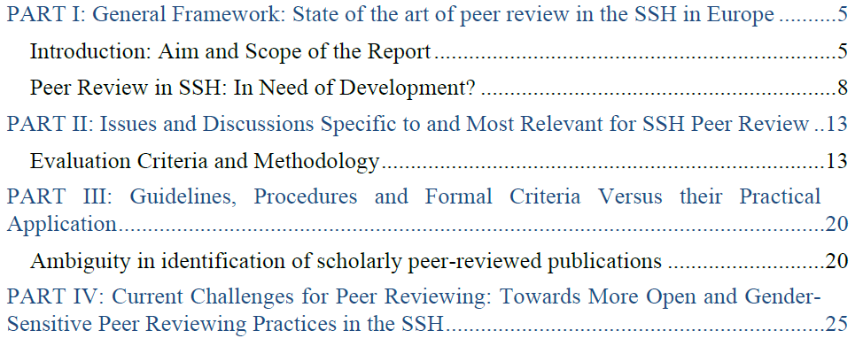
Overview of Peer Review Practices in the SSH

Slide 3
Complexity of peer review in SSH
A wide range of publication outputs: as books, reports, exhibitions … … which often addresses both academic and wider community
No mainstream approach
Diversity with regard to theoretical and empirical approaches
Different paradigms compete with and enrich each other
Discrimination of marginal topics or approaches become an issue in diverse research environments

Slide 4
The language and locality issue
Topic Language | Local & National | International
Regional & National | Topics of national interest Broad readership | Dissemination
International | Comparative research | Theory and methods

Slide 5
Evaluation of the Humanities in Norway (2017)
Put simply, because a topic of research concerns Norway, that does not mean it might not contain insights of a broader methodological or conceptual nature that could also be of interest to scholars working on related topics in entirely different countries and regions
The panel thought more could and should be done to tease out findings and implications of a general nature and to explain their significance for the historical field at large
Recommendations:
publishing more research in international journals
more comparative and transnational work
tie research more closely to international debates

