Slide 1
ENRESSH Final Meeting
Université Sorbonne Nouvelle
Paris, 17 and 18 of February 2020
Towards a methodology for assessing legal journals across countries: Italy, Spain and Croatia
Jadranka Stojanovski¹, Elías Sanz-Casado² and Ginevra Peruginelli³
¹University of Zadar, Croatia
²University Carlos III of Madrid, Spain
³Institute of Legal Informatics and Judicial Systems - National Research Council, Italy

Slide 2
INTRODUCTION: Evaluation in Law
Law as “a discipline in crisis” a “science at the crossroads” or “the odd man out in the university”.
Variety of publications addressing multiple audiences, such as courts, legislators, practitioners, and other academics
There is no European ranking of law journals, no generally accepted peer review system, no appropriate bibliometric databases, and no consensus on quality indicators for academic legal publications
Peer review process as THE main qualitative indicator of legal scholarship

Slide 3
INTRODUCTION: Evaluation of legal journals
Scholarly communication in legal sciences is influenced by a strong link between legal scholarship and legal practice
Availability of different sets of criteria for the evaluation of the quality of journals.
In Italy, such criteria are made specifically for classification of journals in no bibliometrics areas (such as law).
In Croatia and Spain, an universal set of criteria is applied to journals from all disciplines (including law).

Slide 4
RESEARCH GOALS
The objective of this study is to analyse available journal policies on peer review processes, in order to identify their characteristics.
The selection of the law journals from three countries: Italy, Spain and Croatia

Slide 5
METHODOLOGY
110 Journals were selected and analyzed (34 Croatian, 36 Spanish, 40 Italian)
For each journal, the information collected were:
Journal title (original and English language), ISSN (print and online), DOI, Publishing frequency, URL, Publisher, Language and discipline
Documents describing peer-review process: instructions for authors, instructions for peer reviewers, ethical documents, other documents
document as an unit (case), one document per journal (English, Italian, Spanish and Croatian language)
Content analysis and text mining tools:
Provalis Research software for content analysis (QDA Miner and WordStat for word frequency analysis and text mining)
automatic coding using non-validated categorization dictionary (main categories, sub-categories, words, phrases and rules)

Slide 6
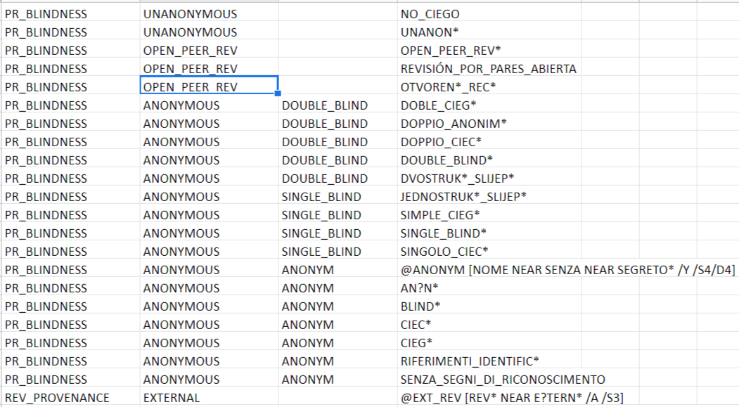
CATEGORISATON DICTIONARY: 9 categories, 40 subcategories, 335 words, phrases and rules

Slide 7
LIMITATIONS OF THE STUDY
not all Italian legal journals were included (150)
peer review process description could be short and shallow, not fully reflecting practices
peer review process description could be different from the employed peer review process (in practice)
words and phrases included in the categorization dictionary could be ambiguous
linguistic differences
categorisation dictionary was not validated
automatic, not manual coding

Slide 8
RESULTS: Category dictionary
Peer review: process and reviewers
Reviewer's characteristics: academic level, autonomy, competence, objectivity
Reviewer's provenance: external, internal
Peer review blindness: single-blind, double-blind, unanonymous, open peer review
Number of reviewers: one, two, three or more
Evaluation criteria for submissions: originality, methods, relevance, clarity, accuracy, soundness, impact, novelty, bibliography, interdisciplinarity
Peer review outcome: peer review report, reviewer's recommendations (acceptance, rejection), manuscript revisions
Ethical issues: editorial standards and codes, conflict of interests, confidentiality, research integrity, unbiased peer review
Manuscript type: original scientific article, professional article, review article, book review, etc.
CATEGORIES | FREQUENCY | %
PEER REVIEW | 1012 | 19.1
REVIEWER_CHARACT | 242 | 4.58
REV_PROVENANCE | 6 | 0.11
BLINDNESS | 161 | 3.05
REV_NUMBER | 57 | 1.08
SUBMISS_EVAL_CRITERIA | 940 | 17.80
REV_OUTCOME | 380 | 7.20
ETHICAL ISSUES | 485 | 9.19
MANUSCRIPT_TYPE | 1997 | 37.82

Slide 9
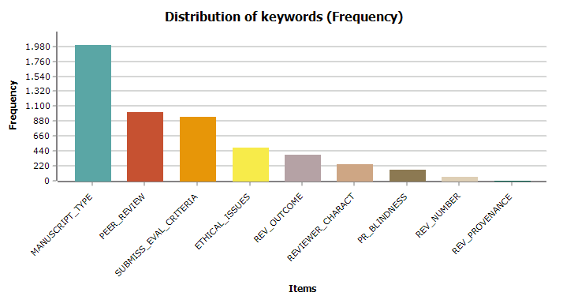
Results: All categories

Slide 10
RESULTS: Visualization of the word frequencies included in the dictionary

Slide 11
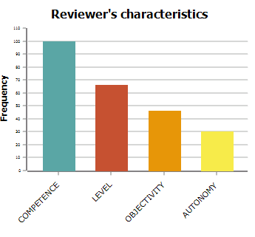
RESULTS: Reviewer's characteristics category
Subcategories | CROATIA | ITALY | SPAIN
Autonomy | 10 | 12 | 8
Competence | 15 | 58 | 27
Academic Level | 23 | 41 | 2
Objetivity | 23 | 21 | 2

Slide 12
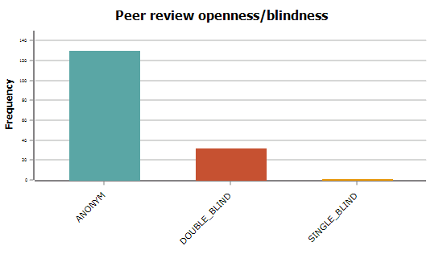
RESULTS: Openness/blindness of the peer review process category
Subcategories | CROATIA | ITALY | SPAIN
Anonymous | 24 | 82 | 22
Double blind | 7 | 15 | 10
Single blind | 1 | 0 | 0

Slide 13
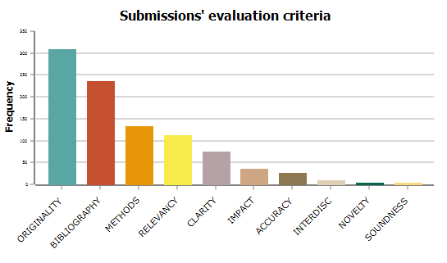
RESULTS: Submissions evaluation criteria category
Subcategories | CROATIA | ITALY | SPAIN
Accuracy | 6 | 17 | 3
Bibliography | 167 | 46 | 22
Clarity | 38 | 26 | 10
Impact | 18 | 13 | 4
Interdisciplinarity | 7 | 2 | 1
Methods | 89 | 28 | 14
Novelty | 1 | 3 | 0
Originality | 169 | 88 | 51
Relevancy | 60 | 31 | 22
Soundness | 3 | 0 | 1

Slide 14
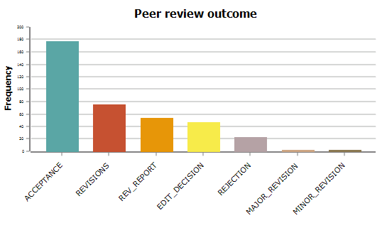
RESULTS: Peer review outcomes category
Subcategories | CROATIA | ITALY | SPAIN
Revisions | 8 | 64 | 3
Revisions/Major_Revision | 2 | 0 | 0
Revisions/Minor_Revision | 2 | 0 | 0
Rev_Recommend/Acceptance | 47 | 71 | 59
Rev_Recommend/Edict_Decision | 34 | 9 | 4
Rev_Recommend/Rejection | 12 | 2 | 9
Rev_Report | 29 | 23 | 2

Slide 15
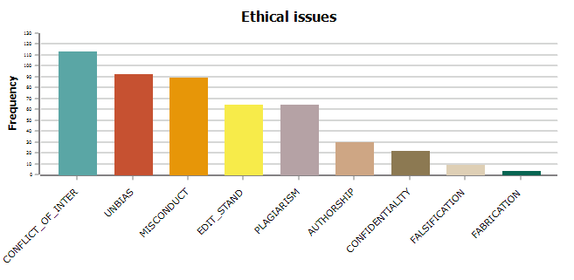
RESULTS: Ethical issues category
Subcategories | CROATIA | ITALY | SPAIN
Confidentiality | 12 | 10 | 0
Conflict of interest | 36 | 43 | 34
Editorial standards | 28 | 27 | 7
Authorship | 18 | 8 | 4
Fabrication | 1 | 0 | 2
Falsification | 3 | 0 | 6
Misconduct | 63 | 10 | 16
Plagiarism | 24 | 24 | 16
Unbias | 55 | 35 | 3

Slide 16
RESULTS: Manuscript Type
Categories | CROATIA | ITALY | SPAIN
BOOK_REV | 21 | 0 | 0
CASE_NOTE | 1 | 5 | 14
ESSAY | 0 | 23 | 0
PROFESS_ART | 35 | 0 | 0
REVIEW_ART | 11 | 0 | 0
SCHOLARLY_ART | 148 | 128 | 78
TYPE_NOT_DEFINED | 860 | 438 | 235

Slide 17
SOME CONCLUSIONS
Similarities and differences in editorial processes and peer review in the journals across the 3 countries, as well as those produced in the country itself.
Reviewer´s characteristics (Academic level in first place), Peer review outcomes (Editor’s decision in second place), in Ethical Issues (Research misconduct in first place).
I
Reviewer´s characteristics (competences in first place), Peer review outcomes (Rejection in the second place), Ethical issues (Conflict of interest in first place)
Reviewer's characteristics (competences in first place), Peer review outcomes (Revision in second place) and Ethical issues (Conflict of interest in first place)
None of the three countries consider the research methods in the top positions of Submission evaluation criteria: Croatia in third place, and Italy and Spain in fourth

Slide 18
Towards a methodology for assessing legal journals across countries: Italy, Spain and Croatia
Acknowledgment: ENRESSH STSM and our host Ginevra Peruginelli
Future research: more countries included, join us!
jadranka.stojanovski@irb.hr
ginevra.peruginelli@igsg.cnr.it
elias@bib.uc3m.es

