Slide 1
Strategies for OA publishing in the SSH
Gunnar Sivertsen
Nordic Institute for Studies in Innovation, Research and Education, Oslo, Norway

Slide 2
Share of scientific articles in DOAJ journals 2011-17. Major areas of resarch. All Norwegian institutions

Slide 3
Share of scientific articles in DOAJ journals 2011-17. Languages. All Norwegian institutions

Slide 4
I want us to discuss
What to do with book publishing
How to flip national language journals
Why and how to avoid APC (article processing charge)

Slide 5
1. What to do with book publishing (A)
Respect the traditional book market. SSH scholars collaborate as authors with book publishers in creating widely read books for
Education
Interest groups in the wider public
These books are not the end results of specific research projects, but built on personal competences that are acquired from many different activities in academic life.
Such books are distributed through book stores in the streets or on the internet.
Their revenues are returns from investment by authors and publishers in collaboration

Slide 6
1. What to do with book publishing (B)
Concentrate the OA development on books that are the end results of specific research projects.
These books are most often, but not always, of more specialized interest within the academic world
They should be distributed immediately and for free, not through expensive book stores, in order to reach all relevant readers and the highest potential of qualified scholarly criticism

Slide 7
1. What to do with book publishing (B)
Concentrate the OA development on books that are the end results of specific research projects.
These books are most often, but not always, of more specialized interest within the academic world
They should be distributed immediately and for free, not through expensive book stores, in order to reach all relevant readers and the highest potential of qualified scholarly criticism
The present business model for OA publishing of such books is problematic

Slide 8
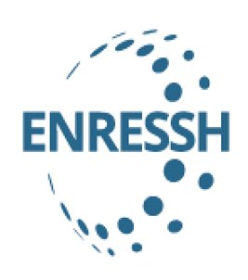
1. What to do with book publishing (B)
Concentrate the OA development on books that are the end results of specific research projects.
These books are most often, but not always, of more specialized interest within the academic world
They should be distributed immediately and for free, not through expensive book stores, in order to reach all relevant readers and the highest potential of qualified scholarly criticism
The present business model for OA publishing of such books is problematic
This problem is being addressed

Slide 9
1. What to do with book publishing (C)
Develop OA book series building on the independent journal model

Slide 10
2. How to flip national language journals
A narrow selection of only the central, most respected and most needed SSH journals publishing in the national language
No author payment
Funded partly by the government, partly by a consortium of research institutions that frequently publish in the journals
Monitored by a national panel appointed by the deans of the humanities and social sciences

Slide 11
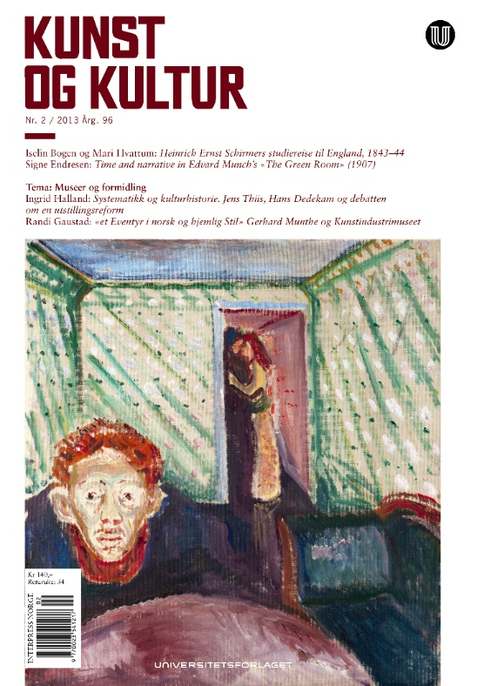
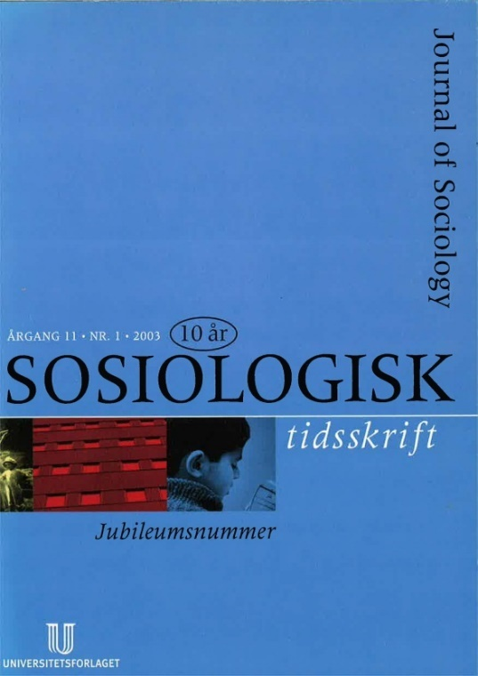
Scholarly journals in the national language (examples)
Notes:
Alle de nordiske landene har en rekke nasjonale vitenskapelige tidsskrifter som publiserer på eget språk. Her er noen norske eksempler.

Slide 12
3. Why and how to avoid APC (article processing charge)?
Why?
Journals in the SSH are fora for academic exchange, not just compilations of individual original articles from funded projects
Some of the authors are not affiliated with research institutions
APC is bureaucratic and time-consuming is small journals
How?
Make contracts with professional publishers for them to serve – and not own – the journals
Establish general subsidies for the journals and/or long-term contracts with the main institutional contributors of articles

