Slide 1
Forming the basis for the establishment of collaboration between ENRESSH and HIRMEOS
Nataša Jermen
ENRESSH WG Meeting
Podgorica, March 7th 2019

Slide 2
HIRMEOS and OPERAS:
HIRMEOS (High Integration of Research Monographs in the European Open Science Infrastructure) – 30-month EU-funded project, with the main goal to integrate OA monographs into the Open Science ecosystem in a systemic and coordinated fashion (9 partners from 6 countries)
OPERAS (Open Access in the European Research Area through Scholarly Communication) – European research infrastructure project for the development of open scholarly communication in SSH. The network includes a wide range of OA publishers and research institutions (20 partners from 9 countries)
OPERAS-D (Design) – OPERAS project (2017-2018) focused on the development of e-infrastructure for OA publications in SSH
(Deliverable: The visibility of open access monographs in a European Context: Full Report; https://operas.hypotheses.org/visibility-oa-monographs)

Slide 3
HIRMEOS:
Main objective: to enhance five European digital platforms for the publication of OA monographs (OpenEdition Books, OAPEN Library, EKT Open Book Press, Ubiquity Press and Göttingen University Press) and to ensure their interoperability by adopting common standards
Publishing platforms will be enriched with services and tools that enable identification, authentication and interoperability (DOI, ORCID, Fundref), certification (peer review process and licence information), entity extraction (INRIA NERD), annotation (Hypothes.is), gathering usage and alternative metrics data

Slide 4
Usage metrics and altmetrics:
HIRMEOS metrics service will enable the measurement of impact and resonance of OA monographs – still at the developmental stage in Open Book Publishers and Ubiquity Press
The service will provide:
Metrics for views and downloads
Altmetrics and citation metrics
Widget to display all metrics on the partners’ website (including annotation metrics developed by HIRMEOS annotation service )

Slide 5
STSM objectives and activities:
Main objectives:
to confront the aim of HIRMEOS project to prototype innovative metrics service for OA scholarly monographs, which will pave the way to new potential tools for research assessment
to stimulate further research concerning book metrics
Main activitiy:
to analyse the governance and designing of the HIRMEOS service aimed at collecting and visualising metrics and altmetrics for OA scholarly monographs, in addition to the tools and data gathered and presented on the Open Book Publishers and Ubiquity Press publishing platforms
Host institutions: Open Book Publishers, Cambridge; Ubiquity Press, London
Host researcher: Dr. Rupert Gatti

Slide 6
Ubiquity Press (UP):

Slide 7
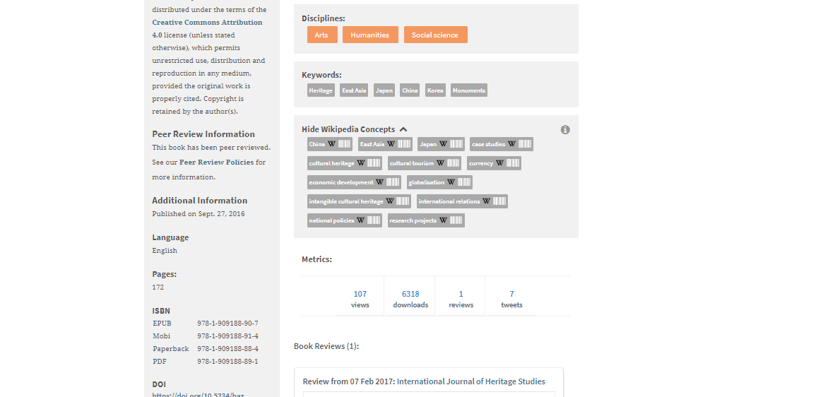

Slide 8
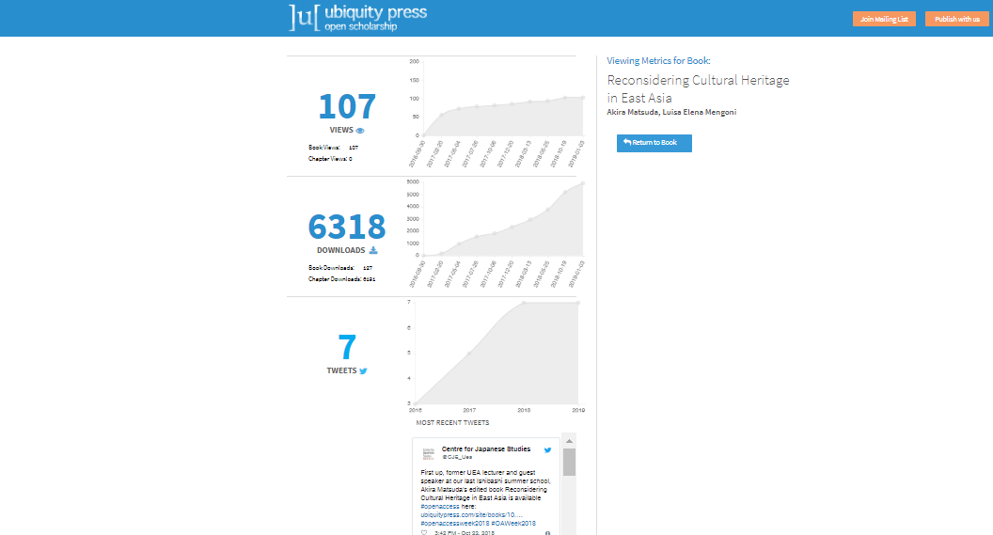

Slide 9
Open Book Publishers (OBP):
OBP has used usage metrics to demonstrate:
Levels of engagement with content
Geographic reach of published content
Differences in engagement/popularity by format
Engagement with publications over time
University usage for reports to libraries

Slide 11
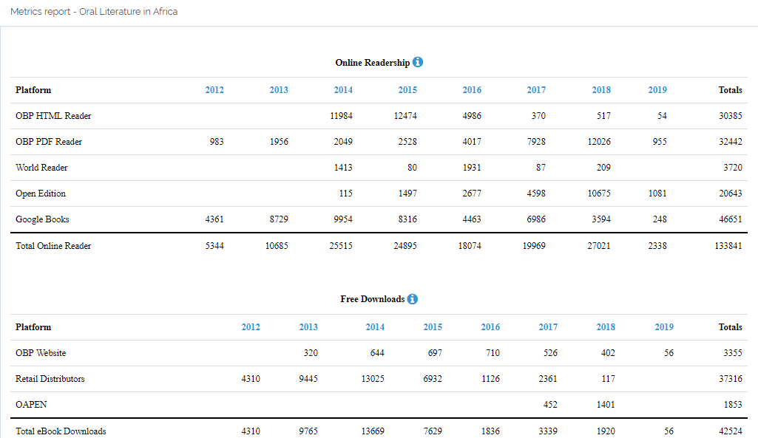

Slide 12
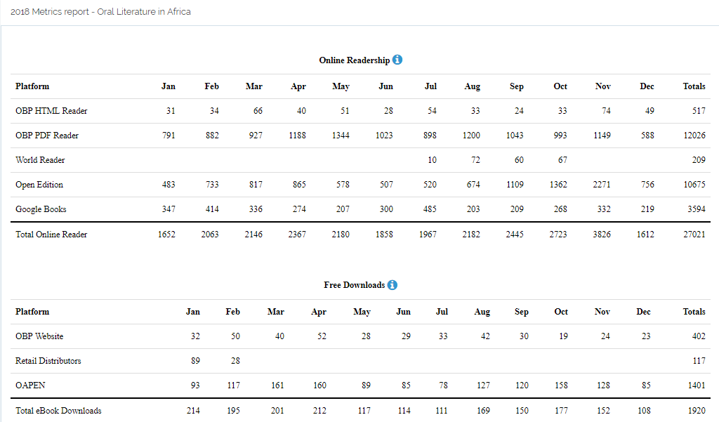

Slide 13
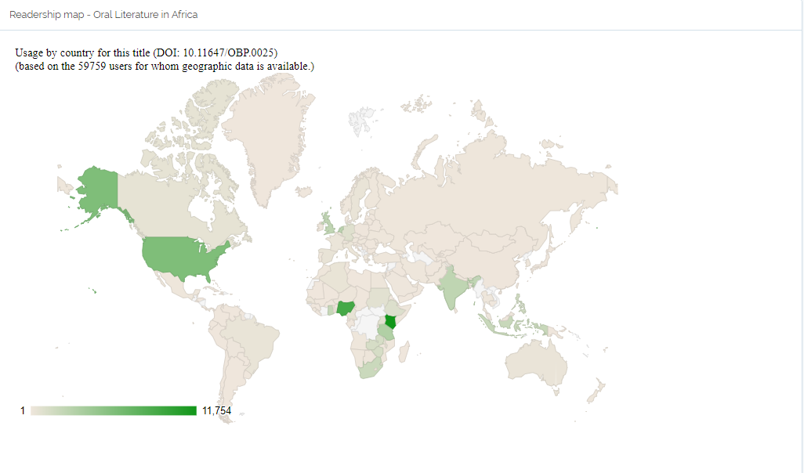

Slide 14
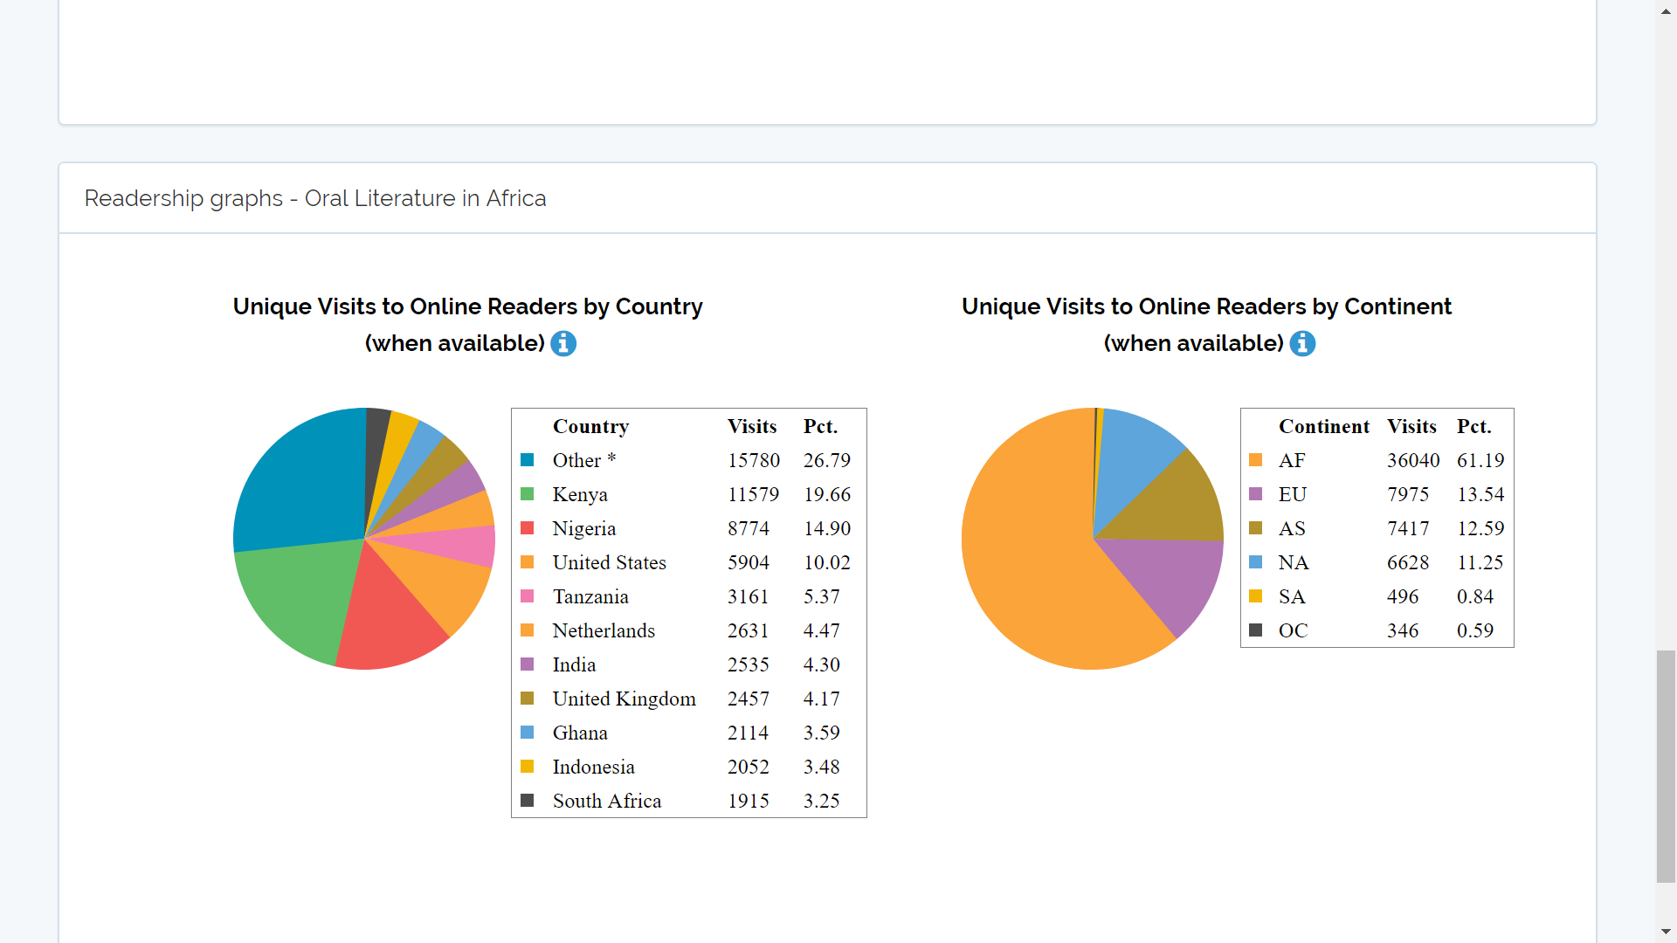

Slide 15
Analysis of the usage of Oral Literature in Africa:
Over 170 000 views since 2012
Over 60% of online users come from Africa (Kenya, Nigeria, Tanzania)
Online readership has not tailed off in seven years since publication - but book downloads seem to have peaked in 2014
On the OBP website – relative popularity of HTML and PDF readers has varied over time
OpenEdition is becoming an increasingly important discovery/access platform for online users
Free downloads from retail distributors (Amazon & Google Play) have been significant

Slide 16
Survey on OA book usage:
In 2017 OPB was involved in a study which aimed to understand how free ebooks are discovered, acquired, and used by users
Over 830 responses from OBP titles and around 30 from University of Michigan Press
OA books do seem to be reaching readers outside the academy:
50% of users acquired the book for “personal” use, with 44% “for my job,” and 6% for “course use;” 82% had graduate degrees and 62% were between 31 and 60, 29% were over 60, and 9% were 18-30
20% of respondents identified themselves as having established academic positions, with an additional 10% identifying employment within a library or university administration; 34% of respondents identified non-university related employment

Slide 17
Survey on OA book usage:
OA amplifies the diversity of different uses that ebooks already facilitate:
Skimming, reading in detail, rarely reading the whole book, sharing (15% of the respondents planned to share the work) − reinforces the importance of social media and online communities in spreading the word about OA books
Social media and “word of mouth” is extremely important in discovery:
Over 35% of the respondents learned about a work from Twitter (15%), Facebook (9%), LinkedIn (8%), or Academia.edu (3%); email recommendations were probably the most common source of discovery; traditional modes of discovery such as reviews in journals and citation tracking - in a small percentage of cases
More in: Watkinson, C. et al. (2017): Mapping the Free Ebook Supply Chain: Final Report to the Andrew W. Mellon Foundation. https://deepblue.lib.umich.edu/handle/2027.42/137638

Slide 18
Danger with metrics:
OPB – three different ways of measuring usage on the website: Google Analytics, Matomo and direct analysis of weblogs (COUNTER); they report GA to the website, COUNTER to libraries
GA vs Counter: monthly usage metrics shows 25% difference (Oral Literature in Africa)
Huge number of bots which are screened out of the statistics
Downloads vs. online readers
Volume vs. chapter data
Missing lots of data
Aggregating into single number
Chasing the metrics (gaming the statistics)

Slide 19
HIRMEOS metrics service:
Altmetrics and citation metrics:
Altmetrics service will record the following measures for books: tweets, Wikipedia quotes and annotations. UP will host, manage and maintain this system and make it available as a service to other platforms (source code, APIs, and standards will be published Open Source).
Citation service – driver that collects data form Crossref developed by UP
Usage metrics (downloads and views):
OPB developed its own software capable of collecting, processing, and standardizing usage metrics from third-party platforms (sofware is provided Open Source to allow its reuse)
Widget: Developed by Knowledge Unlatched Research

Slide 20
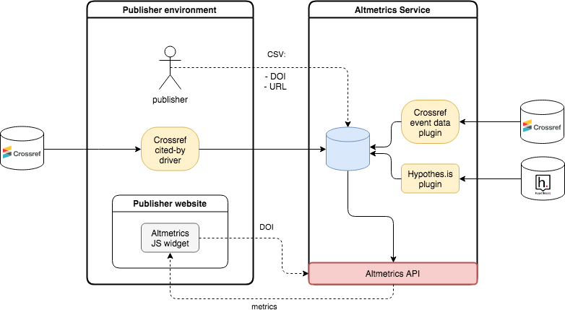
Altmetrics flow diagram:

Slide 21
Metrics flow diagram:

Slide 22
Conclusion:
HIRMEOS:
aims at buidling the service that will connect and gather metrics on OA scholarly monographs in SSH from different publishing platforms
metrics service will enable integration and standardisation of data, their anaysis and potential use for the research assessment
publication system remains open to the participation of other platforms
project will contribute to accessibility and visibility of OA scholarly monographs in SSH

Slide 23
The outcome of STSM:
overview of the HIRMEOS project
analysis of the HIRMEOS publishing platforms
case study on Twitter usage of a book recently published by Open Book Publishers (in progress)
analysis of the governance and designing of the HIRMEOS metrics service
establishment of the collaboration between ENRESSH and HIRMEOS (OPERAS)
(further steps: assessment of the HIRMEOS metrics service)
writing a case study on Twitter usage of a book recently published by Open Book Publishers (for the publication at the Open Book Publishers Blog).
the long-term goal further development of alternative metrics for the evaluation of scholarly monographs and recommendations for the implementation and usage of the HIRMEOS metrics service in the research assessment.
The assessment of the HIRMEOS metrics service will be performed after the implementation of the service on the HIRMEOS publishing platforms.

Slide 24
Thank you for your attention!
Nataša Jermen
The Miroslav Krleža Institute of Lexicography
Zagreb, Croatia

