Slide 1
Open access challenge at national level: comprehensive analysis of publication channels used by Finnish researchers in 2016-2017
Janne Pölönen¹, Raf Guns², Emanuel Kulczycki³
and Gunnar Sivertsen⁴
¹Federation of Finnish Learned Societies, Snellmaninkatu 13, 00170 Helsinki (Finland)
²University of Antwerp, Centre for R&D Monitoring, Middelheimlaan 1, 2020 Antwerp (Belgium)
³Adam Mickiewicz University, Scholarly Communication Research Group, Szamarzewskiego 89c, 60-568 Poznań (Poland)
⁴Nordic Institute for Studies in Innovation, Research and Education (NIFU), P.O. Box 2815,0608 Tøyen, Oslo (Norway)
ENRESSH-meeting
7-8 March 2019, Podgorica

Slide 2
Background
International and national Open Access agendas (European Commission, Plan S, national policies)
Ambitious OA targets: in Finland 65% in 2017, 75% in 2018 and 100% in 2020
Majority of channels currently do not support OA → either flip to Golden or Green OA model or replace with existing or new OA channels
Most attention to journal publishing and role of big publishers
Web of Science and Scopus do not provide full picture of OA publishing
Grand challenges at the national level:
What share of peer-reviewed output is published as OA and in how many and what kind of channels.
Infrastructure, tools and resources needed for flipping national journals that are crucial especially in SSH scholarly communication.
Integration of book publications into the OA scholarship

Slide 3
Aims of the study
The aim is to provide a comprehensive picture of open access publishing in Finland, including all channels, publication types and fields.
Data consists of complete national peer-reviewed output of 14 Finnish universities in 2016-2017 stored in the VIRTA Publication Information Service.
Each publication record contains an indication if it is openly available in Gold or Hybrid OA channel and/or if it is deposited in OA repository.
On basis of this information we investigate:
Publication channels with full, partial or no open availability
DOAJ, Sherpa/Romeo, and open availability of outputs in journals/series
Open availability of book publications vs. journal articles
Open availability with book publishers vs. journals/series
The role of largest commercial publishers
OA levels across fields

Slide 4
VIRTA publication data 2016-2017
10342 PUBLICATION CHANNELS
9500 JOURNALS/SERIES |  |  |  |  |  | 842 BOOK PUBLISHERS
48177 PEER-REVIEWED OUTPUTS
34507 JOURNAL ARTICLES |  |  |  | 6283 CONFERENCE ARTICLES |  |  |  | 7387 BOOK ARTICLES, MONOGRAPHS AND EDITED VOLUMES
ALL FIELDS OF SCIENCE
NATURAL SCIENCES |  | ENGINEERING |  | MEDICINE |  | AGRICULTURE |  | SOCIAL SCIENCES |  | HUMANITIES

Slide 5
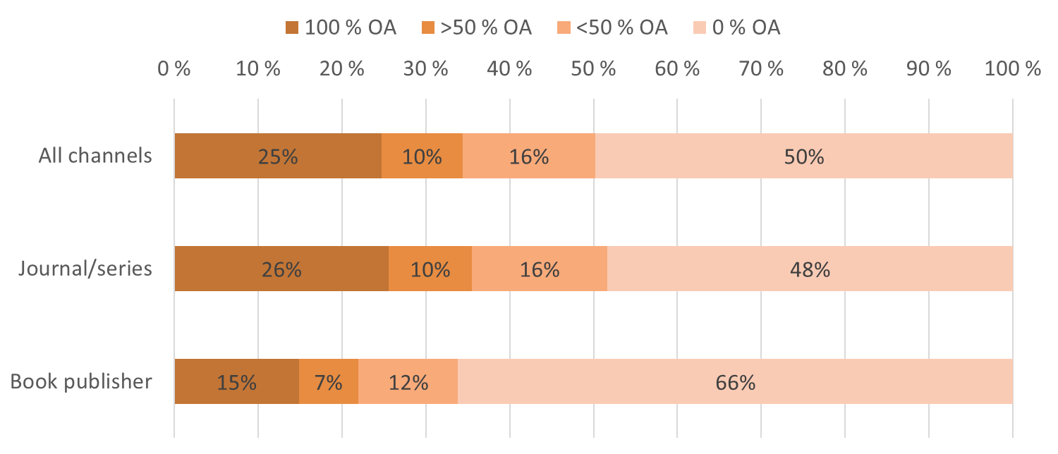
Open Availability across Channels
According to VIRTA OA info, in 25% of channels all Finnish outputs are OA, while in 50 % of channels all outputs are NOT OA
Clear differences between journals/series and book publishers

Slide 6
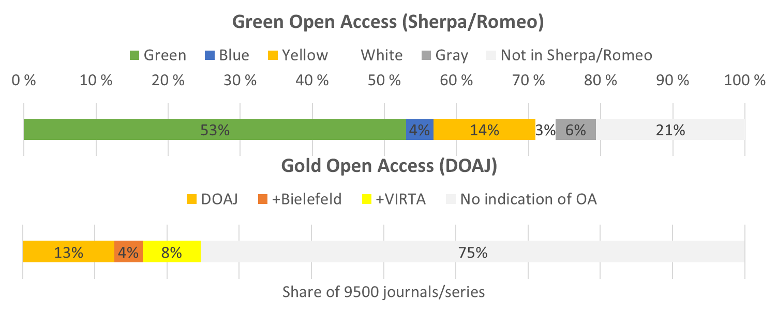
Journal Open Access Information
Sherpa/Romeo covers 79 % all journals/series used by Finnish researchers
DOAJ covers 13 %, Bielefeld additional 4 % and VIRTA 8 %
37 % (767) of potential Gold OA journals/series not in DOAJ or Bielefeld list

Slide 7
Open Availability and Sherpa/Romeo
Unless the journal/series is also Gold OA, relatively small share of outputs is OA, irrespective of the self-archiving policy
Gap between potential and uptake of Green OA

Slide 8
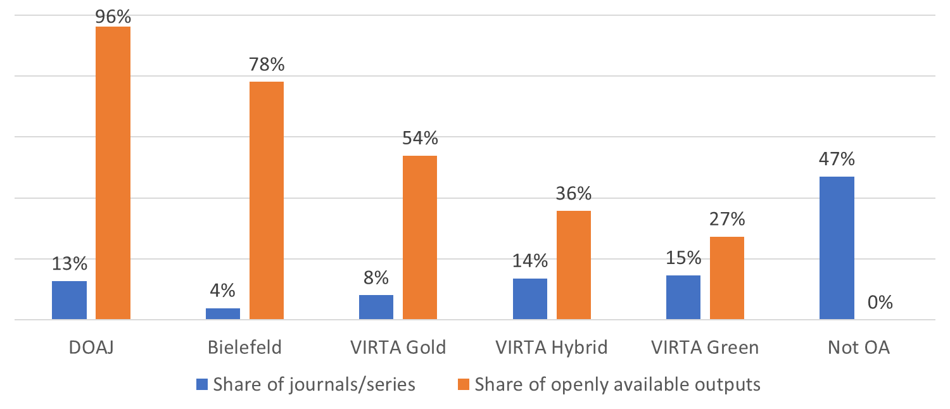
OA levels in Gold, Hybrid & Green journals/series
OA levels differ considerably according to OA status of the journal/series
Gold 96 % - 54 %, Hybrid 36 % and Green 27 %

Slide 9
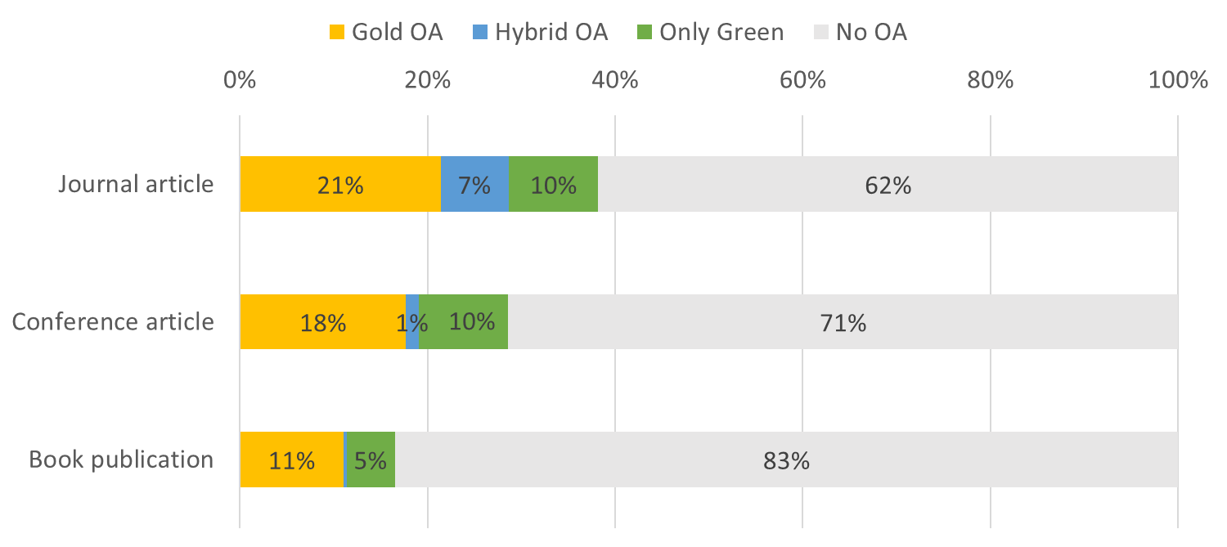
Journal vs. book publications
OA levels higher among journal articles (38 %) than book publications (17 %)
All OA types are less frequent among book publications (especially Hybrid)

Slide 10
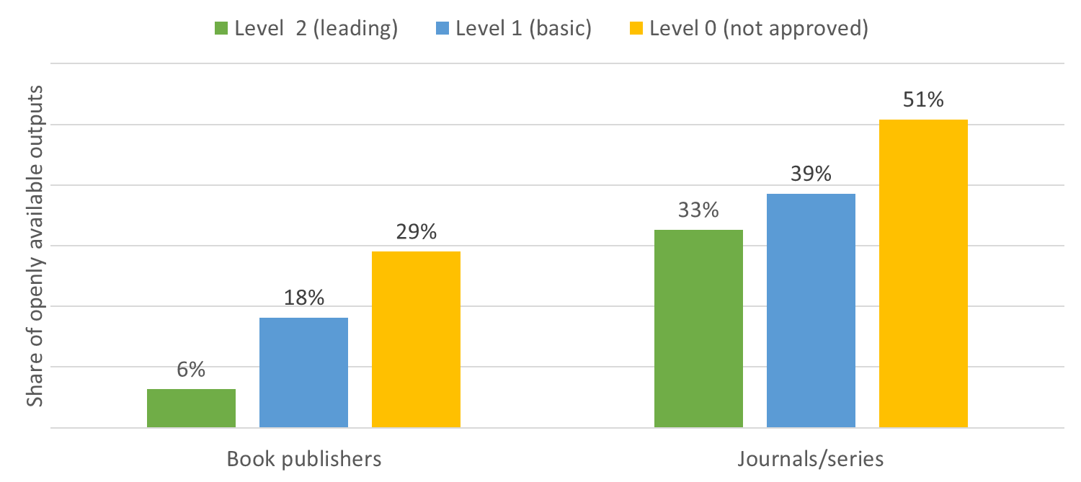
Open availability and channel prestige
In leading channels (level 2) OA levels are lower
Difference between leading and basic journals/series is small
3438 3221 1279
13450 24267 2522

Slide 11
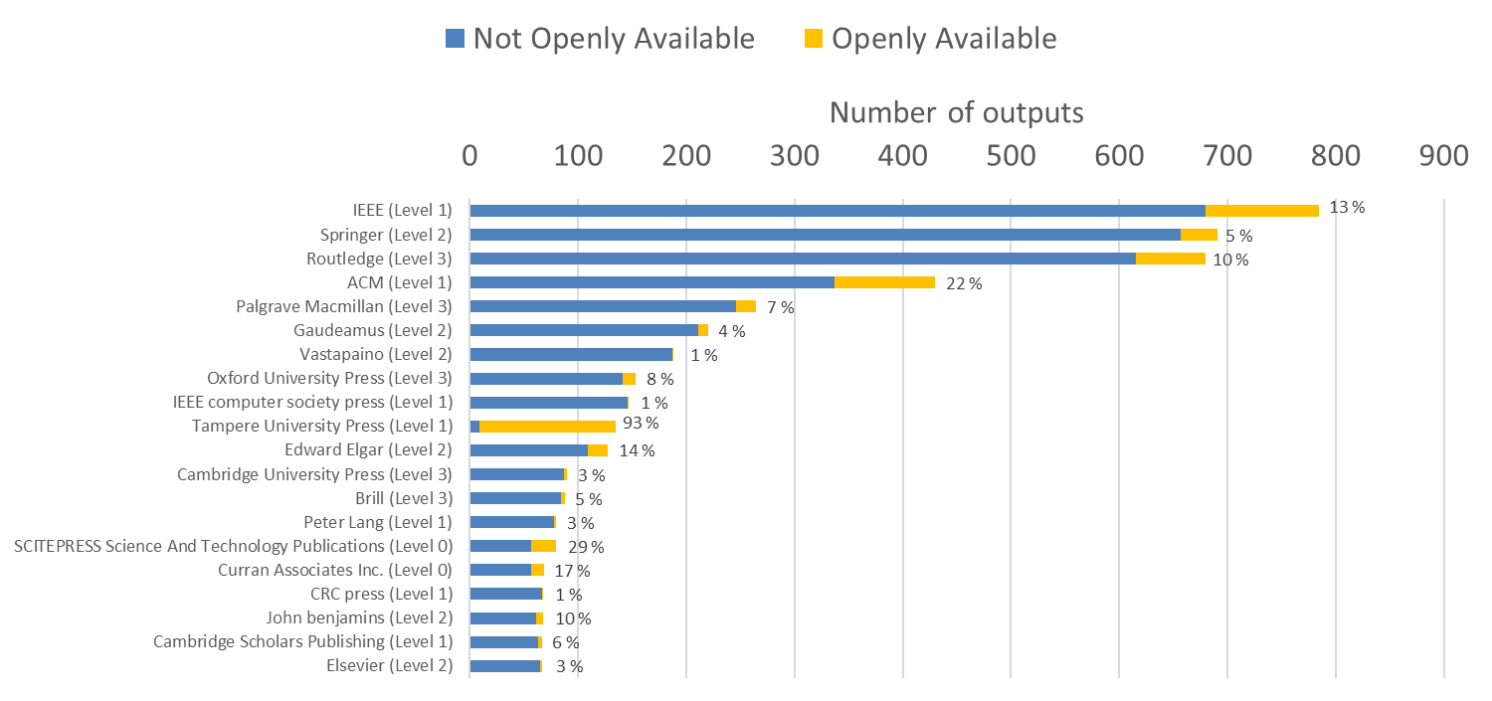
Problematic OA status of book publishers
Among the 20 most used publishers only Tampere Univ. Press is almost 100 % OA
More consistent information needed on book publishers OA status and policies

Slide 12
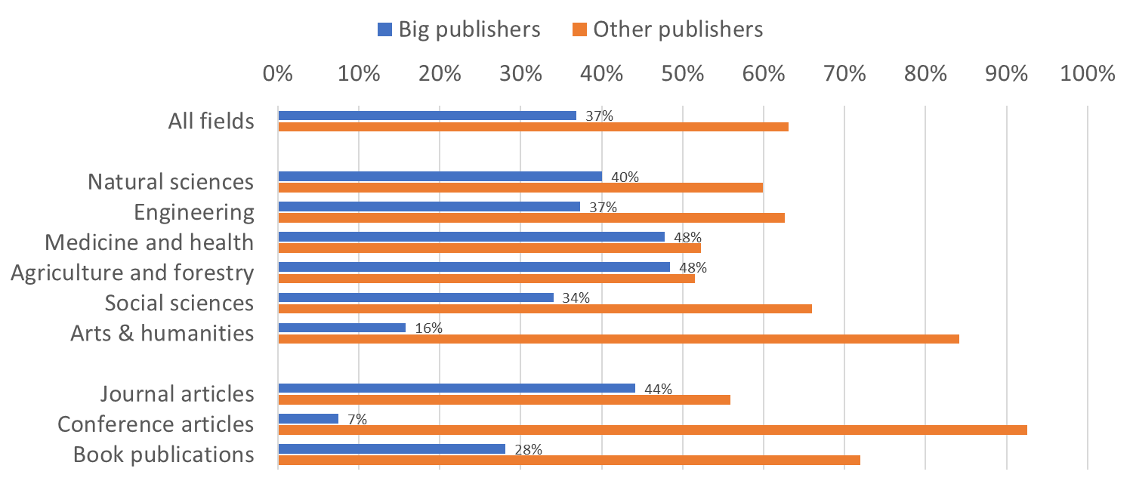
Big Publisher Dominance?
Elsevier, Springer Nature, Wiley-Blackwell, Taylor & Francis, Sage and American Chemical Society account for 37 % of peer-reviewed outputs
Dominance is less pronounced in SSH

Slide 13
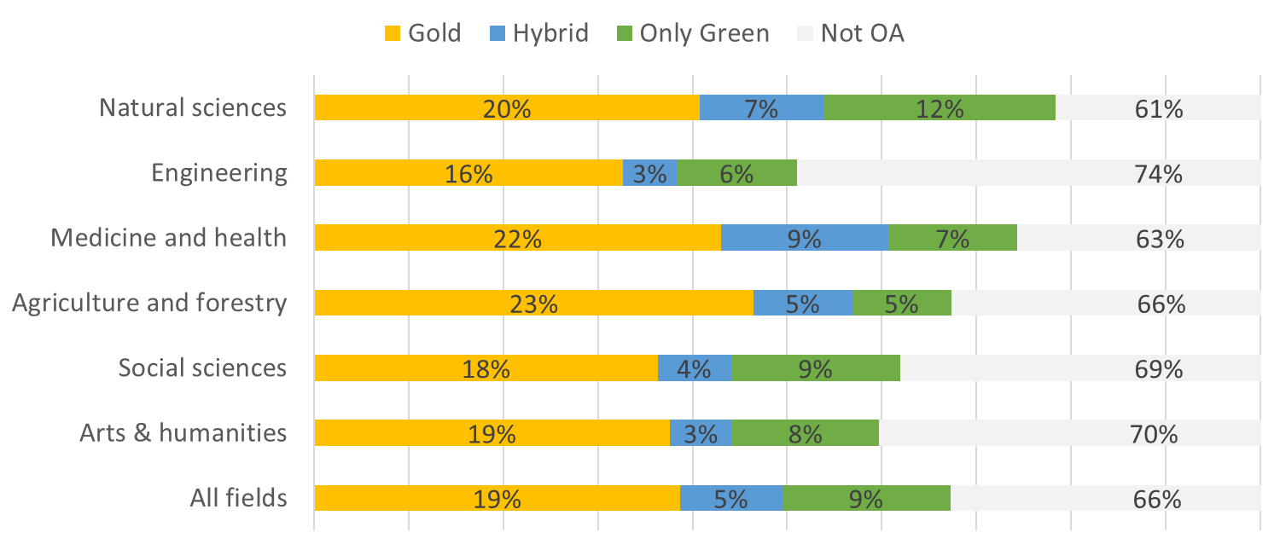
Share of Openly Available Outputs
The share of openly available outputs is 34 %.
Range from 39 % in the natural sciences to 26 % in engineering.
The share of Gold 19 %, Hybrid 5 % and (only) Green 9 %.

Slide 14
Conclusions
Flipping or replacing currently used channels presents a challenge:
Around 2500 currently used channels provide of full OA of Finnish outputs.
Around 2500 provide for partial OA.
Around 5000 should either flip to Gold or Green OA or be replaced.
34 % of all outputs currently OA, social sciences 31 % and humanities 30 %
Green and Hybrid OA are less effective than Gold OA
DOAJ covers 13 % of 9500 journals/series used by Finnish researchers
DOAJ covers 53 % of potential Gold OA journals, +Bielefeld 10 %
The Big 5 dominate with 37 % of the output, but less in SSH (compare Larivière et al., 2015)
OA levels lower among book publications than journal/conference articles
Register with information on book publishers’ OA status and policies needed

