Slide 1
European databases for research output
The role of disciplinary classifications
Comparison of classification-related differences in the disciplinary structure of social sciences and humanities in Flanders and Norway (2006-2015)
Linda Sīle, PhD Student in Social Sciences
Podgorica: March 7, 2019

Slide 2
Outline
The problem of comparability
The study
Results

Slide 3
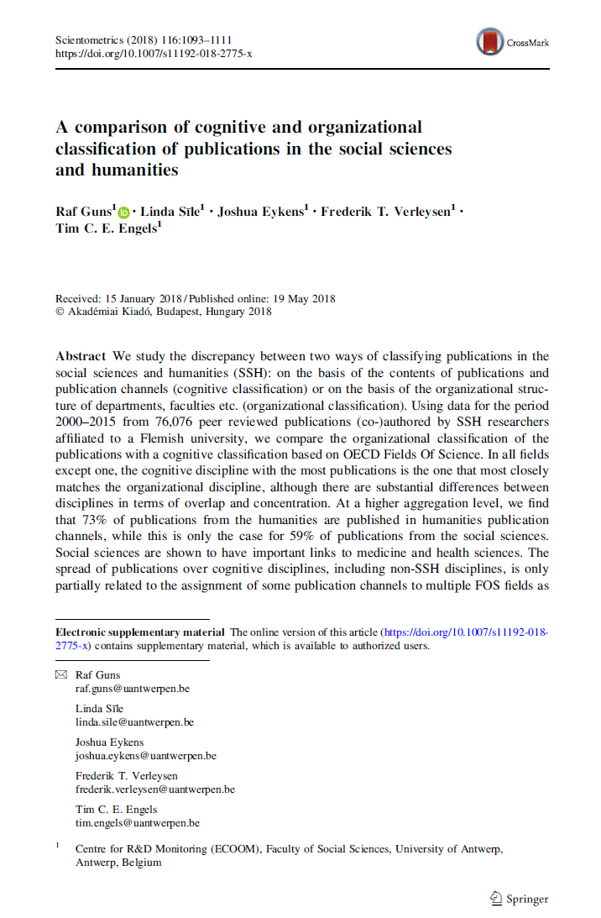
Which academic discipline?

Slide 4
The problem of comparability

Slide 5
The problem of comparability
for 11 of 13 national databases
national disciplinary classification scheme
for 3 databases
the classification is based on OECD Fields of Research & Development
Sample: COBISS, CROSBI, RIV, IHSZOLD, RINC, CREPČ, BFI, MTMT, CRISTIN, VABB-SHW, PBN, VIRTA, SWEPUB.

Slide 6
The problem of comparability
Communication studies a discipline in social sciences or humanities?
Psychology a discipline in social sciences or health sciences?
Anthropology distinct discipline or a subcategory within sociology?
Science studies other social sciences?

Slide 7
“classificatory activities reproduce the pattern of social inclusions and exclusions” (Bloor 1982, p. 267)
“to communicate information in the aggregate, we must first classify”
(Bowker and Star 2000, p.68)

Slide 8
The study

Slide 9
to what extent the choice of disciplinary classification influences bibliometric representations of research in social sciences and humanities?

Slide 10
Bibliometric comparison
Data sources: VABB-SHW and Cristin
Sample: peer-reviewed journal articles in SSH by authors affiliated to universities (2006-2015)
Sample size: n_{Flanders} = 29’648, n_{Norway} = 26’007
Four classifications (mapped on OECD FORD):
VABB-SHW cognitive classification
NPI journal classification
Science-Metrix journal classification
Web of Science Subject Categories
A
B
C
D

Slide 11
Differences in the structure of 4 disciplinary classifications
 | VABB-OECD | NPU | SM | WOS-SC | OECD-FORD
Number of levels | Two | Two | Three | One | Two
Number of SSH categories in level 1 | 2 | 2 | 2 | - | 2
Number of SSH categories in level 2 | 17 | 35 | 6 | - | 14
Number of SSH categories in level 3 | - | - | 43 | 76 | -
Assignment of categories | Multiple | One | One | Multiple | -

Slide 12
Bibliometric comparison
For datasets B, C, D:
B: WoS versus original classification
C: Science-Metrix versus original classification
D: WoS versus Science-Metrix classification
How does the distribution of publications across disciplines change depending in relation to the classification?
How does the share of publications in a discipline change in relation to the classification?

Slide 13
Findings I: the level of knowledge domains

Slide 14
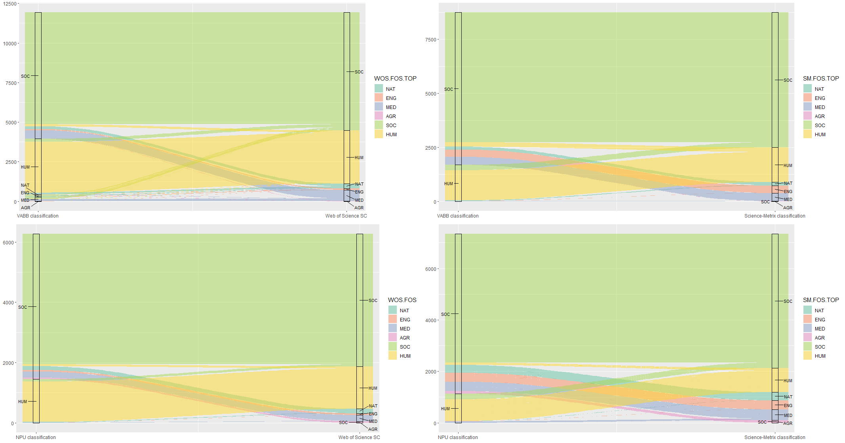
Overview of co-occurrence frequency for classification pairs: knowledge domains

Slide 15
Findings II: the level of academic disciplines

Slide 16
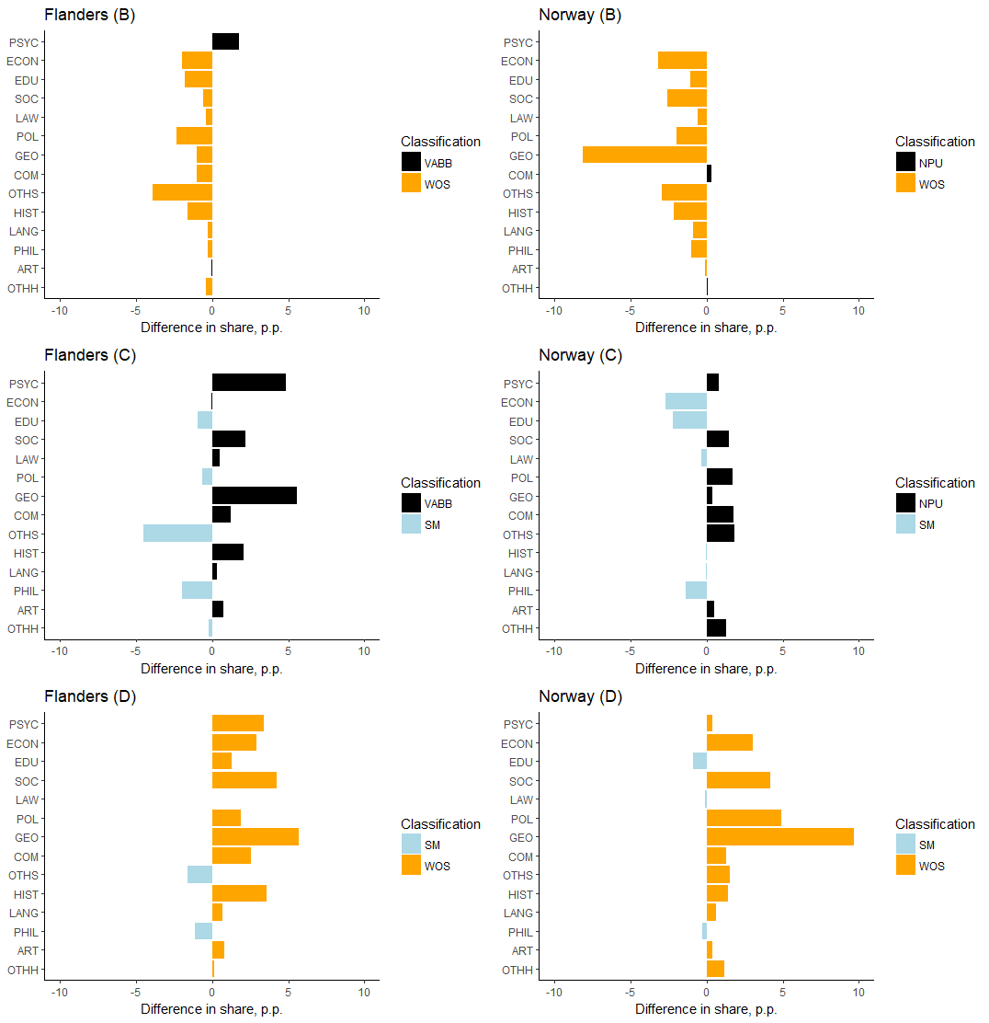
Differences in the share of journal articles across SSH disciplines

Slide 17
In short
Higher levels of aggregation: differences are modest.
Lower levels of aggregation: differences are minor.

Slide 18
Thank you
For more information:
Linda.Sile@uantwerpen.be

