Slide 1
“Introduction to Careers & Social Impacts in SSH : an conceptual and empirical introduction”
Presentation to ENRESSH WG2 meeting, 7 March 2019, Podgorica, Montenegro
Paul Benneworth, Department of Business Administration, Høgskulen på Vestlandet, Norway (& CHEPS, University of Twente, the Netherlands )
Julia Olmos Peñuela, Department of Management, University of Valencia, Spain (& INGENIO, CSIC-UPV, Spain)

Slide 2
Acknowledgements
The European Network on Research Evaluation of the Social Sciences and Humanities (CA15137)
COST (European Cooperation in Science and Technology)
Respondents to the questionnaire
Julia, Marta, Rita, Reetta, Corina, Brad, Stefan
COST (European Cooperation in Science and Technology) is a pan-European intergovernmental framework.
Its mission is to enable break-through scientific and technological developments leading to new concepts
and products and thereby contribute to strengthening Europe’s research and innovation capacities.

Slide 3
Evaluation as a governance technology
reviewers
audience
partners
colleagues
Drawing here on a mid-level theory of science steering (Glaser, 2012)
Science advances via extended communities working in parallel
Coordination critical: achieved via shared understanding of ‘goodness’
Retrospective judgements of past activities
Ongoing attunement of contemporary practices
Prospective anticipation of future peer judgements
Past projects
Current research
Project plans
Future avenues
Retrospective
Formal evaluations
Journal peer reviews
Tenure/ promotion committees
Ongoing
Interim evaluation
Project partners
Conference papers
Seminars
Social media
Prospective
What will reviewers/ funders find ‘good’ about the ideas I want to have
Scientist

Slide 4
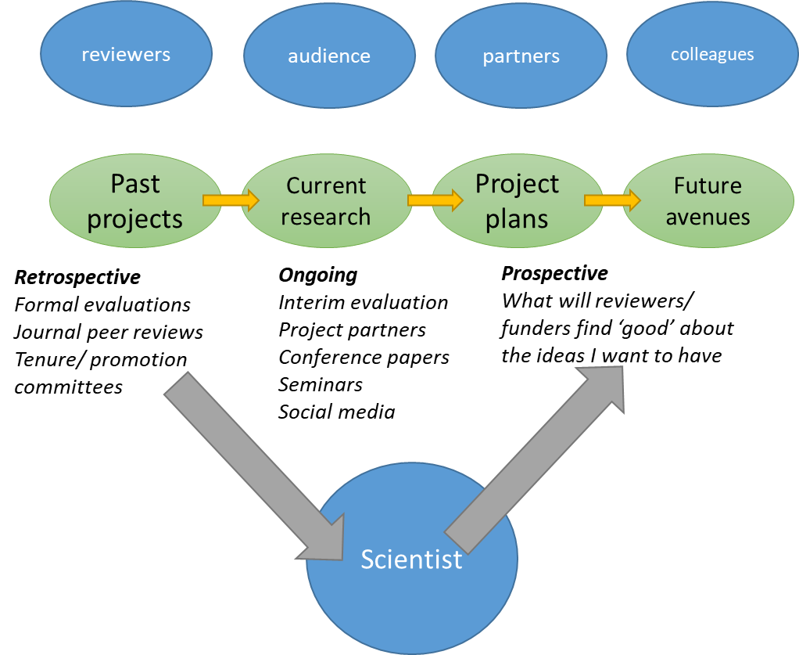
Scientific decision-making and steering in a well-functioning science system
Scientists play multiple roles simultaneously
Scientists are path-impregnated (Knorr-Cetina, 1981)
Scientists cluster around common definitions of ‘goodness’
codified in ‘landscape features’
reproduced in epistemic communities
Regulated by scientists
Landscape features: journals, imprints, proceedings, standards, protocols
Epistemic community: learned societies, conferences, research networks, Standing Commissions

Slide 5
The evaluation challenge as providing effective steering signals
Good evaluation practice steers scientists to more ‘good’ things
Ideal as complement/ reflection of existing signals (e.g. cites)
Providing reliable signals to shape good practice
Authentic & achievable:
Reflecting everyday/ not extraordinary performance (Sivertson, 2019)
Molas Gallart (2014) – risk of multiple reasons for evaluation
Challenge of Finance Ministry led interest in research efficiency
Imposition of external ideas of what is ‘good’ research
Hybridisation of evaluation
‘Orphan disease charity panels’
Vs. users making excellence calls

Slide 6
Evaluation and the complexity of steering science governance networks
Long-term nature of steering effects: shift is generational effect (Ziman, 2003)
Matthew Principle & mimicry: ‘goodness’ based partly on who is doing good work
Sensitivity: ad hoc judgements can become ‘landmarks of the field’ / exert substantive power
Scientific governance also a field of power: barriers to entry, sunk costs, scientific capital
Risk of tunnel vision/ bubbles forming (e.g. Willsdon UK biotechnology)
→ Need for authentic signals of judgements to minimise the risks of pursuing false leads

Slide 7
Distortion in behaviour and practices as a result of contemporary definitions of ‘excellent’ research
These evaluation-derived problems are now creating acute distortions in science behaviour because so much funding is channelled to excellence
Journal juicing & drone journal capture
Questionable research practices around “p-hacking”- significance bias positive feedback loops.
Salami Slicing and the ‘minimum publishable unit’
Coercive citations: my audience want to read research that is relevant to them (cites research published in my journal)
Excessively specialised contributions optimised to a journal requirements and not general scientific welfare.
Citation “husbandry” to boost metrics (h-index)
(Martin, 2013; Hall & Martin, 2018)
Notes:
As a result of this contemporary definition of excellent research, we can observe an increasingly amount of scientific malpractices such journal juicing, p-hacking, salami slicing or coercitive citations, just to mention some of them. As indicated by Hall and Martin in their 2018 paper about research misconduct, , some of this kind of these practices fall under the category of Blatant (BLEITANT) misconduct, inappropriate conduct or questionable conduct.
All these malpractices suggest that we have to link come up with a better way of defining excellence in terms of what matters for the scientific community and not what is easily counted.
************************************ Martin, B. R. (2013). Whither research integrity? Plagiarism, self-plagiarism and coercive citation in an age of research assessment.
Hall, J., & Martin, B. R. (2018). Towards a taxonomy of research misconduct: the case of business school research. Research Policy.
Contemporary definitions of ‘excellent’ research can lead to distortions in behaviours and practice
These problems are now creating acute distortions in science behaviour because so much funding is being channeled to excellence
Journal juicing & drone journal capture
Questionable research practices around “p-hacking”- significance bias positive feedback loops.
Salami Slicing and the ‘minimum publishable unit’
Coercive citations: my audience want to read research that is relevant to them (cites research published in my journal)
Excessively specialised contributions optimised to a journal requirements and not general scientific welfare.
Citation “husbandry” to boost metrics (h-index): to be very selective about what you do….

Slide 8
What are the effects of these signals on researchers in the ‘formation stage’?
Signals are received primarily prospectively
Making decisions now in anticipation of their future effects
Managing current activities to optimise future opportunity
Influences skills learned/ which trajectories pursued
Effects may only be evident after a generation
When supervisors/ mentors are all formed on these paths
Contemporary situation of conjunction of increased:
Intensity of evaluation across research systems
Stakes (academic precarity)
Expectations (‘all must be excellent’)
Breadth of evaluation (excellence, engagement)
Workload (junior mental health crisis)
→ Very complex environment to anticipate/ unexpected effects

Slide 9
“CARES (Careers and Research Evaluation Systems for societal impact)”
How is increased emphasis on evaluation of research impact affecting early career researchers in SSH?
ECR → formative stage
Evaluation → prospective anticipation
SSH → risk of exogenous signals
Impact → additional agenda
Career → “publish or perish”
Need for sensemaking of a complex environment with unknown categories/ connections
Exploratory data gathering to get information on potential categories and connections
Identifying areas of influence/ micro-dynamics of decision-making
Stylised facts of “impact evaluation” & ECRs

Slide 10
Preliminary sensemaking activities
Instrument developed for data-gathering
Brainstorm (07.18)
N=1 feedback (08.18)
N=18 group coding session (11.18)
N=102 final analysis (02.19)
Distributed via ENRESSH WG2 network + contacts
Non-representative
Seeking interesting examples
Identifying factors that influence (career) decision making
Hierarchies, disciplinary norms and power in academia: impact as emancipation or tension?
Incentives for impact creation: formal and informal steering by evaluation systems
The consequences of impact evaluation for ESIs’ motivations or identities
The diversity of impact evaluation and academic careers: accounting for local context

Slide 11
The pilot instrument
QUANTITATIVE QUESTIONS
QUALITATIVE QUESTIONS
1a Importance of Research (Likert)
3a Importance to own research (Likert)
3c Motivation to impact (Likert)
4a Training (Likert)
4b impact required for Ph.D. (1=yes)
5a involved in creating (1=yes)
5c Success to date(Likert)
6a University emphasis (1=yes)
6b University support (1 = yes)
7a additional workload (1=yes)
8a problems with impact (1=yes)
8c tensions with aims (1=yes)
8e tensions for career (1=yes)
9a issues stopping impact (1=yes)
1.b Why do you believe that creating wider impact in society is important for (publicly-funded/ academic) research in general?
2.a. What kinds of impacts, if any, do you believe research can usefully create in society?
2.b. Can you give any emblematical examples of what you would regard as ‘worthwhile’ research impact?
3.b. Why do you believe that creating impact in society is important for the research that you are doing?
3.d. Why are you motivated to do research that can create societal impact?
5.b. Please describe involvement in creating societal impact out of your research-duties
6.c. In your career to date, what kinds of other support and encouragement have you been given to do research that creates societal impact?
7.b. Please describe whether creating societal impact requires additional work from your regular workload
8.b. In your career to date, please describe any problems have you experienced problems in trying to do research that creates societal impacts
8.d. Please describe any tensions that doing research creating societal impacts produces against with your other aims for research (e.g. doing excellent research, creating knowledge useful for teaching)?
8.f Please describe any tensions hat doing research that creates societal impacts originates for your career development?
9.a. Can you please describe any particular issues or features that stop you from doing research that is useful for society?
10. Please name up to three key improvements/ interventions that could be made to make it materially easier to do research that created societal impact:
11. Are there any issues or information which you would otherwise think are relevant but have not been able to ask?

Slide 12
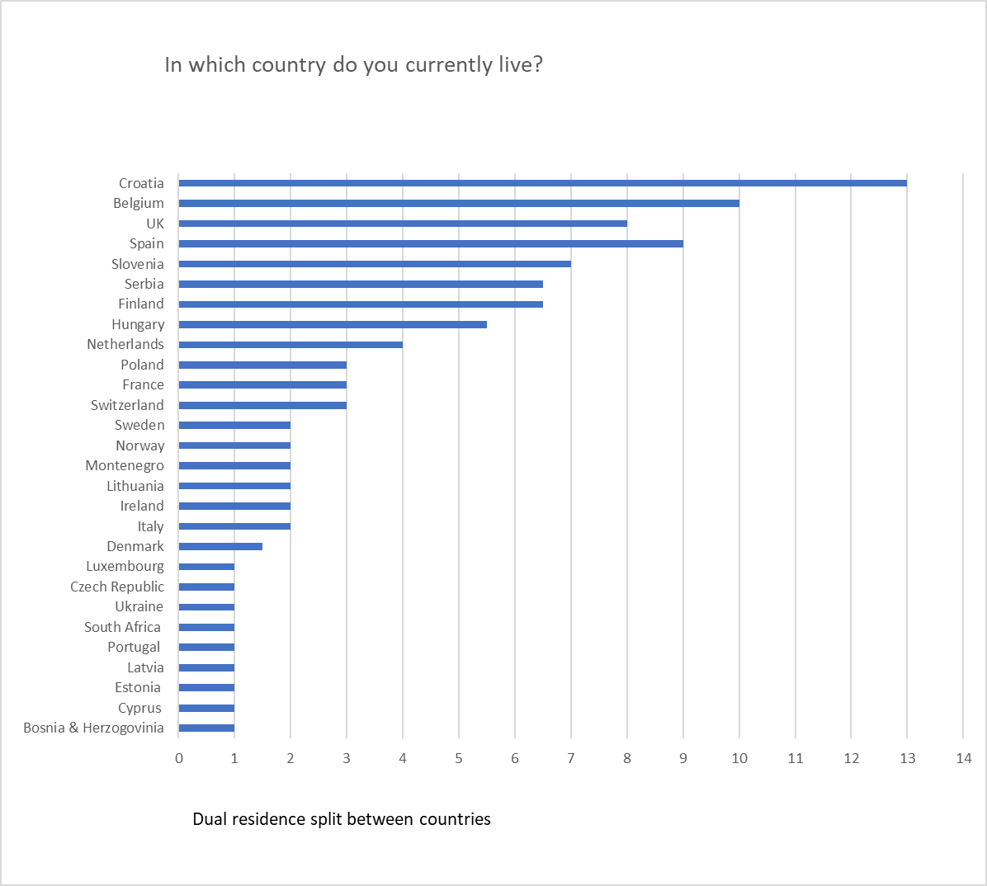
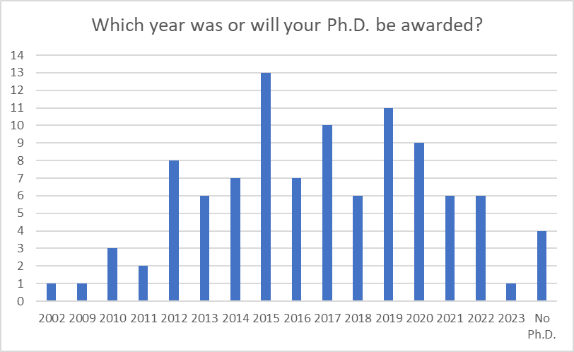
Overview of the respondents

Slide 13
Respondent characteristics pt/2

Slide 14
Beliefs in value vs. personal success

Slide 15
Motivation vs training

Slide 16
The geography of impact

Slide 17
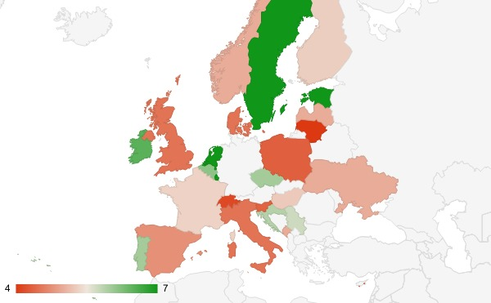
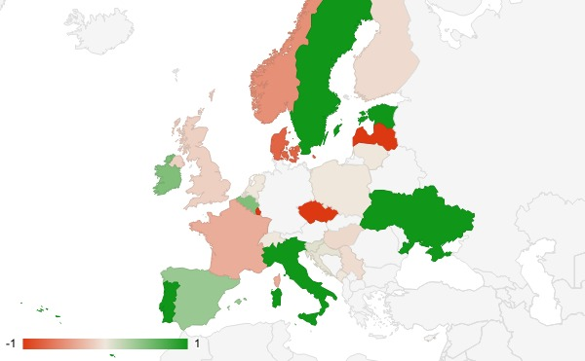
Via Brad Good
Personal motivation (green high)
Do you experience barriers (green high)?

Slide 18
Where are the problems in creating impact?

Slide 19
Preliminary messages
Survey focuses on people with greatest prospective orientation – ECRs with precarious jobs
Impact is a consideration for early career researchers in SSH (even given data set coverage)
There is awareness of impact across Europe – also in low-performing countries
Belief in value of impact is high – sense of own personal success low
Motivation to deliver impact is high, training to deliver impact has been low
Opportunistic time barriers to impact high – principled barriers to impact low

Slide 20
RQ: What are the effects of evaluation signals on researchers in the ‘formation stage’?
ECRs are receptive to these signals & include them in career decisions
Even where these signals are not the loudest/ most influential.
Awareness of ‘impact’ X-Europe
But often framed as part of a tension; ‘necessary but hard-to-deliver’
Strong ‘intrinsic motivation’ to create impact
It is a duty for researchers in receipt of public funding
Sense of success to date is relatively weak
Role for evaluation in reinforcing belief that success is possible
Question of ECR capacity to deliver impact successfully/ valuably
Perception of more training needed for researchers to deal with problems
Primary impact barriers are opportunistic (time, circumstance)
Creating impact not at odds w intrinsic wish to be ‘good’ researcher

