Slide 1
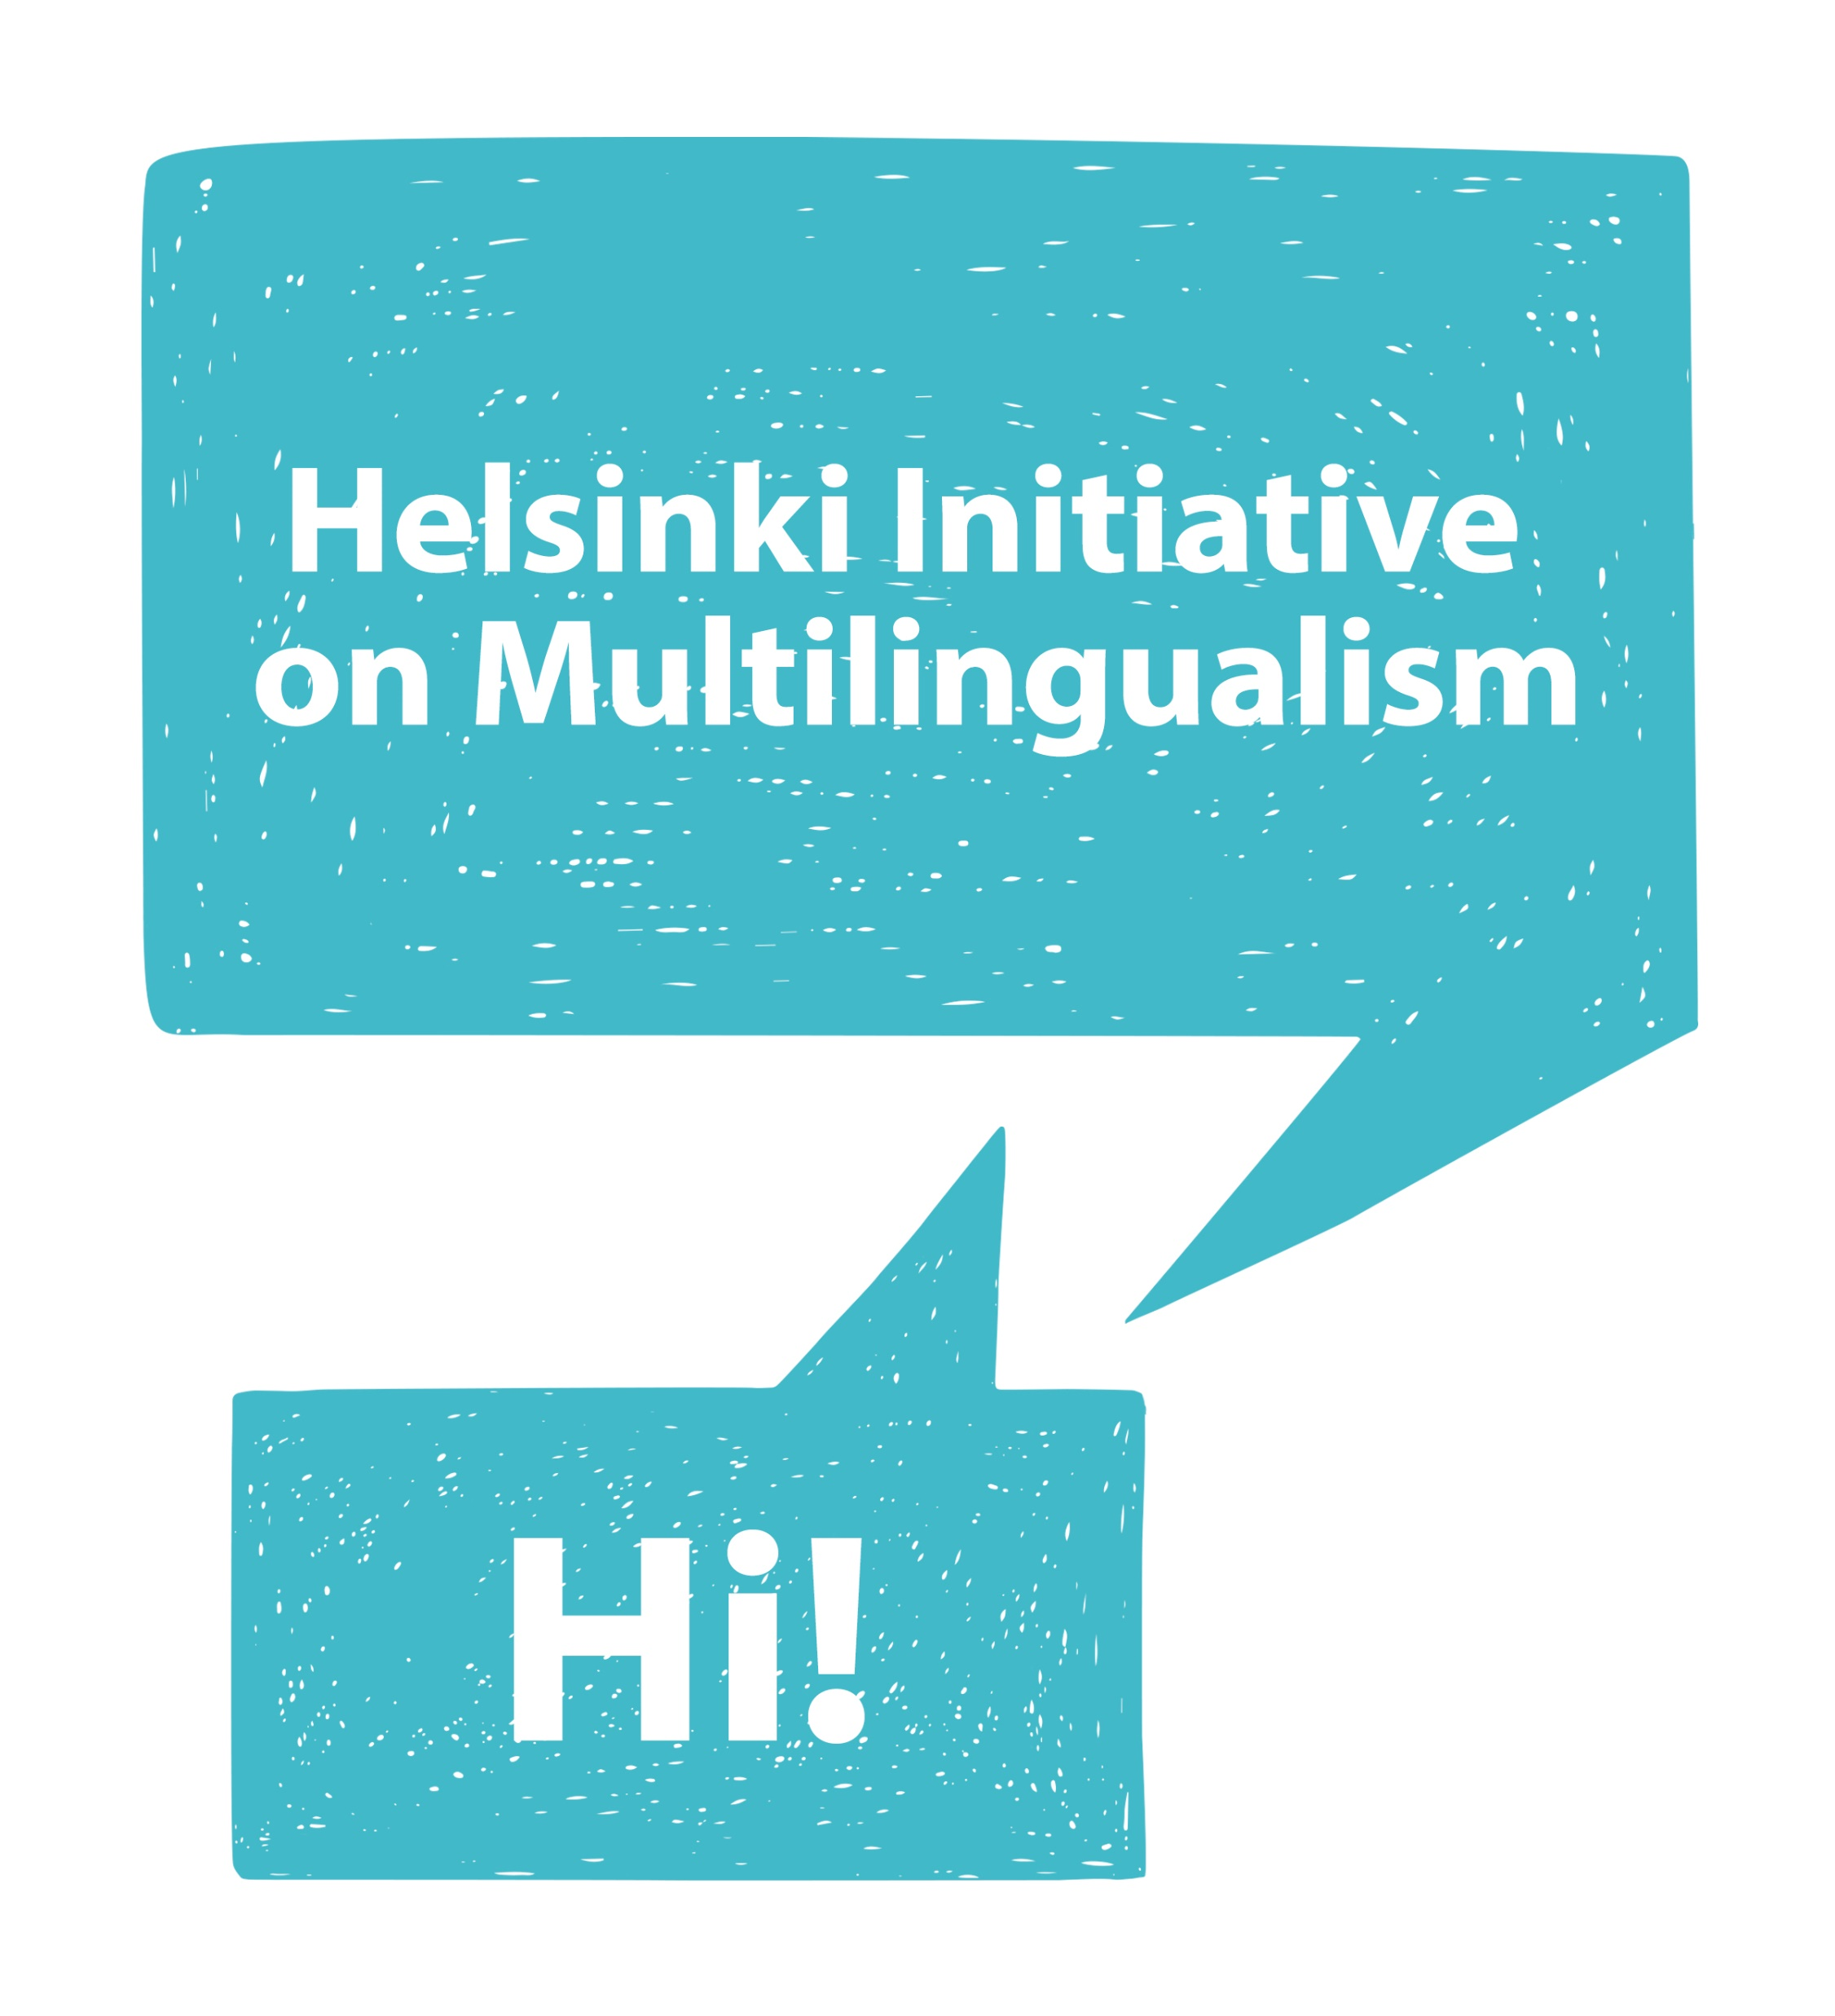
HELSINKI INITIATIVE ON MULTILINGUALISM IN SCHOLARLY COMMUNICATION
Janne Pölönen
Federation of Finnish Learned Societies (TSV)
Committee for Public Information in Finland (TJNK)
Finnish Association for Scholarly Publishing
Universities Norway (UHR)
COST Action "European Network for Research Evaluation in the Social Sciences and the Humanities" (ENRESSH).
ENRESSH Dissemination event
18 February 2020
Paris

Slide 2
RECOMMENDATIONS
1. Support dissemination of research results for the full benefit of the society.
Make sure researchers are merited for disseminating research results beyond academia and for interacting with heritage, culture, and society.
Make sure equal access to researched knowledge is provided in a variety of languages.
2. Protect national infrastructures for publishing locally relevant research.
Make sure not-for-profit journals and book publishers have both sufficient resources and the support needed to maintain high standards of quality control and research integrity.
Make sure national journals and book publishers are safeguarded in their transition to open access.
3. Promote language diversity in research assessment, evaluation, and funding systems.
Make sure that in the process of expert-based evaluation, high quality research is valued regardless of the publishing language or publication channel.
Make sure that when metrics-based systems are utilized, journal and book publications in all languages are adequately taken into account.

Slide 3
WHY MULTILINGUALISM?
Timetable for the Brussels Event
#Envision2030: 17 sustainable development goals to transform our world
Question 1: how strong role science (including SSH) plays in framing, solving and raising awareness of UN goals?
www.Helsinki-initiative.org

Slide 4
WHY MULTILINGUALISM?
Timetable for the Brussels Event
#Envision2030: 17 sustainable development goals to transform our world
Question 1: how strong role science (including SSH) plays in framing, solving and raising awareness of UN goals?
Question 2: how succesful is research community, globally and locally, in promoting these goals without multilingualism in scholarly communication?
www.Helsinki-initiative.org

Slide 5
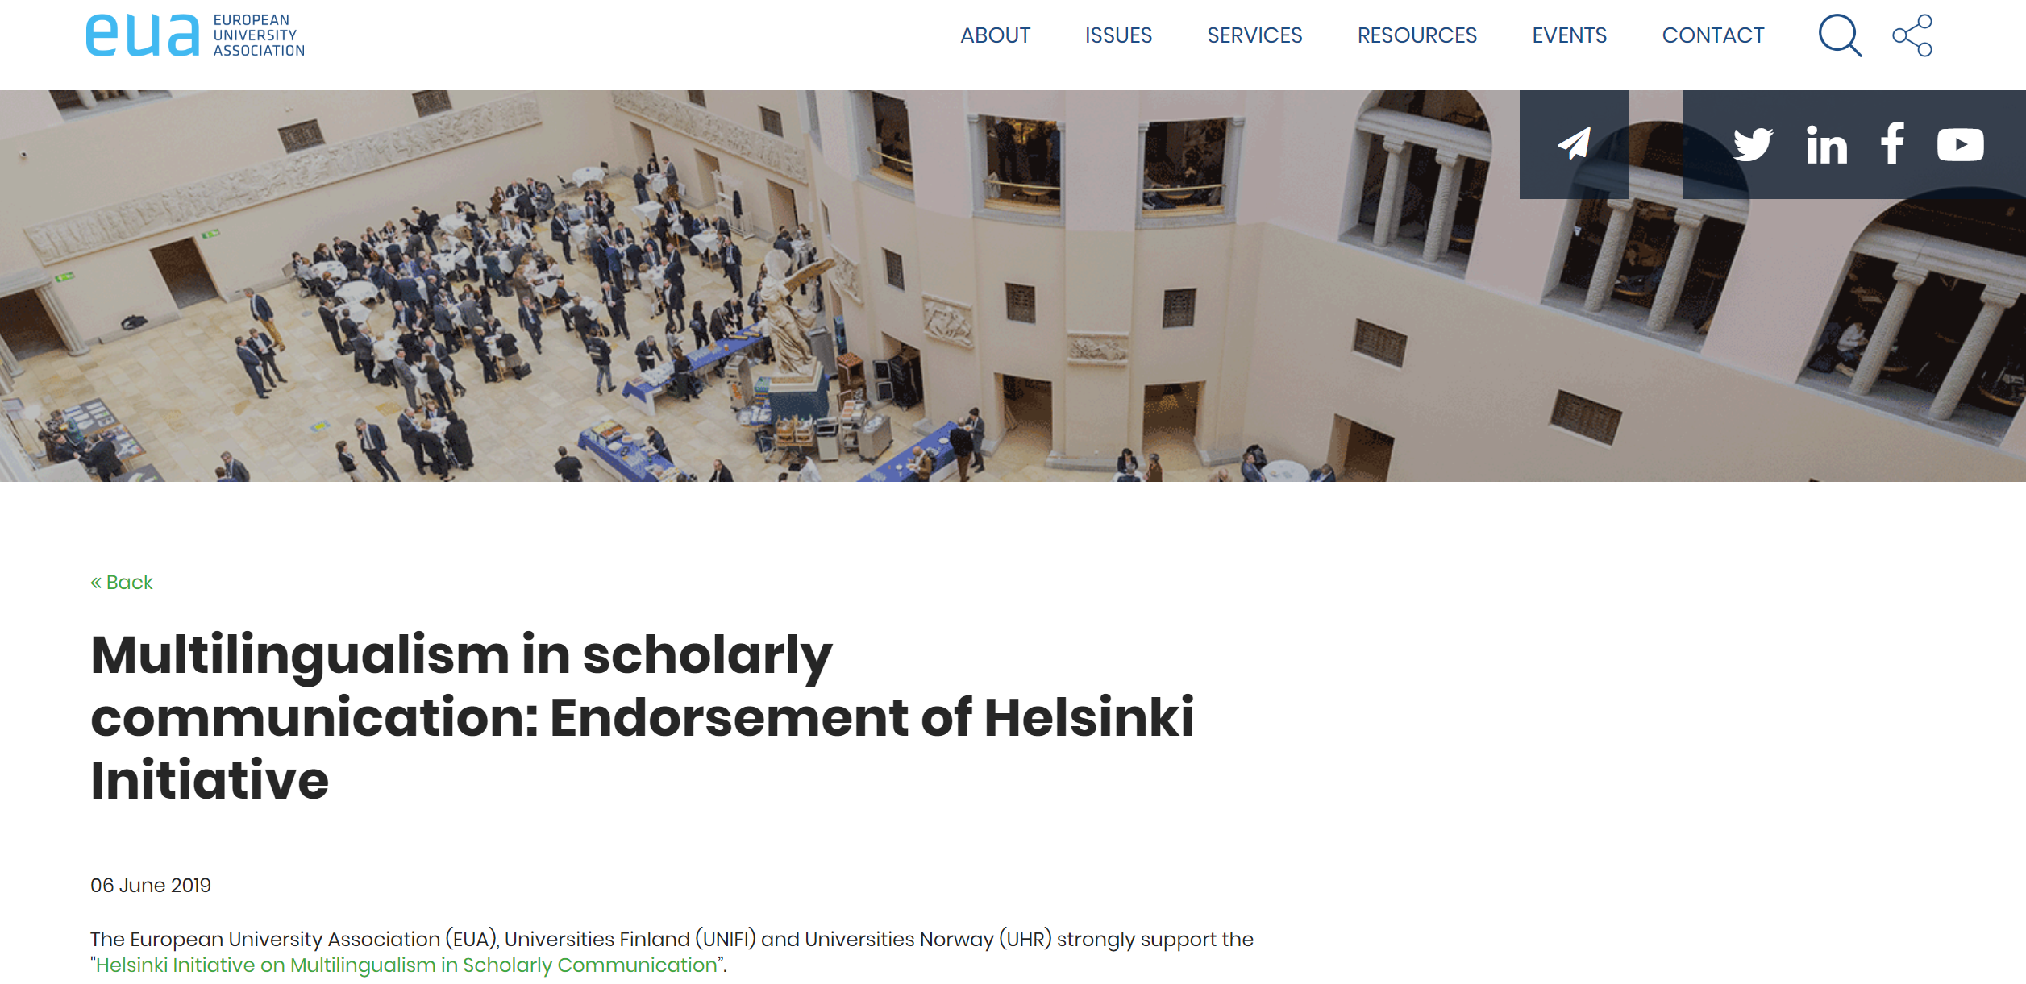

TRANSLATIONS
“OPERAS wants to point to the relevance of research and scholarly communication in local languages”.
Open access indirectly supports the translations into different languages, as there are no longer any rights and licenses to pay for the translation of the work.

Slide 6
BALANCED POLICIES
“The Helsinki initiative brings forward the concept of ‘balanced multilingualism’, which promotes equality between different needs. For example, multilingual work should be fully acknowledged in scholarly assessments and English should not have more weight than other languages in communication”.
“Balanced multilingualism is particularly relevant for Europe, as its research is characterised by geographic, cultural and linguistic diversity and the common principle of excellence”.
“The strength of European universities lies in aiming at international leadership while being locally anchored. This also affects the use of language at higher education institutions”.

Slide 7
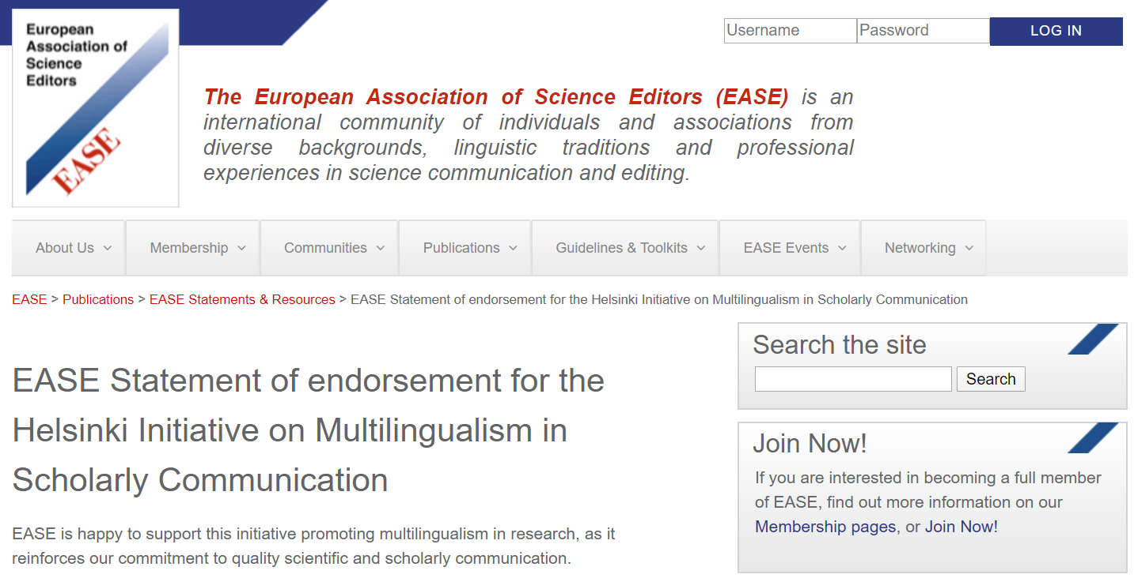
NATIONAL PUBLISHERS
“We also endorse the need for support of local non-profit publishers and we especially call for the support of editors to ensure the quality of published research, and the suitability of dissemination”.
“We are committed to language diversity, especially in the humanities and social sciences where translations may be less appropriate to properly discuss and describe cultural issues”.

Slide 8
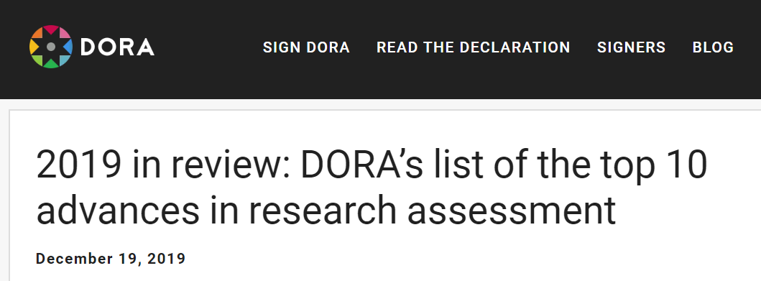
RESPONSIBLE EVALUATION

Slide 9
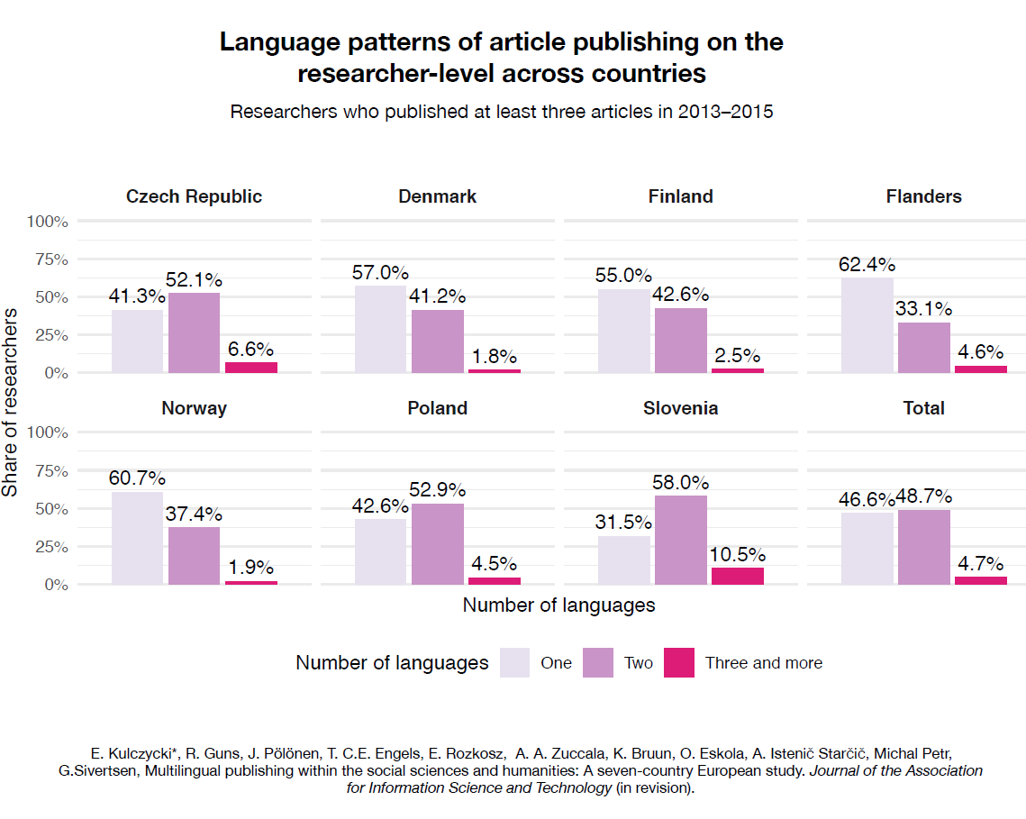
MULTILINGUALISM IN SSH

Slide 10
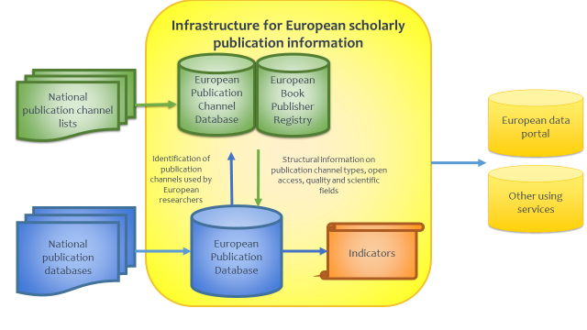
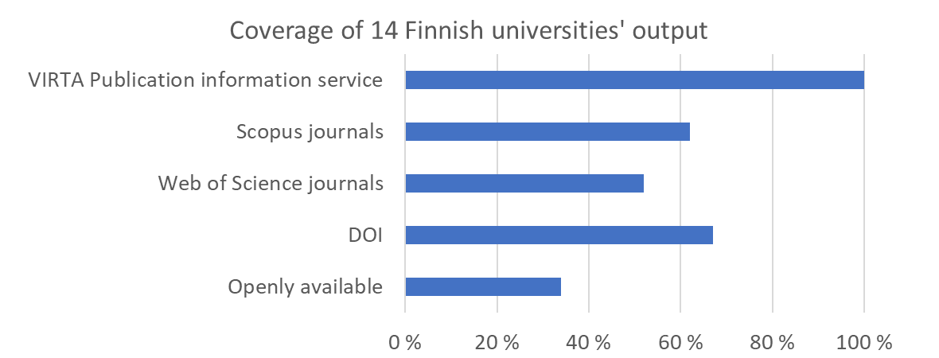
WHAT EU SHOULD DO?
Helsinki Initiative meeting at the European Parliament, Brussels 24 March 2020
Balance international excellence and local relevance in EU science policy – why Responsible Research and Innovation (RRI) and Open Science need multilingualism?
Value multilingualism in evaluation and metrics of academic work – why should multilingualism be integral part of DORA and Leiden manifesto?
Monitor multilingualism in European scholarly communication – how to develop a complete European Scholarly Publication Infrastructure (ESPI)?
Provide resources for national journals and book publishers – why sustainable Open Access needs technical and financial support?

Slide 11
MORE INFORMATION
Read and sign:
www.helsinki-initiative.org
Email:
helsinki-initiative@tsv.fi
Hashtag:
#InAllLanguages

