Slide 1
Group 1
General Design of a
National [bibliographic] Database in
Social Sciences & Humanities
Authors:
© P. Arefiev, 2019
© C. Corona-Sobrino, 2019
© H. Grabowska, 2019
© P. Hartmanovà, 2019
© F. Krawczyk, 2019
© B. Vienni , 2019
ENRESSH Training School 2019
“National Bibliographic Databases and their Uses for Evaluating and Understanding Research”
Poznan, UAM
25th October, 2019

Slide 2
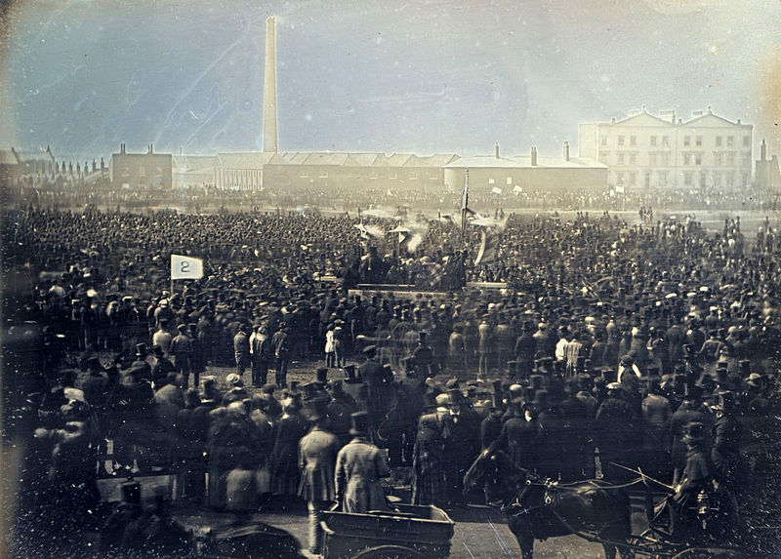
Instead of Foreword: 1848
London
Source:
William Edward Kilburn - Taken from A World History of Photography ISBN 0789203294

Slide 3
Instead of Foreword: 1968
Mexico
Source:
https://ru.wikipedia.org/wiki/%D0%9F%D1%80%D0%BE%D1%82%D0%B5%D1%81%D1%82%D1%8B_1968_%D0%B3%D0%BE%D0%B4%D0%B0#/media/%D0%A4%D0%B0%D0%B9%D0%BB:Ex%C3%A8rcit_al_Z%C3%B3calo-28_d'agost.jpg

Slide 4
Instead of Foreword: 2018
Paris
Source:
Olivier Ortelpa - https://www.flickr.com/photos/copivolta/46193754882/

Slide 5
Summing up Instead of Foreword
What does unite all three photos above?
They all depict the consequences…
Consequences of what?
Look further!

Slide 6
Foreword: some historical background
Europe, XIX-th century
1848: Revolutions in European countries OR Spring of Nations/
Europe, XX-th century
1968: Mass Civil Disorders around the world (including Red May in Paris & Prague Spring also)/
Europe, XXI-th century
2018: Mouvement des Gilets Jaune = Yellow vests movement/

Slide 7
Foreword: some historical background
Europe, XIX-th century
Pre-1848: Karl Marx and his “Ökonomisch-philosophische Manuskripte aus dem Jahre 1844“, “Die deutsche Ideologie” (“Communist Manifesto” as well)
Europe, XX-th century
Pre-1968: Paul-Michel Foucault and his “Les Mots et les Choses. Une archéologie des sciences humaines = The Order of Things”;
Pre-1968: Michel Crozier and his “Sociological-Analysis of French Economic” and “Crisis and Innovation in French Government”.
Europe, XXI-th century
Pre-2018: Works criticizing New Public Management and current socio-economic situation in Europe, and ROW as well (6 articles retrieved from WoS CC).

Slide 8
The Purposes of the National Database in SSH
The SOCIETAL IMPACT + The CULTURAL IMPACT
together constitute IMPACT upon the NATION
These impacts of studies and researches in Social Sciences and Humanities lead to the NECESSITY of:
(a) monitoring all possible results of scientific activities in these fields of knowledge, and
(b) collecting (acquiring) all possible research results in SSH.

Slide 9
The main characteristics of the National SSH Database
Multi-Functional system
Information Retrieval (Search)
Evaluation and Assessment
Science Communication (communication channel from academy to public – through blogs and other social network tools).
Type of database:
Bibliographic index with citation analysis options as well as
fulltext options.

Slide 10
The Users
MAIN Target User Groups
Researchers
Students
Librarians
Policy Makers
Funding Authorities
Common Public.

Slide 11
Data Collection
The main suppliers are all relevant sources (channels) of information:
National / international organizations that conducts researches
National organizations that publish and disseminate research outputs
International organizations that publish and disseminate research outputs
Any other relevant sources like open archives and repositories – national/international/institutional.

Slide 12
Expertise from all relevant knowledge domains
Pre-Design Stage
Survey & Focus Groups (representatives from particular fields of knowledge) on: needs, types of research outputs, activities, etc.
Aim: “to take into account the views of researchers, librarians, bibliometricians, and policy makers”.
Design Stage and Developing Stages
The main expert board
Advisory Expert Panel.
Additional expertise
IT support and Regulations for maintenance.

Slide 13
Data model
Bibliography + References + Full texts (if possible).
Different type of output (music, photos, information about data exhibitions).
Information might be harvested from other databases – necessary protocols.
Some data still could be uploaded manually.
Persistent identificators (DOI, GRID, ORCID).

Slide 14
Technical solution and design the technical structure of the database
Commercial system versus own system.
Cooperation with University (IT department).
System of maintaining database (backup and indexing).

Slide 15
Business Model
Start-up of the national databases in SSH – governmental grant (s).
Database maintenance and technical support (provided by IT department of the partner university) as well as further development of the database – all these expenditures are covered with the fees taken from evaluated organizations in the database as annual participating fees (sic!).

Slide 16
GENERAL conclusion
If we want to develop a good national database,
we need to change a system…

Slide 17
Final GENERAL message
NEVER UNDERESTIMATE
the value of
SOCIAL SCIENCES and HUMANITIES

Slide 18
Thank you for your
ATTENTION!

