Slide 1
Setting up a national bibliographic database for Whateverland
Organisation, transparency and sustainability
Group 3

Slide 2
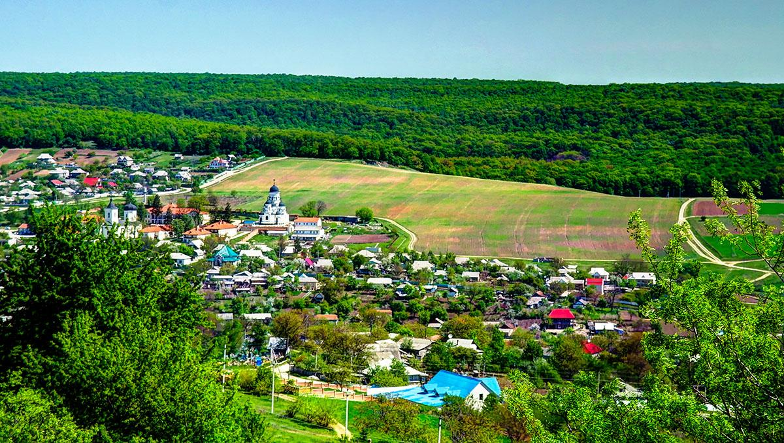
Once upon a time…
Whateverland

Slide 3
Whateverland
Population: 10 million
Language(s): 4 local languages
Universities: 10
Number of researchers: 20 000
Publications: 40 000 per year
GDP: 251,9 billion USD

Slide 4
Database we are setting up
National bibliographic database for research evaluation purposes, but open for all users (information discovery)
Centralized database
Why:
Research funded by the ministry -> they need information on research output in local languages to promote the national identity
Ministry wants to control and establish the rules for how the data of research output is provided in order to allocate the funding

Slide 5
ORGANISATION
7. Collaborate with stakeholders
Identification of stakeholders: academic community (researchers, universities, research institutions), administrative staff, government, funding agencies, libraries, general public
Consulting the stakeholders (”hourglass model”):
Online survey open to all
Workshops for expert groups (academic community, administrators, end users)
Open commenting
Consulting the stakeholders (”pyramid”)
Workshops for expert groups
Open commenting

Slide 6
ORGANISATION
8. Specify roles and responsibilities in the maintenance of the database
Technical maintenance: National library
Data input:
Academic libraries
Imports from various databases (National library)
Quality control:
Content curation (National library)
Vocabularies, authority control and identifiers (National library)

Slide 7
ORGANISATION
9.Embed the national database in a national legal framework
Regulation of research evaluation requires accurate up-to-date data on research output
Regulation defines the main responsibilities for maintenance of the database

Slide 8
TRANSPARENCY AND SUSTAINABILITY
27. Encourage feedback from users and other stakeholders
Service team at the National library (help desk)
helping the academic libraries
replying to requests sent by e-mail
Organising live sessions, seminars, workshops
Designated e-mail address (report errors, notifications about missing data, suggestions for improvement etc.)

Slide 9
TRANSPARENCY AND SUSTAINABILITY
28. Provide up-to-date documentation about the database, its purpose, envisioned uses, limitations, and other aspects
Instructions page (both national languages and in English) with up-to date and regularly reviewed information on
Policy background
Database purpose and limitations
Database sources and information sources
Quality control procedure
User guides (videos)
Q&A

Slide 10
TRANSPARENCY AND SUSTAINABILITY
29. Implement procedures for data provenance
Data provenance / system level
Publicly available and updated documentation where data provenance is outlined
Information on: Input, process, transfer, user rights
Data provenance / record level
If possible: permanent links to original data
Change log

Slide 11
TRANSPARENCY AND SUSTAINABILITY
30. Follow and adapt to development in research practices, research policy, and database maintenance
Model the database / data provenance procedures
according to existing regulations on science evaluation
Database maintenance
Regular updating of data
Regular assessment of data sources (adding/removing)
Hire (and keep!) a good IT team
Stay up-to-date with regluations of Research Data Management Plans

Slide 12
Dziękuję
Kiitos
Thanks
Gracias
謝謝你
Multumesc
Danke
Hannia Gonzalez Urango
Christoph Thiedig
Eeva Savolainen
Irina Cojocaru
Tomasz Umerle
Jiangtian Xu

